Slide 1
Year 4
Information for the year ahead

Slide 2
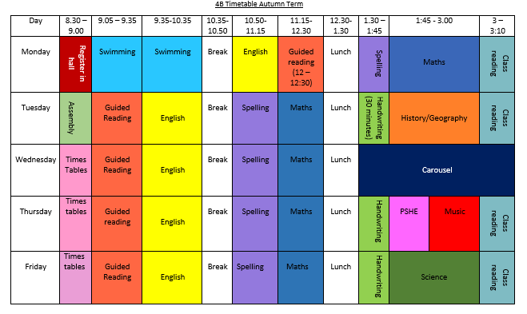
Time Table – this is what a typical timetable in year 4 looks like. (4C have swimming after break instead of first thing on a Monday)

Slide 3
Swimming
A letter has been sent to parents via parentmail
Children will need towel, costume/tight fitting trunks and a swimming cap if their hair is long enough to go in their eyes. Also a bag to carry the kit in - it will be wet!
Children will not be allowed to wear googles as the programme is about swimming to survive. If you think your child might need to wear them for medical reasons, we will need a doctor’s note.
4A and 4B - Please, please could you make sure your child is in school at 8.30 on Mondays. The bus will not be able to wait and your child will miss a compulsory part of the PE curriculum and a valuable life skill.

Slide 4
Reading Books
Each child will come home with a reading for pleasure book and a black reading journal.
Their book can be changed whenever they finish and the children are in charge of changing their own.
Like last year, the reading journal is for the children to reflect on their books. We will be doing some work on ideas for this in class.
Logins for TTrockstars, Seesaw and Edshed are stuck in the reading journals.
If the children are reading a book band book (colour banded) then they will also receive a reading book matched to the colour and a reading record for you to sign to show they have read at home to you. This will be changed once at least once a week.
Reading with your child is still really valuable whatever level they are on and we are always so grateful that you can do this at home.

Slide 5
Homework
The expectations for Year 4 is:
Daily reading – book band or school’s selected book list
Reading for pleasure (for children on book bands)
Reading Journals
TT rockstars
Times tables booklets

Slide 6
Times TabLes and year 4 –In year 4 It is Expected that the children know all their times tables from 1 x 1 to 12 x 12
During the last week of May, before the half term, all Year 4 children will be participating in the National Multiplication Tables Check (MTC)
This is an online test very similar to Sound Check on TTrockstars which tests accuracy
The children have 25 random questions and 6 seconds to answer each one
The test will take place in the computer suite
The children will be given plenty of practice throughout the year and a trial run before the test

Slide 7
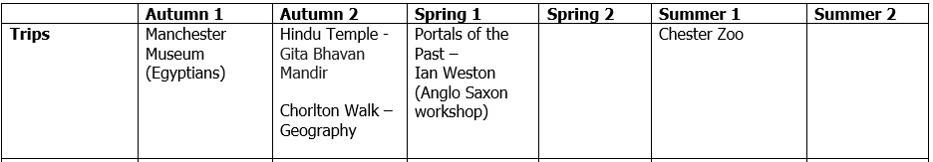
Trips
We are in the process of arranging the trips for the year.
We will need parental volunteers, so please look out for this on the letters that we send home for each visit.

Slide 8
Pen License
The children will start the year using pencils
From October we will be starting to give children pens to write with based on their fine motor skills and handwriting
From Easter we will be giving everyone a pen to write with

Slide 9
Other Info
We no longer have cups in our classrooms so please send your child into school with a water bottle which they can refill when needed
Our PPA time is on a Wednesday afternoon so this is when the children will be taught Spanish with Mr Caldwell, Art with Ms Appleby and PE with Mr Bentley. Please make sure they come to school wearing appropriate clothing
We are not allowed to give out any birthday treats. If they are sent in we will unfortunately, have to send them home.
A reminder that the children should not be bringing in toys or cards to school.
If you have any questions or concerns, the easiest way to reach us is by emailing admin@oswaldroad.manchester.sch.uk and the message will be passed on
Thank you! Helen Savage, Paul Salisbury, Hayley Craven & Christian Burton

