Slide 1
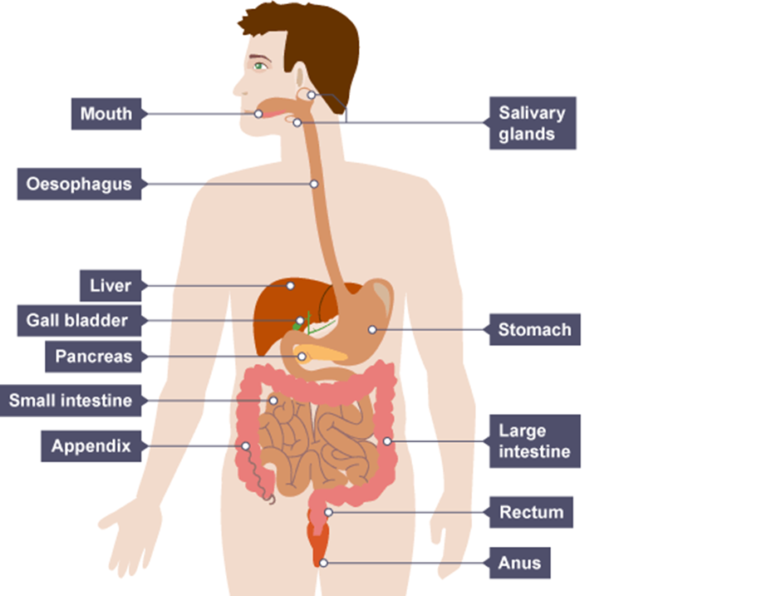

Slide 2
Science investigations at Oswald Road

Slide 3
The National Curriculum has a programme of study for each year group, which includes suggestions as to how children can ‘work scientifically’ but what does this mean?

Slide 4
Working scientifically is defined as doing one of the following types of activities:
Observing processes over time (such as looking at how plants grow, or how seasons work),
Pattern seeking (do bigger hands hold more marbles?),
Identifying, classifying and grouping (sort these animals into different groups based on observable characteristics),

Slide 5
Comparative and fair testing (what happens in a process when I change one thing, but keep everything else the same?),
Research using secondary sources (What animals live in desert biomes?),
Modelling (construct a model of an intestine, or a gear train),
Technological (Can you design a pair of ear muffs to keep out sound?)

Slide 6
EYFS
Science is covered in UNDERSTANDING THE WORLD
Typical activities might involve:
Sorting
Observation
Talking about what they see in the world and picking up the vocabulary needed to describe it
Listening to stories,
Looking at pictures
Playing with toys and equipment and learning words associated with forces
Looking at seasons
Planting seeds and watching them grow
Cooking – first experiences of chemical changes
Etc etc
The children’s experiences at this age should be about basic concepts and learning how to describe them correctly. The foundations are laid for all the future work done.

Slide 7
Fair test investigations
ONE PER HALF TERM MINIMUM (with some exceptions where this is not possible)
PLAN - Ask children to raise their own questions as much as possible and let them investigate them. It doesn’t matter if it all goes horribly wrong, with erroneous results which don’t tell them much (that’s what happens in science every day).
PREDICT - allow children to predict what they think will happen and say why they think this (based on their own experience of the world, subject knowledge taught to them, previous practical work etc)
DO – children should make their own observations and measurements and then:
RECORD – using appropriate methods (usually tables and graphs)
REVIEW – children should be able to explain their results, draw conclusions and give some ideas as to how the investigation could be improved to give more reliable results.

Slide 8
Fair test investigations
TABLES and GRAPHS
In line with the maths curriculum, we should be trying to include the constructions and use of the following:
YEAR 2
Tally charts
Pictograms
Year 3
Bar charts
Year 4
Bar charts and introducing line graphs
Year 5 and 6
All of the above with more accurate line graphs used for interpolation

Slide 9
Fair test investigations
CONCLUSIONS AND EXPLANATIONS
The results obtained need to be carefully examined and discussed by the children. They should then draw conclusions based on the results and describe these using the correct scientific language according to their age group.
PRECISION IS IMPORTANT!
When children give their conclusions, spend as much time as you can suggesting the best ways to express them.
For example:
I think the sound was louder because the rubber band was pulled back more.
I think that the volume increased because there was a greater vibration in the rubber band and this in turn made the air vibrate more.
The second one is more scientifically correct.

Slide 10
Recording and progression
Year 1 – Mostly on seesaw – demonstrate knowledge and understanding verbally in the main
Year 2 – Starting to use books for write ups on a basic level, scaffolded – using tally charts and pictograms
Year 3 - using the basic format for experimental write ups and beginning to use bar charts
Year 4 – using full write ups with increasing accuracy and incorporating bar charts and scaffolded line graphs (with axes pre-prepared). Children begin to make suggestions for planning some investigations.
Years 5 and 6 – as Year 4 but able to do their own planning of experiments having been provided with a basic brief and appropriate equipment. They should also be allowed to carry out follow up experiments to investigate further if time and resources allow.

Slide 11
Recording and progression
Year 1 – Mostly on seesaw – demonstrate knowledge and understanding verbally in the main
Year 2 – Starting to use books for write ups on a basic level, scaffolded – using tally charts and pictograms
Year 3 - using the basic format for experimental write ups and beginning to use bar charts
Year 4 – using full write ups with increasing accuracy and incorporating bar charts and scaffolded line graphs (with axes pre-prepared). Children begin to make suggestions for planning some investigations.
Years 5 and 6 – as Year 4 but able to do their own planning of experiments having been provided with a basic brief and appropriate equipment. They should also be allowed to carry out follow up experiments to investigate further if time and resources allow.
DIAGRAMS can be used throughout.

Slide 13
