Slide 1
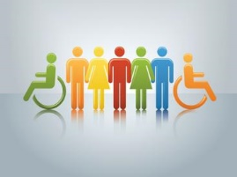
One Education HR The Equality Act 2010 Understanding the Basics
Training for School Staff
August 2022
Laura Clark - Senior HR Manager

Slide 2
Aims of Today’s Training
NOT to make you an expert in equality law!!
To raise awareness and understanding
To make you think about how the issues we will be discussing could relate to you in your role at school
To give you confidence to ask questions and to tackle discrimination if you see or hear it!

Slide 3
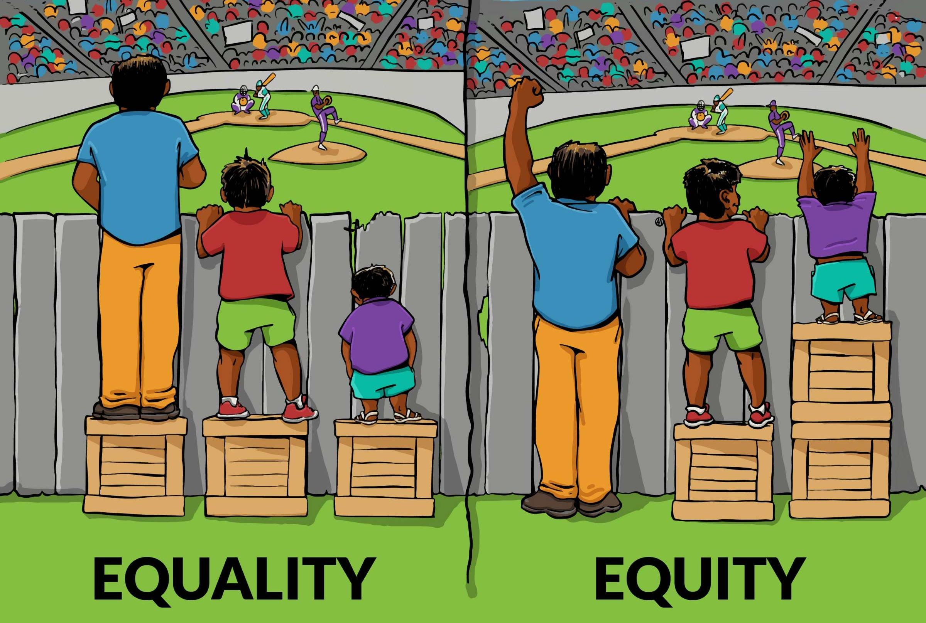
The meaning of “Equality”
What does it mean to you?
Under the Equality Act, it’s about treating people fairly, providing equal opportunities
NOT necessarily treating everyone the same
It’s different for people with disabilities

Slide 4
Purpose of the Equality Act 2010
The Equality Act 2010: -
Brings together all our previous equality laws
Protects individuals with protected characteristics from different kinds of discriminatory behaviour
Created a new equality duty which applies to schools and creates EXTRA obligations

Slide 5
The Equality Duty
Schools must have due regard to the need to: -
prevent unlawful discrimination
advance equality of opportunity (promote equality, remove or minimise disadvantage)
foster good relations (tackle prejudice, promote understanding)
AND must : -
publish equality information and objectives

Slide 6
Your School’s Equality Information
Do you know your school’s current equality objectives?
Could you contribute to future equality work and future objectives?
Are you familiar with your school’s Equality Policy?

Slide 7
How does this apply to me?
You ALL have a role to play
You could be personally liable for your own acts of discrimination if carried out…“in the course of employment”
THINK!! social events and social media
Doesn’t matter if you “didn’t mean it”
Could result in disciplinary action!!

Slide 8
Protected Characteristics
Aspects of a person’s identity
Age, disability, gender reassignment, marriage and civil partnership, pregnancy and maternity, race, religion or belief, sex, sexual orientation
All equal BUT……
Disability - may need to treat more favourably

Slide 9
Disability (s6 EA)
A disability is a physical or mental impairment which has a long term and substantial adverse effect on someone’s ability to carry out their normal day to day activities
All parts of the definition to be met
Medical diagnosis not necessary
Recent case - long Covid might be a disability
Hidden disabilities and knowledge

Slide 10
EHRC Technical Guidance Example
Pupil with diabetes (amounted to a disability)
Parents advised the school secretary of child’s condition and that he may need to eat in class if blood sugar levels dropped.
Message not passed to the pupil’s teacher,
Pupil disciplined when seen eating in class
Even though teacher didn’t actually know pupil had diabetes, was deemed to know as school secretary knew.

Slide 11
Gender Reassignment (S7 EA)
Trans/Trans person has the protected characteristic of gender reassignment
Does not need to be a medical procedure
Personal process of moving away from birth sex
Recent ET case said protection extended to people identifying as non binary and gender fluid
New schools’ guidance expected

Slide 12
Religion or Belief (s10 EA)
Includes lack of a belief and philosophical belief
Must satisfy number of criteria including being worthy of respect in a democratic society and compatible with human dignity
Examples: - atheism, ethical veganism, humanism, strong belief about climate change and the environment.
Recent cases held “a gender critical belief” and a lack of belief in “transgenderism” are protected beliefs

Slide 13
Discriminatory Language/Behaviour
Relevant to ALL Protected Characteristics
Could amount to discrimination and/or harassment
Beware ableist, ageist, racist, sexist etc language
Mis-gendering, names, pronouns
Perception NOT intention
Stereotyping and unconscious bias
If in doubt - don’t say it…
Ask - sometimes, it’s ok to not know!!

Slide 14
Unlawful Behaviour
Six main types of unlawful behaviour: -
Direct discrimination
Indirect discrimination;
Harassment;
Victimisation;
and for disability also……
5. Discrimination arising from a disability;
6. Failure to make reasonable adjustments.

Slide 15
Some New Concepts
Also….
Discrimination and Harassment: -
by association
by perception
To be protected, you don’t always have to actually possess a protected characteristic yourself!

Slide 16
Association Discrimination
Treating someone worse than others because of their association with someone who has a protected characteristic.
Example
It would be sexual orientation discrimination by association to refuse to admit a pupil to a Catholic primary school because his parents are a lesbian couple

Slide 17
Perception Discrimination
Treating someone worse than others because you think they have a protected characteristic…. even if you are wrong
EHRC Example
A straight male pupil who has long hair and wears eyeliner isn’t allowed to play on the school rugby team. The boy isn’t gay but his teacher thinks he is and treats him worse than the other boys because of his perception. This would be sexual orientation discrimination by perception

Slide 18
Direct Discrimination
Treating someone less favourably than others BECAUSE OF a protected characteristic.
Example: - Refusing to admit a child to a school because of their race or because they have a disability

Slide 19
Direct Discrimination
Generally, no defence
Some general and school specific exceptions
School curriculum excluded - note the difference between content and delivery of curriculum
Motive or intentions (even if good!) irrelevant
Beware stereotyping and unconscious bias

Slide 20
Stereotyping
Making assumptions and uninformed decisions
A belief that people with certain protected characteristics all have the same characteristics
Not looking at a person as an individual
Often goes hand in hand with unconscious bias

Slide 21
Unconscious Bias
Unintended people preferences
Often based on past experiences and representation of certain groups in the media
Associations based on social categories leads the unconscious brain to make judgements about others
Be aware of it so it doesn’t result in discrimination!!

Slide 22
Questions….
Why am I having this thought?
What proof do I have that my judgement about this particular person or group is correct
What don’t I know about this person or group?
Is it possible that I could be biased?

Slide 23
Indirect Discrimination
When a rule, practice, policy or way of doing things is applied equally …..BUT
….it has the effect of putting people with a protected characteristic at a disadvantage compared to others who don’t have that protected characteristic.

Slide 24
Example
A school plans meetings for pupils to discuss career options to take place on Friday evenings.
Planning the meetings for a Friday night is a neutral practice - i.e. practice applied equally to all pupils.
A Jewish pupil points out that this would prevent him personally from attending because he observes Shabbat from dusk on a Friday evening. If there are other Jewish pupils, is likely they would all be placed at a disadvantage too
This is potentially indirect discrimination

Slide 25
Objective Justification?
There is a defence if….
…. there a legitimate aim - a good, valid, lawful reason AND you have considered all alternatives (including reasonable adjustments) so your actions are proportionate, i.e. there is no other less discriminatory way….
Legitimate aims in schools: -
Might be safeguarding
Might be maintaining academic or other standards
Might be health, safety and welfare of staff/ pupils

Slide 26
Take a few Minutes….
Think about school, rules, policies, decisions that MIGHT disadvantage pupils with protected characteristics compared to others without those characteristics…….can they be objectively justified?
Decision about school trips, homework, exams, after school clubs, activities….
Application of attendance policies, behaviour policies, uniform, hair policies …

Slide 27
Example EHRC Technical Guidance
A school has a policy that if a pupil breaks the school rules on three occasions, he or she will automatically be given a detention.
Some disabled pupils, such as those with attention deficit hyperactivity disorder (ADHD), autistic spectrum disorders or learning difficulties, are much more likely to break the school rules than other pupils.
Rigid application of this policy is likely to amount to indirect
The school will find it very difficult to justify the treatment as a proportionate means of achieving a legitimate aim if reasonable adjustments not been made.

Slide 28
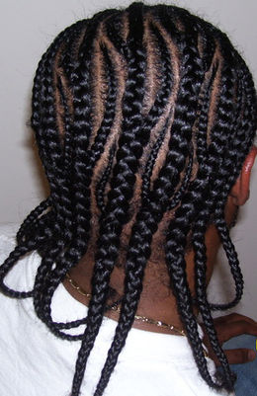
Hair Policy Case
11 year old boy wore hair in cornrows
School’s hair policy (short back and sides)
For pupil cutting hair and wearing in cornrows was a matter of cultural and racial identity
School’s legitimate aim - to prevent haircuts as “badges of honour” (to combat gang culture)
Was a blanket ban proportionate?
Held - NO - WAS indirect race discrimination
Policy should have been applied flexibility
School’s defence was unsuccessful!

Slide 29
Harassment
Unwanted conduct or behaviour related to a relevant protected characteristic OR of a sexual nature
which has the PURPOSE or EFFECT of violating a person’s dignity or creating an intimidating, hostile, degrading, humiliating or offensive environment for that person
Less favourable treatment because of submission to or rejection of sexual harassment/harassment related to sex

Slide 30
Harassment
May be verbal, written or physical
Includes: - bullying, nicknames, threats, “BANTER” gossip, inappropriate questions, excluding someone (e.g. ignoring them), insults or unwanted physical contact; abuse by email, photos, pictures, imagery, graffiti, physical gestures, facial expressions, mimicry, jokes, pranks etc.
“One person’s banter is another person’s harassment”

Slide 31
Harassment
Is the victim’s perception
Doesn’t have to be intentional
Victim doesn’t have to object
Victim doesn’t have to possess the pc
Applies if harassed by association or perception
Can apply to someone who witnesses harassment

Slide 32
Victimisation
Treating someone badly OR unfairly because they have made or are going to make a claim or complaint about discrimination
Example:
A teacher shouts at a pupil because he thinks he intends to support another pupils sexual harassment claim.

Slide 33
Discrimination Arising from a Disability (s15 EA)
Treating a disabled person unfavourably because of something connected or linked to THEIR disability.

Slide 34
S15 Scenarios
Not allowing a pupil on a school trip OR excluding them from a school activity or club or lesson, OR excluding from school completely because of their disruptive behaviour which is connected or linked to their disability.

Slide 35
Potential Defence??
Schools MIGHT be able to defend S15EA discrimination claims
IF…. decisions can be objectively justified
WHICH MEANS…. all options/alternatives have been considered, including reasonable adjustments, and there is no other less discriminatory option available.

Slide 36
Scenario
A pupil with learning difficulties (a disability) becomes agitated/upset whilst queuing at lunchtime for a school meal. The pupil is asked by the school to bring in a packed lunch instead and to eat it separately, away from her friends.
The pupil’s agitated behaviour in the queue is connected to her learning difficulties
Que 1. Do you think the school’s actions are likely to be discriminatory?
Que 2. If so, do you think the school will be able to justify their actions?

Slide 37
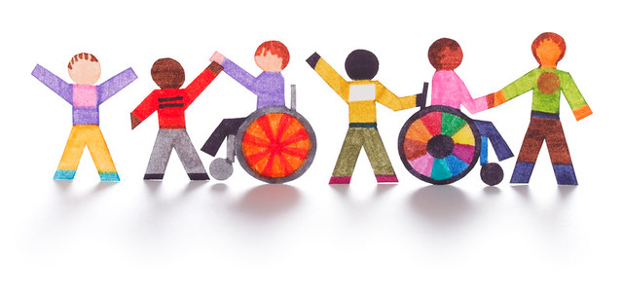
Duty to Make Reasonable Adjustments
If something puts a disabled person at a substantial disadvantage compared to someone who isn’t disabled, there is a duty to take reasonable steps to try and avoid that disadvantage.
Changing how things are done
Changing physical features of the school (accessibility planning duties)
Providing extra equipment (auxiliary aids and services)

Slide 38
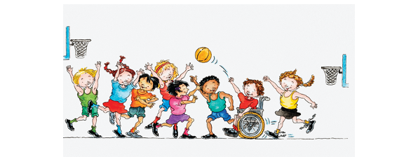
Questions
Is the person with a disability at a substantial disadvantage?
Can the disadvantage be avoided and if so, what steps could be taken?
Is it reasonable for the school to take the steps?

Slide 39
Example
A disabled pupil requires assistance with personal care needs, such as toileting, washing and dressing. This assistance is provided during the school day by a learning support assistant (LSA) provided through his EHC plan. The school arranges a residential school trip for his year group. The pupil wishes to attend, but is not able to do so unless his personal care needs are met.
Is the pupil at a disadvantage?
Can the disadvantage be avoided?
Is it reasonable for school to take these steps?

Slide 40
Some Examples…..
Providing special equipment - e.g. providing an adapted keyboard or a hearing loop
Modifying school policies - e.g. attendance or behaviour or uniform policies
Modifying the timetable
Extra staff assistance, a lip reader, a reader
Changing timings or venues for school trips
Modifying lunch or break times
Making alterations to the lay out of a classroom

Slide 41
Points to Take Away….
Think about how equality issues might arise in your day to day work and decision making?
Think about stereotyping and unconscious bias!
If discrimination could occur, how might you be able to do things differently?
Consider equality issues relevant to your school… get involved!!
Know your school’s Equality Policy and Objectives
DON’T IGNORE discrimination if you see/hear it!
And finally…….

Slide 42
laura.clark@oneeducation.co.uk 07507 546 612 - Laura HR and People Helpline 0161 276 0153 Twitter - @OneEducationHR @Laura_OneEd

