Slide 1
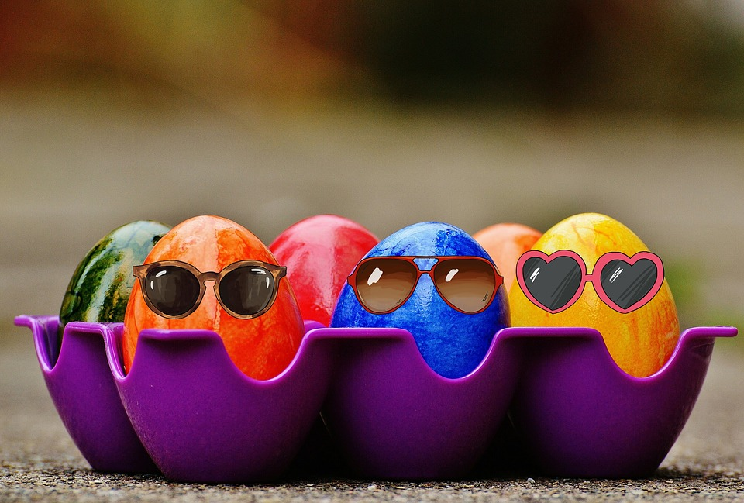

Slide 2
Instructions
The quiz can be used for individuals or teams. There is a sheet for individuals / teams to record answers.
To return to the category slide, click on the sun image, on the bottom left-hand corner of the slide at the end of the category and on the category slides.
The answers to the questions can be found by clicking on the sun image on the bottom right-hand corner of each slide.

Slide 3
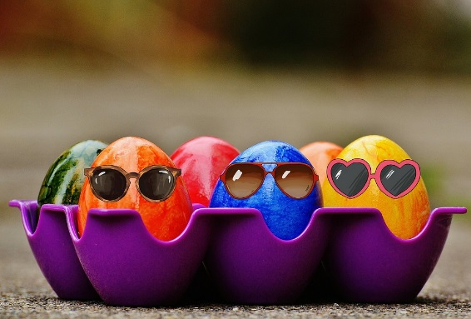

Slide 5
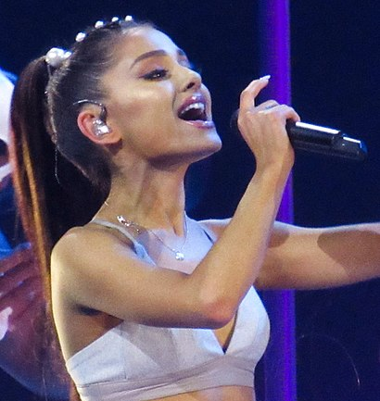
1. Who is this?
Jennifer Lopez
Ariana Grande
Kim Kardashian
Notes:
https://commons.wikimedia.org/wiki/File:Ariana_Grande_(33269922295)_(cropped)_(cropped).jpg

Slide 6
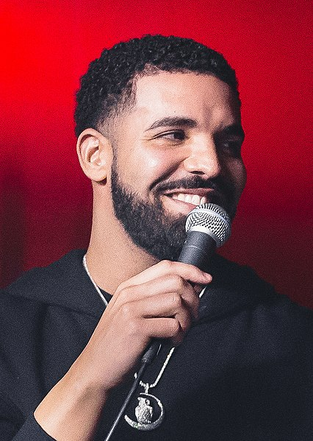
2. Who is this?
Drake
Bruno Mars
Jay Z
Notes:
https://commons.wikimedia.org/wiki/File:Drake_at_the_Velvet_Underground_-_2017_(35986086223)_(cropped_2).jpg

Slide 7
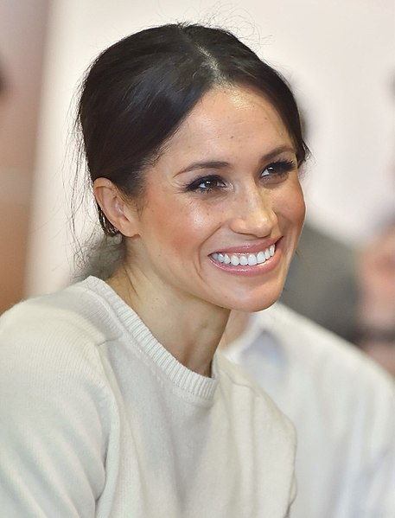
3. Who is this?
Pippa Middleton
Julia Roberts
Meghan Markle
Notes:
https://commons.wikimedia.org/wiki/File:Meghan_Markle_-_2018_(cropped).jpg

Slide 8
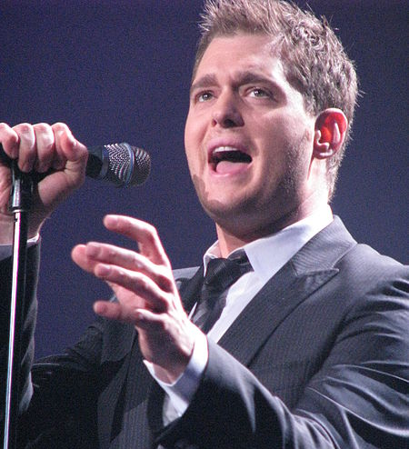
4. Who is this?
Robbie Williams
Michael Bublé
Will Young
Notes:
https://commons.wikimedia.org/wiki/File:Michael_Bubl%C3%A9.jpg

Slide 9
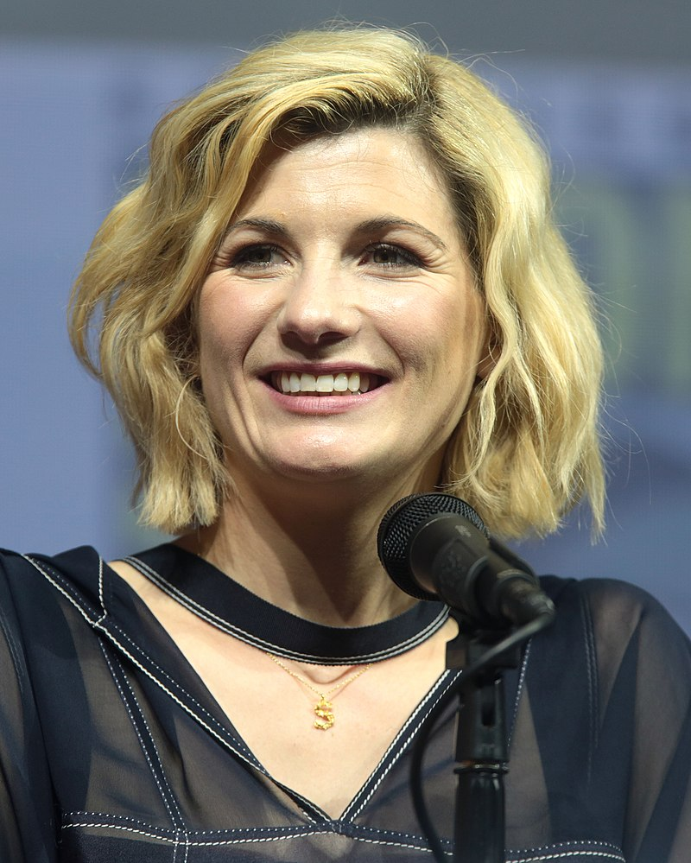
5. Who is this?
Jodie Whittaker
Michelle Gomez
Karen Gillan
Notes:
By Gage Skidmore, CC BY-SA 3.0, https://commons.wikimedia.org/w/index.php?curid=71079716

Slide 10
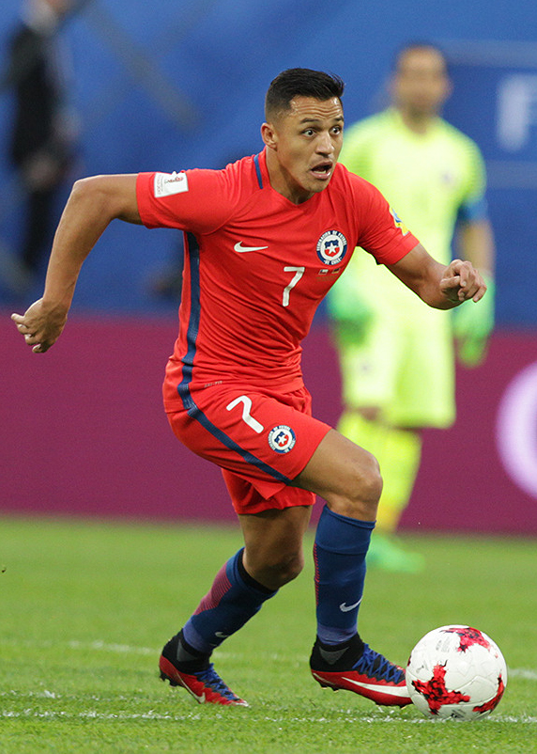
6. Who is this?
Nicolás Otamendi
Marcos Rojo
Alexis Sánchez
Notes:
Di Кирилл Венедиктов - https://www.soccer0010.com/galery/996610/photo/654429, CC BY-SA 3.0, https://commons.wikimedia.org/w/index.php?curid=60641099

Slide 11
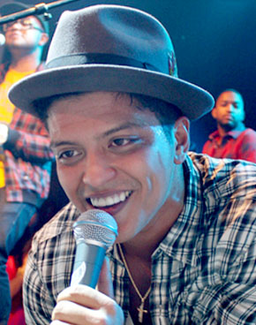
7. Who is this?
Jason Derulo
Bruno Mars
Drake
Notes:
https://commons.wikimedia.org/wiki/File:Bruno_Mars_portrait.jpg

Slide 12
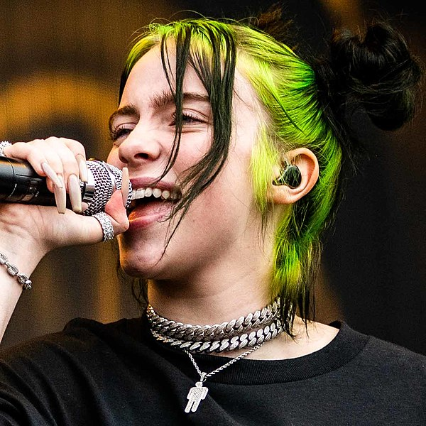
8. Who is this?
Cara Delevingne
Claudia Sulewski
Billie Eilish
Notes:
https://en.wikipedia.org/wiki/File:Billie_Eilish_at_Pukkelpop_(48590443381)_(cropped)_square.jpg

Slide 13
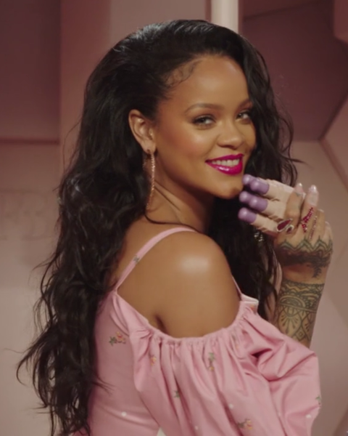
9. Who is this?
Beyoncé Knowles
Rihanna Fenty
Donna Summer
Notes:
https://commons.wikimedia.org/wiki/File:Rihanna_Fenty_2018.png

Slide 14
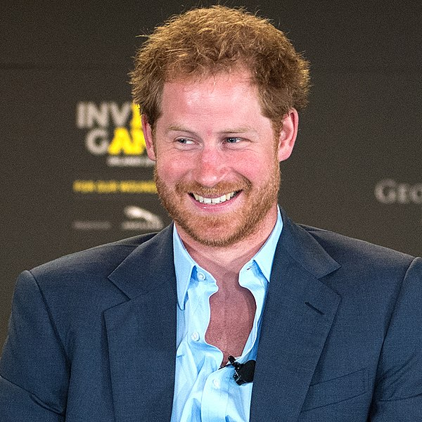
10. Who is this?
Prince Harry
Ed Sheeran
Rupert Grint
Notes:
https://commons.wikimedia.org/wiki/File:Prince_Harry_at_the_2016_Invictus_Games_Symposium_on_Invisible_Wounds_(26292600724)_(cropped).jpg

Slide 15
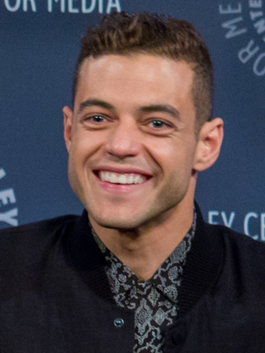
11. Who is this?
Rami Malek
Pete Davidson
Tom Holland
Notes:
https://commons.wikimedia.org/wiki/File:Rami_Malek_in_2015_(portrait_crop).jpg

Slide 17
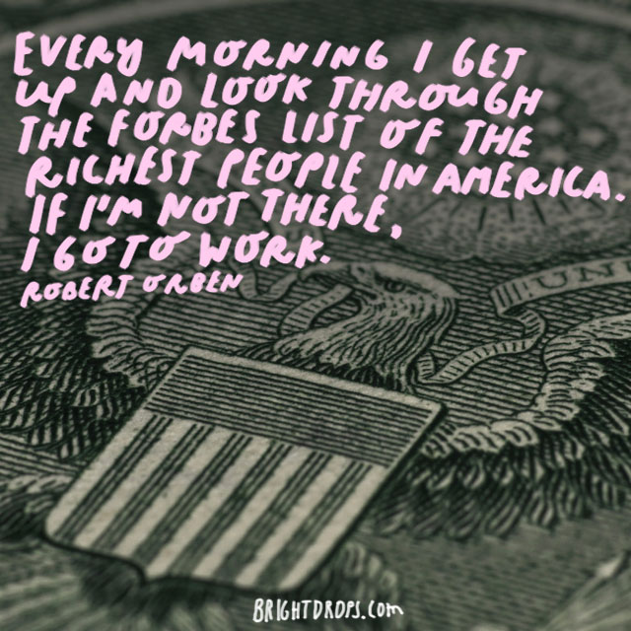
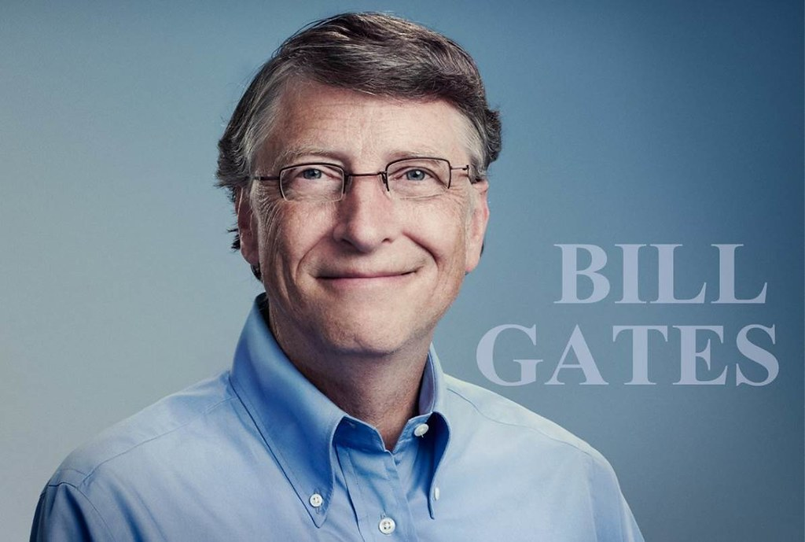
12. The Forbes Rich list for 2020 places Jeff Bezos at the top of the list. Who is in second place?
Bill Gates
Warren Buffett
Bernard Arnault & family
Notes:
https://www.flickr.com/photos/brightdrops/27647057892/sizes/o/
https://www.flickr.com/photos/124561666@N02/14404641675/sizes/l

Slide 18
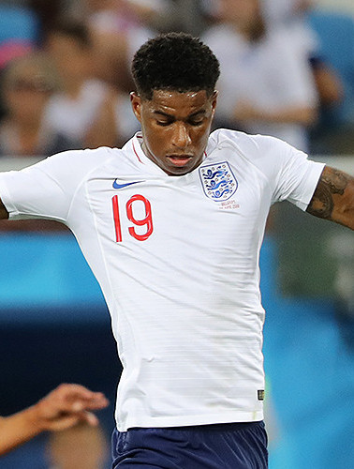
13. Which England footballer wrote a letter to the government asking for an extension for free school meals in the holidays?
Raheem Sterling
Marcus Rashford
Jesse Lingard
Notes:
https://commons.wikimedia.org/wiki/File:Marcus_Rashford_2018-06-28_1.jpg

Slide 19
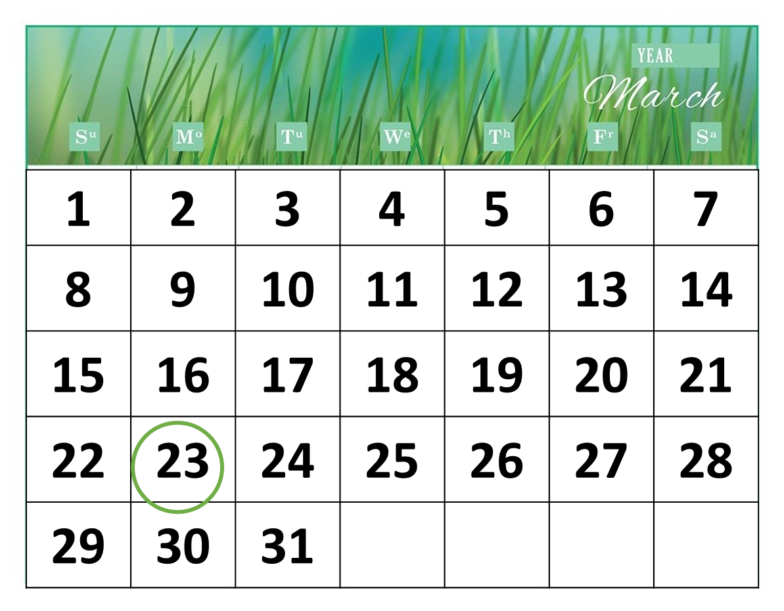
14. What date did the UK go into lockdown because of the coronavrius?
19th March 2020
21st March 2020
23rd March 2020
Notes:
https://commons.wikimedia.org/wiki/File:Lockdown.svg

Slide 20
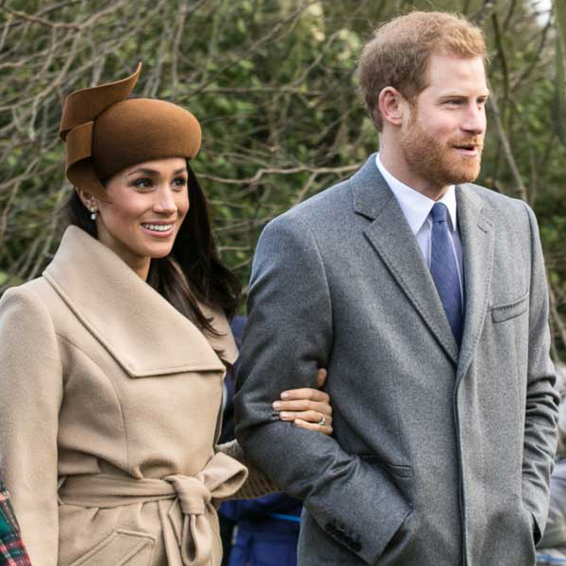
15. On which social media platform did Prince Harry and Meghan Markle announce they were stepping down as senior royals?
WhatsApp
Instagram
Twitter
Notes:
https://upload.wikimedia.org/wikipedia/commons/a/aa/Prince_Harry_and_Meghan_Markle.jpg
https://www.flickr.com/photos/148443584@N05/32570819444

Slide 21
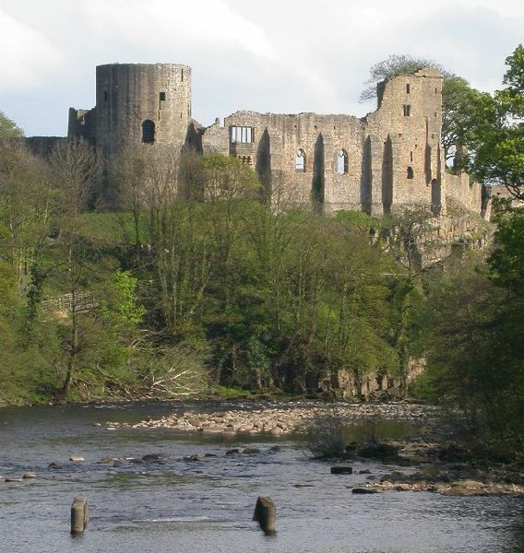
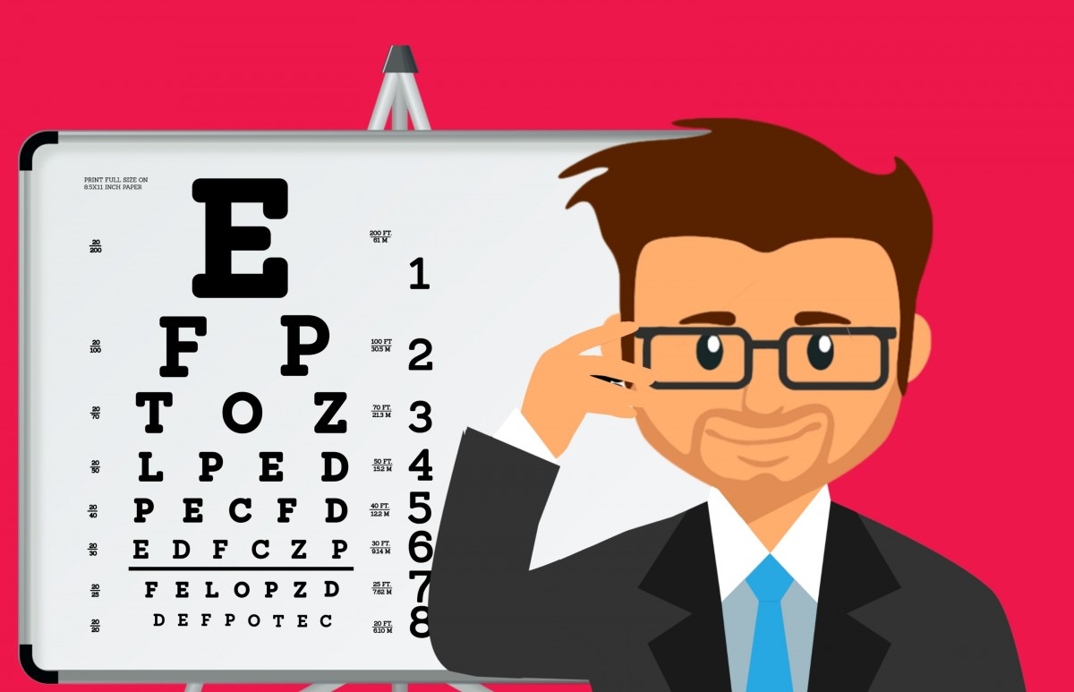
16. Which town was Dominic Cummings driving to test his eyesight after being infected with coronavirus?
Barnard Castle
Durham
Littletown
Notes:
https://commons.wikimedia.org/wiki/File:Barnard_Castle.jpg

Slide 22
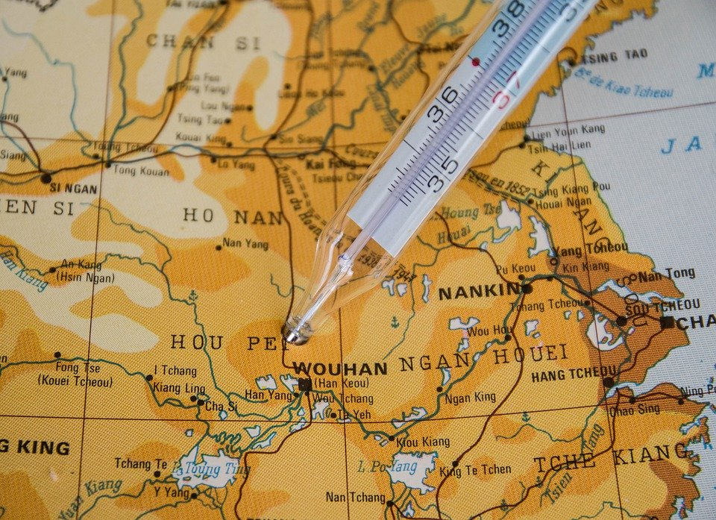
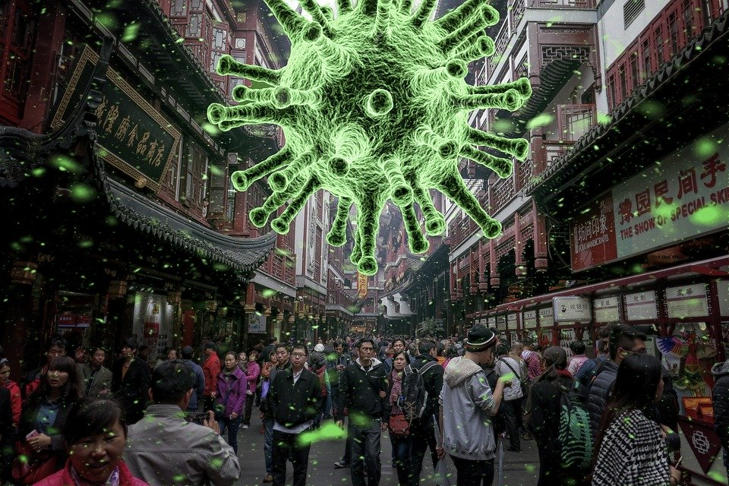
17. In which Chinese city did the coronavirus start?
Wuhai
Wuzhong
Wuhan

Slide 23
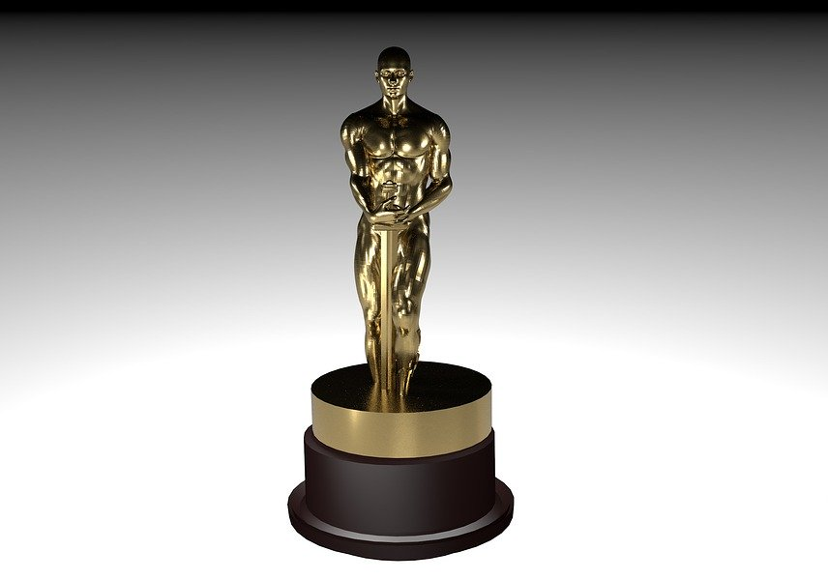
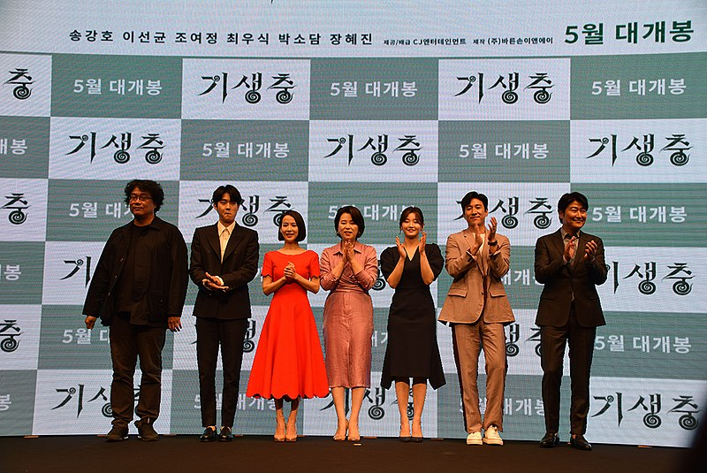
18. Which film won best international feature film at the Oscars?
Parasite
Pain and Glory
Honeyland
Notes:
https://commons.wikimedia.org/wiki/File:Parasite_(film)_director_and_cast_in_2019.jpg

Slide 24
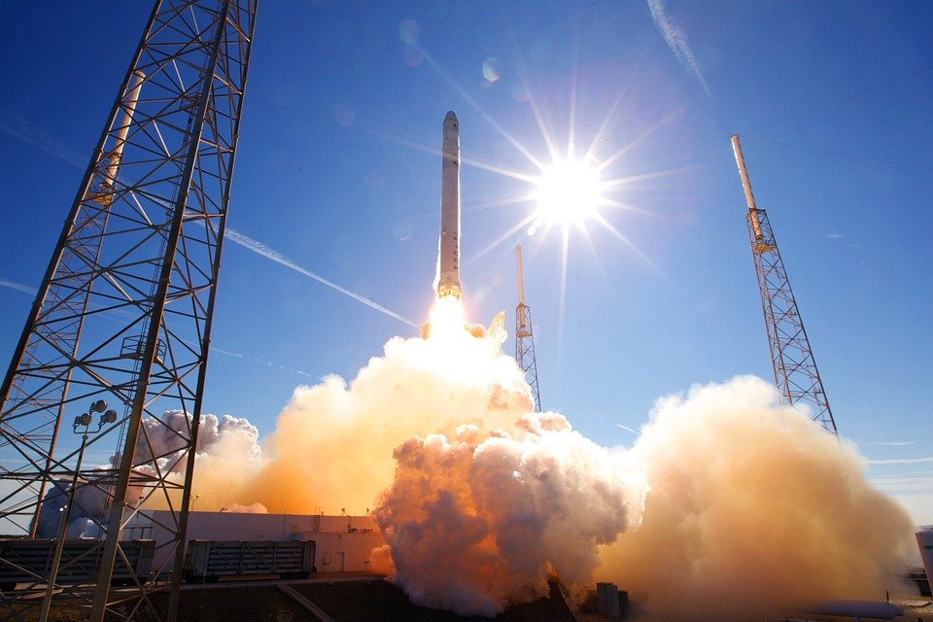
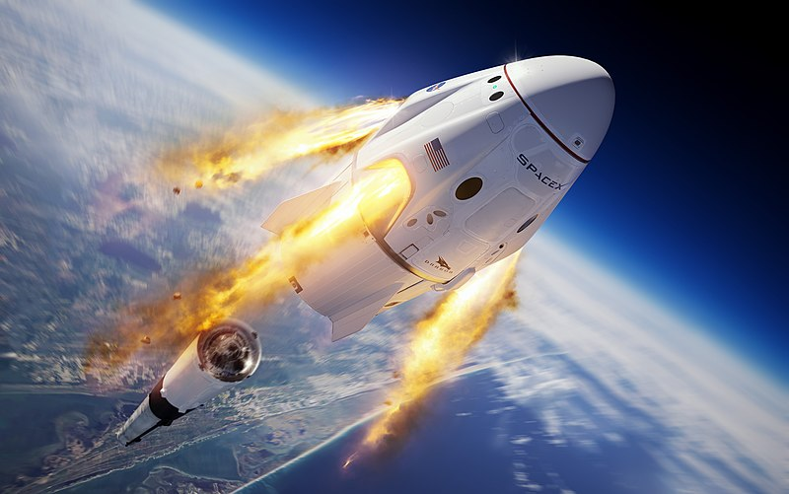
19. Which private company became the first to launch a rocket into space?
SpaceX
SpaceY
SpaceZ
Notes:
https://commons.wikimedia.org/wiki/File:SpaceX_In-flight_Abort_Illustration.jpg

Slide 25
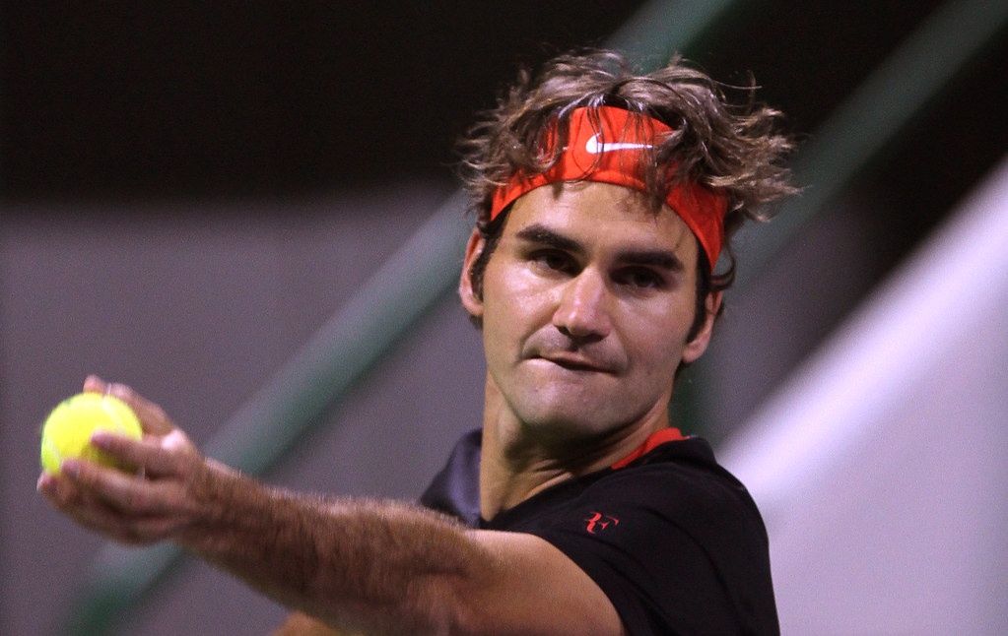
20. Which tennis player was top of the 2020 Forbes magazine list of highest-paid athletes?
Rafael Nadal
Roger Federer
Novak Djokovic
Notes:
https://www.flickr.com/photos/dohastadiumplusqatar/6770966823/sizes/l/

Slide 26
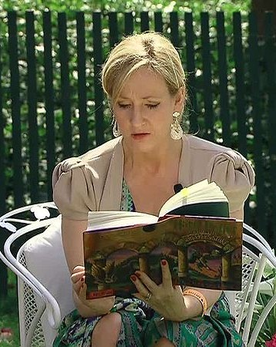
21. Which children’s author caused outrage and controversy with her tweets on twitter?
J.K. Rowling
Jacqueline Wilson
Julia Donaldson
Notes:
https://commons.wikimedia.org/wiki/File:J._K._Rowling_04-2010.jpg

Slide 27
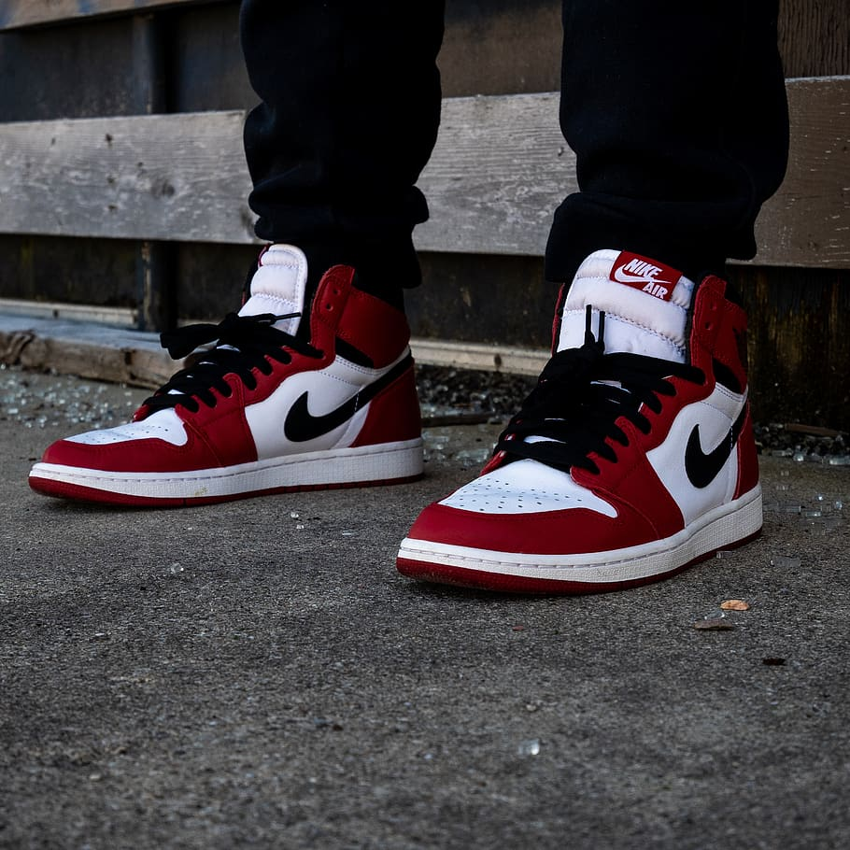
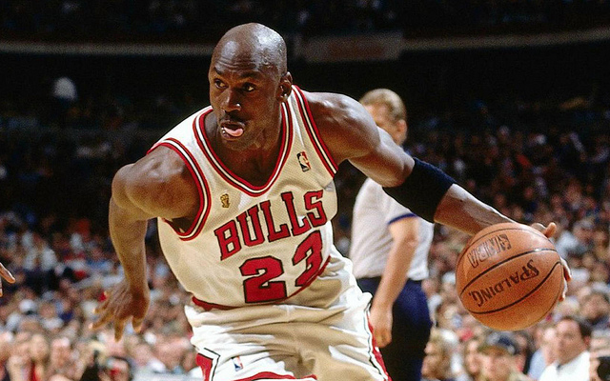
22. Which sportsman broke a world record when a pair of his trainers sold for $560,000?
Michael Jordan
Usain Bolt
David Beckham
Notes:
https://www.flickr.com/photos/93893852@N08/8645746456/sizes/o/

Slide 29
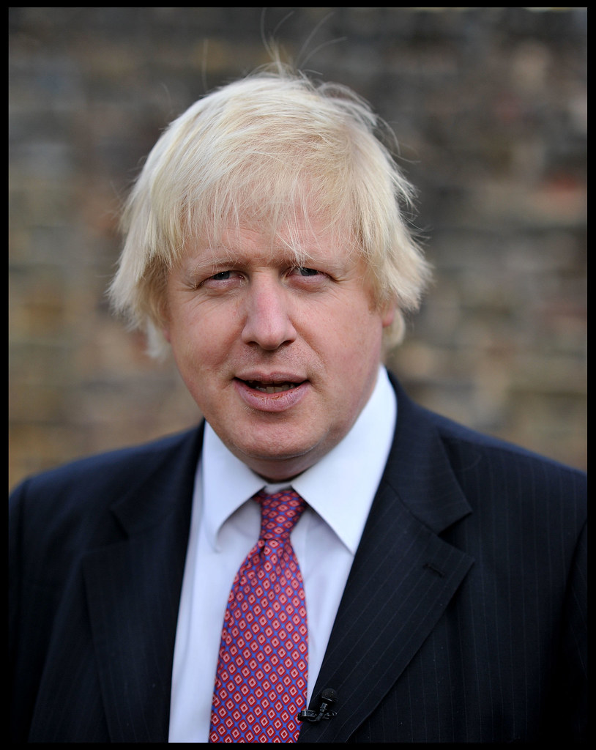
23. What is Boris Johnson’s real name?
My real name is a bit of a mouthful! It’s Alexander Boris de Pfeffel Johnson
Alexander Boris Johnson
Boris Alexander de Pfeffel Johnson
Alexander Boris de Pfeffel Johnson
Notes:
https://www.flickr.com/photos/53797600@N04/6849935334/sizes/l

Slide 30
24. What is the name of the dot on i or j?
tittle
glyph
diacrit

Slide 31
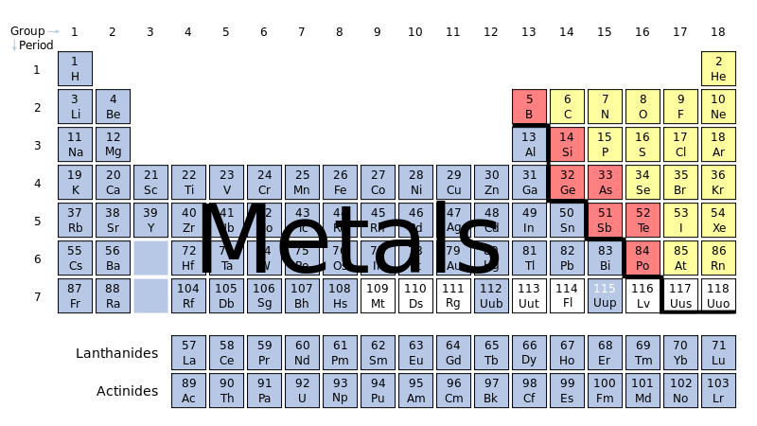
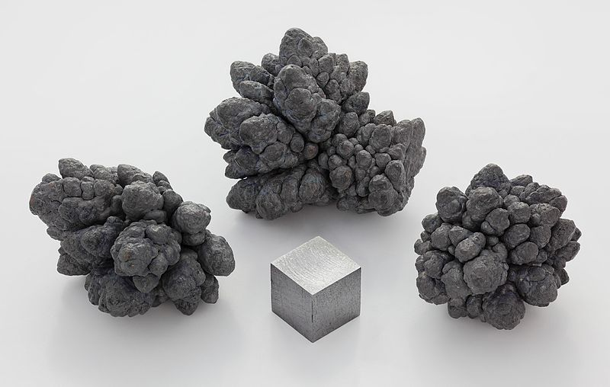
25. Plumbum is the Latin word for which metal?
aluminum
lead
iron
Notes:
https://commons.wikimedia.org/wiki/File:Periodic_table-metals.svg
https://en.wikipedia.org/wiki/File:Lead_electrolytic_and_1cm3_cube.jpg

Slide 32
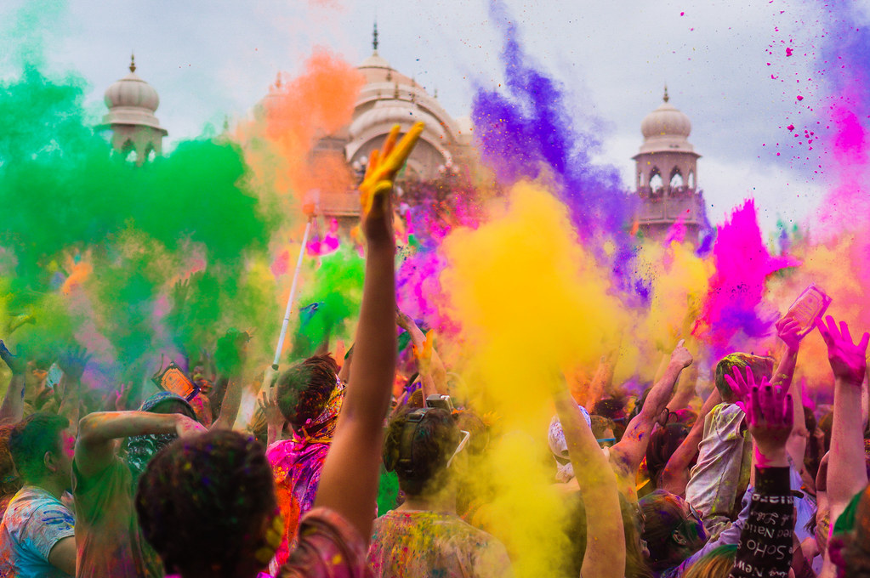
26. What is the festival of colours also known as?
Holi
Diwali
Kwanzaa
Notes:
https://www.flickr.com/photos/sgerner/13919810553/sizes/l

Slide 33
27. What was the first product to be advertised on ITV?
crisps
gravy
toothpaste
Notes:
Lion image https://commons.wikimedia.org/wiki/File:Serengeti_Lion_Running_saturated.jpg

Slide 34
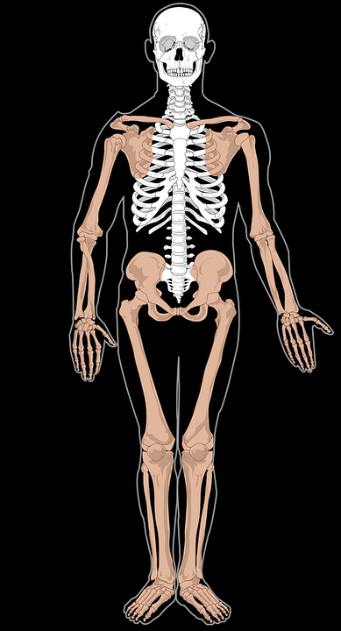
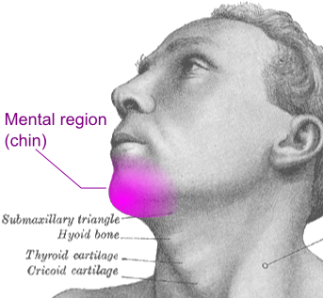
28. In the human body where is the mental region?
chin
brain
elbow
Notes:
Lion image https://commons.wikimedia.org/wiki/File:Serengeti_Lion_Running_saturated.jpg

Slide 35
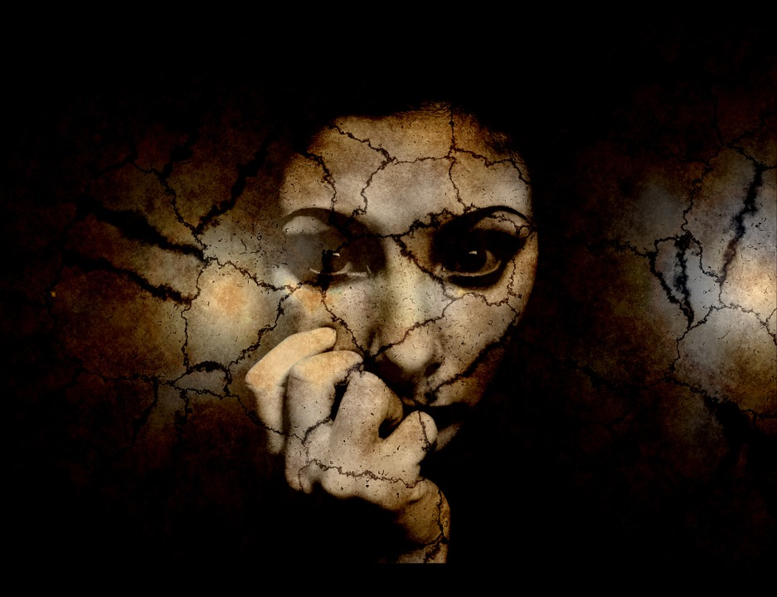
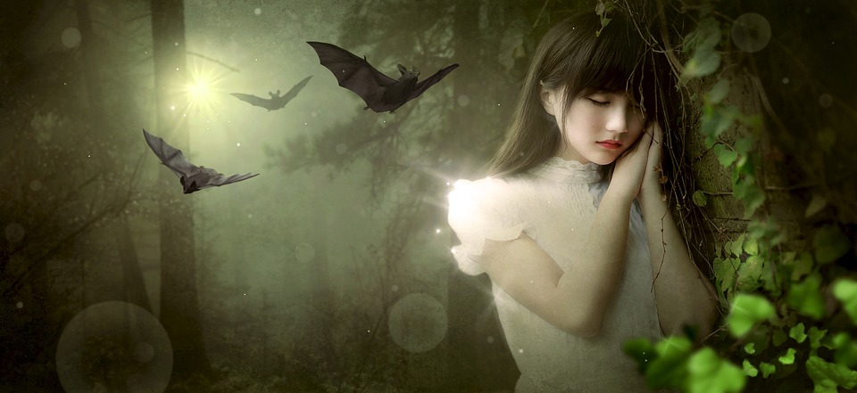
29. What is chiroptophobia the fear of?
birds
bats
feet
Notes:
Lion image https://commons.wikimedia.org/wiki/File:Serengeti_Lion_Running_saturated.jpg

Slide 36
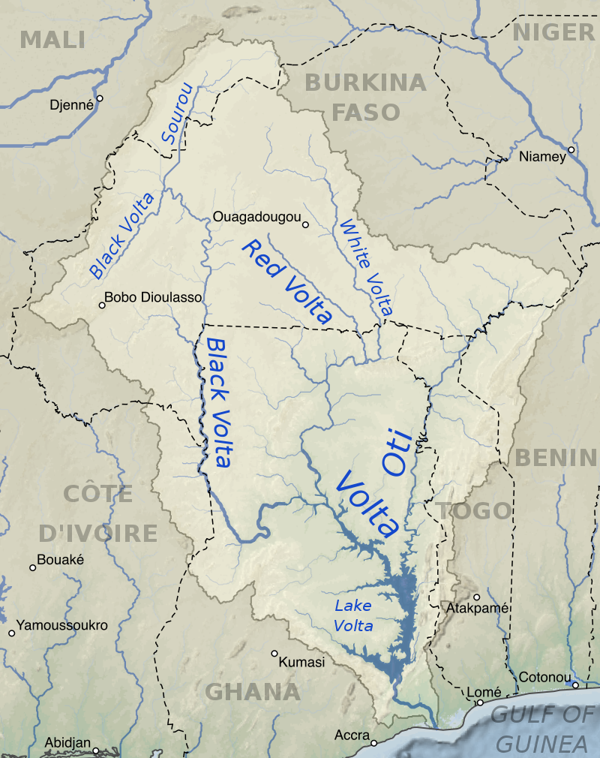
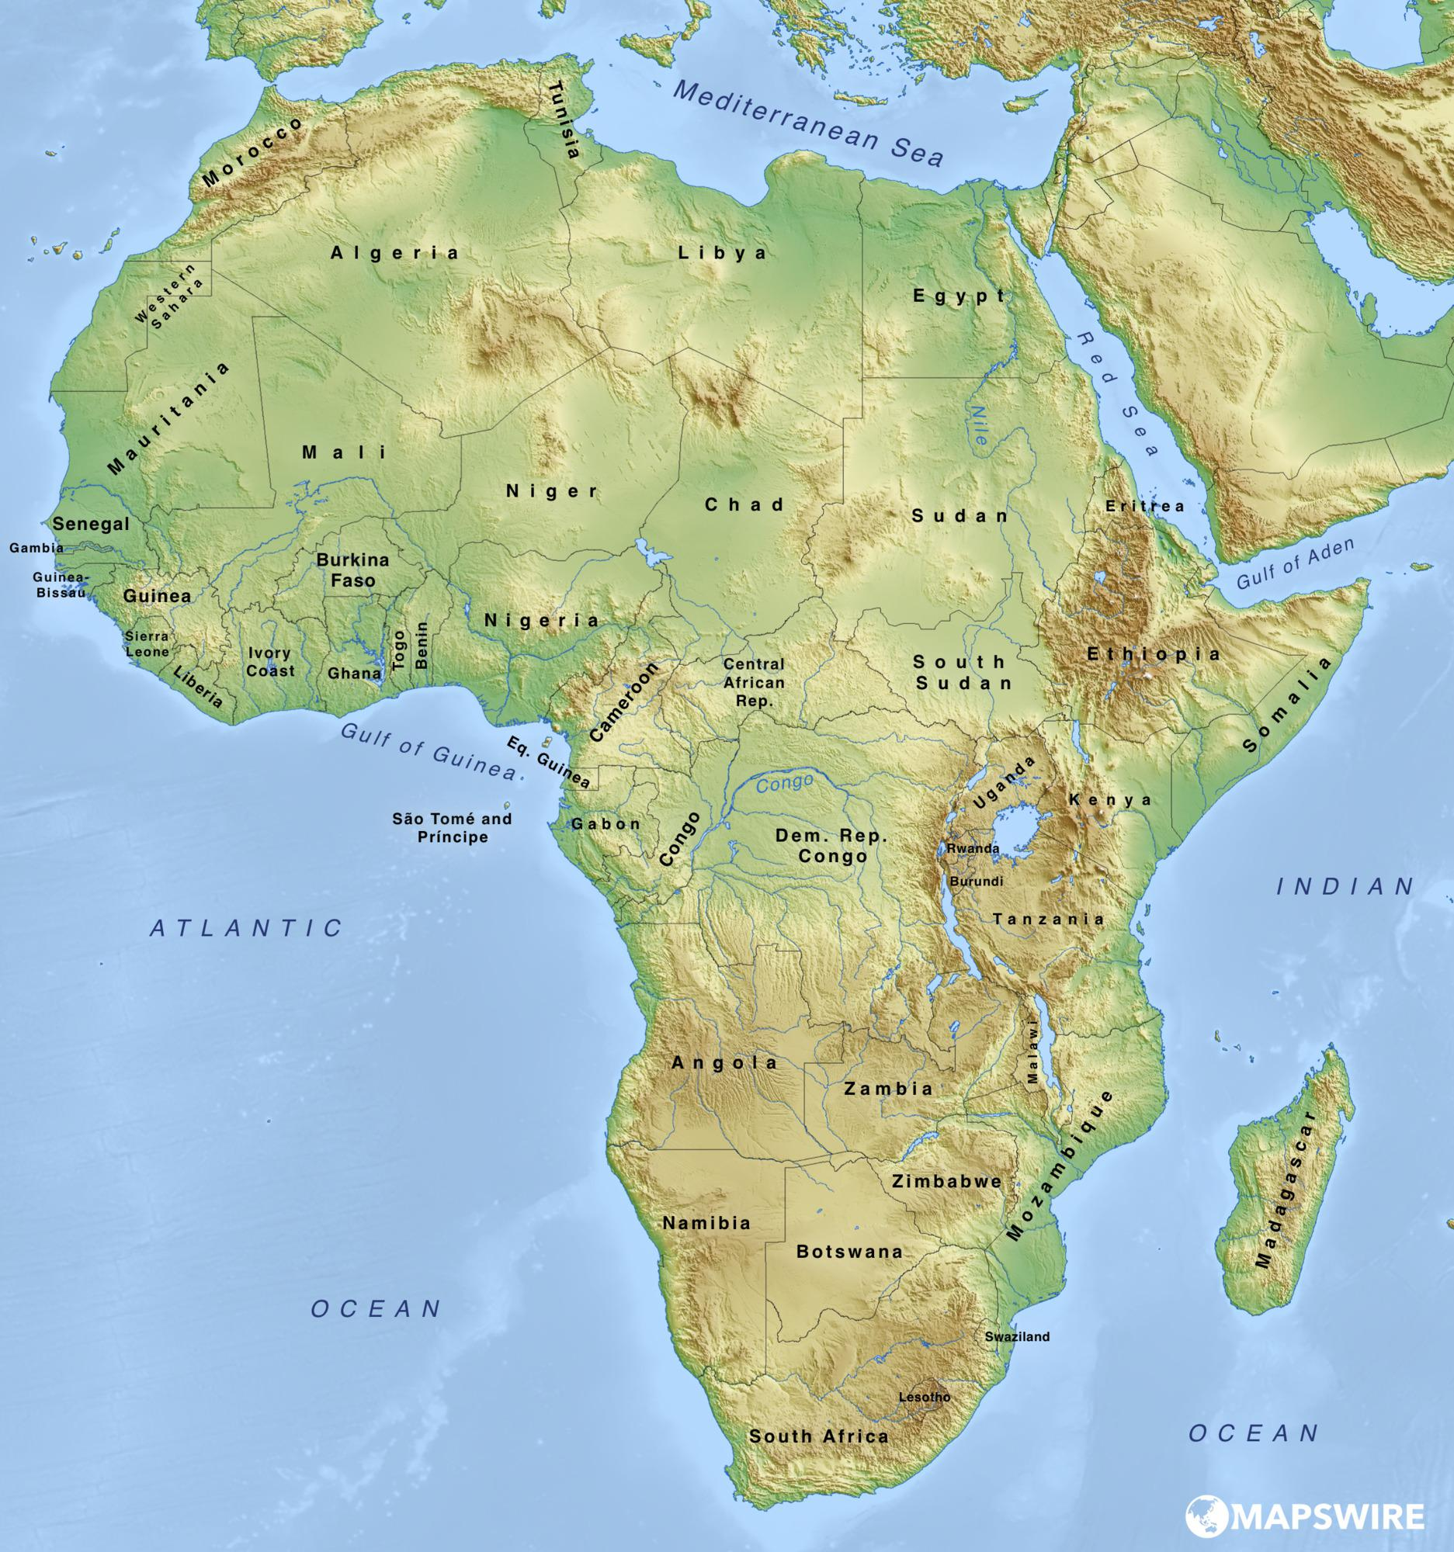
30. What river in Africa has Black, White and Red tributaries (another river or stream flowing into it)?
Volta
Nile
Congo
Notes:
https://en.wikipedia.org/wiki/Volta_River#/media/File:Volta_River_basin_map.svg
https://mapswire.com/maps/africa/africa-physical-map-large.jpg

Slide 37
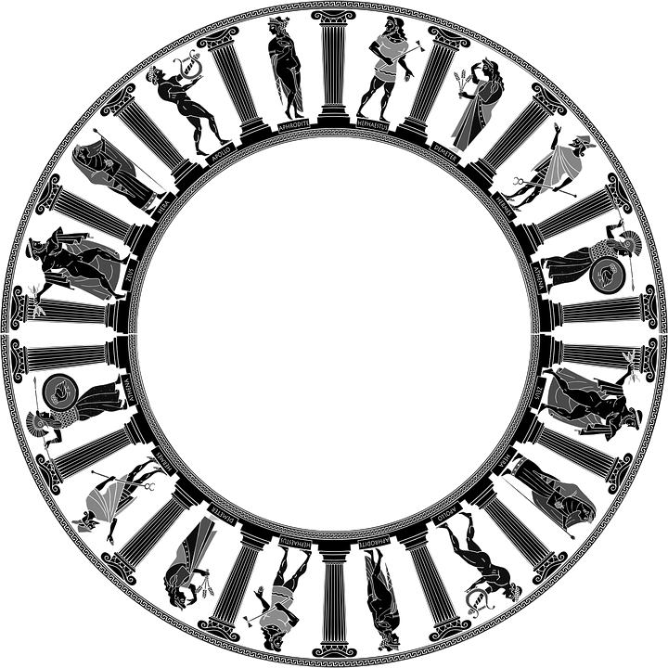
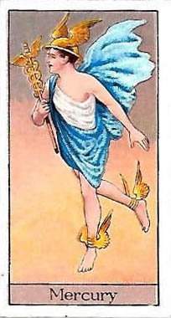
31. In Roman mythology, who was the messenger of the gods?
Hermes
Mercury
Perseus
Notes:
https://commons.wikimedia.org/wiki/File:Mercury_god_card.jpg

Slide 38
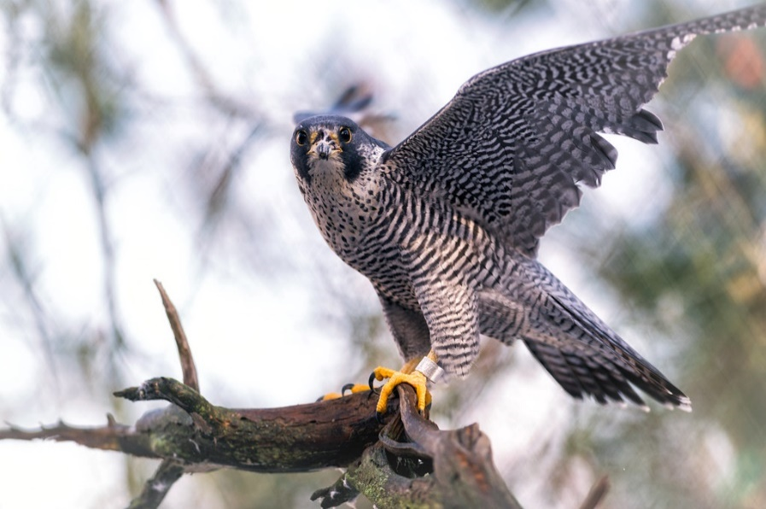
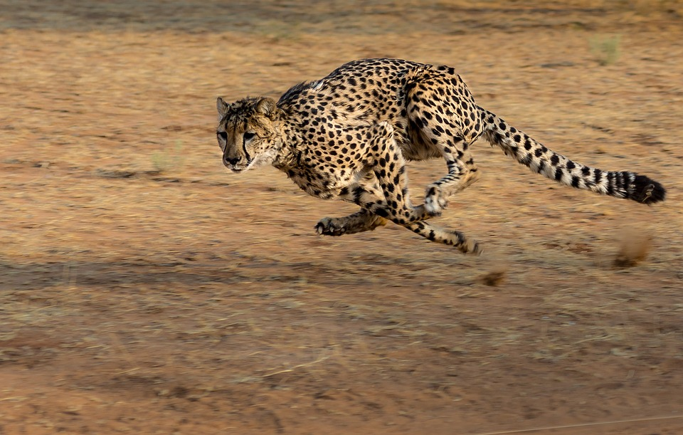
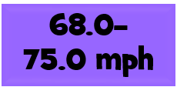
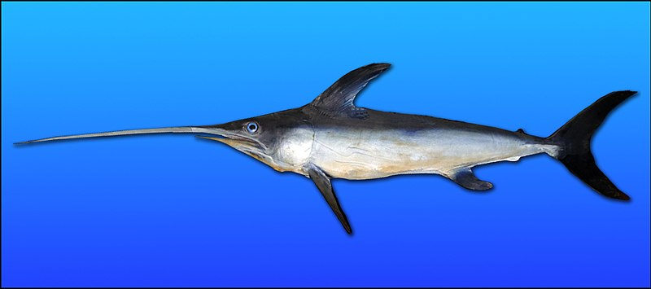
32. What is the world's fastest animal?
peregrine falcon
cheetah
swordfish
Notes:
https://www.flickr.com/photos/ekilby/23782201169/sizes/l
https://commons.wikimedia.org/wiki/File:Swordfish-0046.jpg

Slide 39
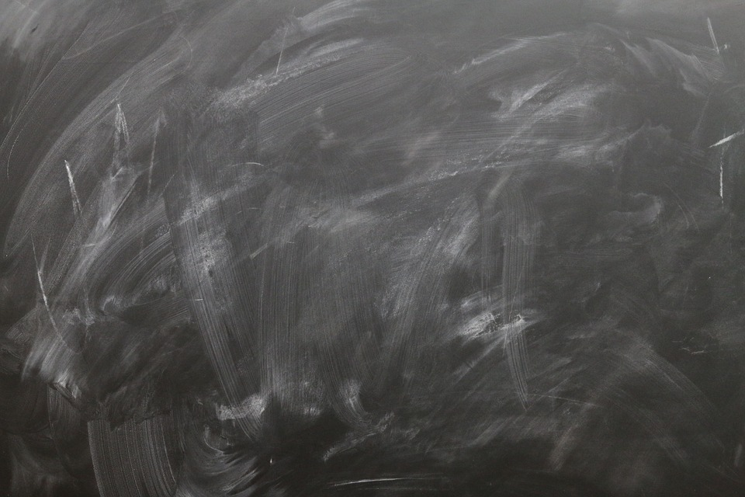
33. What is dendrology the study of?
trees
fingerprints
soils
Notes:
https://commons.wikimedia.org/wiki/File:Etymology_of_Diabetes_Mellitus.svg

Slide 40
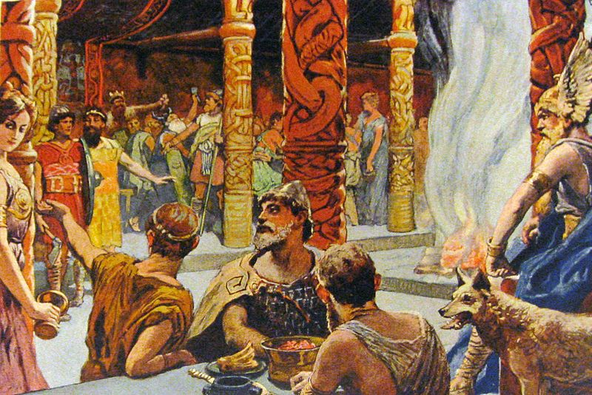
34. In Norse mythology what was the name of Odin's Hall – the equivalent to their ‘heaven’?
Nirvana
Shangri-la
Valhalla
Notes:
https://commons.wikimedia.org/wiki/File:Igneous_rock_eng_text.jpg

Slide 41
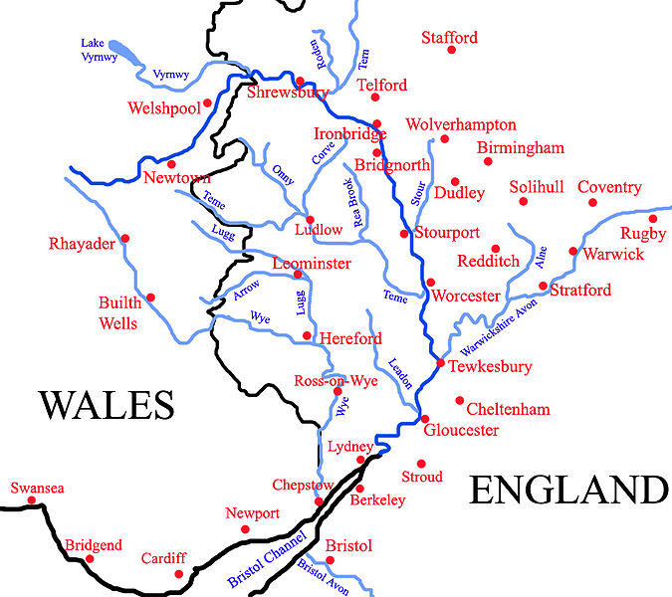
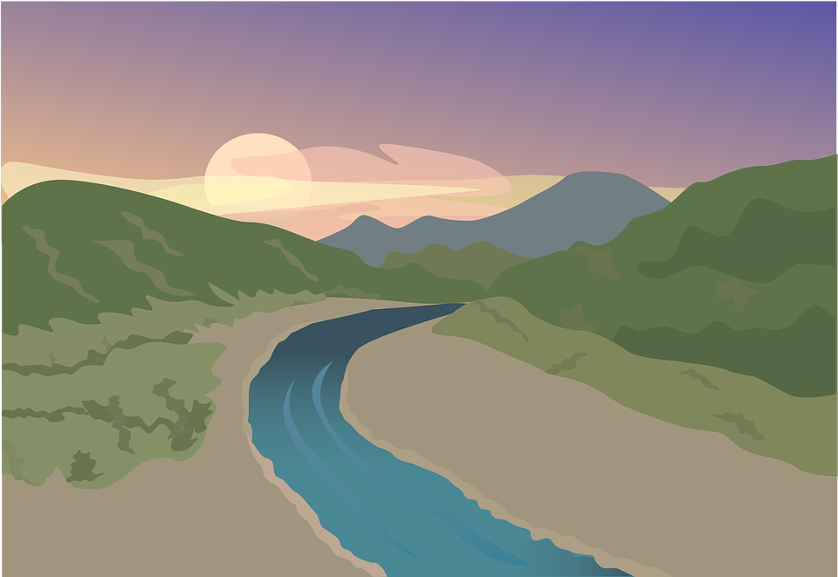
35. Which is the longest river in the United Kingdom?
Thames
Severn
Trent
Notes:
https://commons.wikimedia.org/wiki/File:Igneous_rock_eng_text.jpg

Slide 43
36. Which snooker player has made more than 1,000 century breaks?
Ronnie O’Sullivan
Judd Trump
Mark Williams
Notes:
By DerHexer, Wikimedia Commons, CC-by-sa 4.0, CC BY-SA 4.0, https://commons.wikimedia.org/w/index.php?curid=19363739

Slide 44
37. Who holds the official world record for the marathon?
Eliud Kipchoge
Haile Gebrselassie
Kenenisa Bekele
Notes:
By Dirk Ingo Franke - Own work, CC BY 3.0, https://commons.wikimedia.org/w/index.php?curid=25196419
https://www.flickr.com/photos/149561324@N03/27799862318/sizes/l

Slide 45
38. In golf, which type of club would you use if you wanted to hit the ball a long way?
wedge
putter
wood
Notes:
By Dirk Ingo Franke - Own work, CC BY 3.0, https://commons.wikimedia.org/w/index.php?curid=25196419

Slide 46
39. In which famous race is the last to finish given a red lantern?
Tour de France
Monaco Grand Prix
The Grand National
Notes:
https://commons.wikimedia.org/wiki/File:Cow_on_the_Corner,_Brunswick,_Western_Australia.jpg
https://en.wikipedia.org/wiki/Fielding_(cricket)#/media/File:Cricketfieldingpositions.jpg

Slide 47
40. How many yards are there between each set of stumps in cricket?
20 yards
22 yards
25 yards

Slide 48
41. What is the maximum amount of time a golf player may take to look for a lost ball?
3 minutes
5 minutes
7 minutes
Notes:
By Steve Boulton - Flickr: God, CC BY 2.0, https://commons.wikimedia.org/w/index.php?curid=27609758

Slide 49
42. Penhold is a type of grip in which sport?
lacrosse
judo
table tennis
Notes:
By Mohan Doha Stadium Plus Qatar - Ma Lin, CC BY 2.0, https://commons.wikimedia.org/w/index.php?curid=19072593

Slide 50
43. Which English football club was originally called Newton Heath?
Manchester United
Manchester City
Stoke
Notes:
https://commons.wikimedia.org/wiki/File:Wimbledon_trophies.jpg

Slide 51
44. In golf, how many stokes would you have to take at a par 4 hole to get an albatross?
1
2
3

Slide 53
45. What movie is this soundtrack from?
Grease
Saturday Night Fever
Hairspray
Notes:
https://commons.wikimedia.org/wiki/File:Dua_Lipa-0779.jpg

Slide 54
46. Which 21st Century object made an unexpected guest appearance in Game of Thrones?
a watch
a coffee cup
an iPhone
Notes:
https://www.flickr.com/photos/121483302@N02/13473480295/sizes/l

Slide 55
47. Which movie in 1978 featured the song Summer Nights?
Hairspray
Saturday Night Fever
Grease
Notes:
https://en.wikipedia.org/wiki/File:Donaustadtbruecke-Praterbruecke-DSC_0024w.jpg

Slide 56
48. Who plays the part of Peter Parker in ‘Spider-Man: Far From Home’?
Andrew Garfield
Tom Holland
Tobey Maguire
Notes:
By Gage Skidmore, CC BY-SA 3.0, https://commons.wikimedia.org/w/index.php?curid=50404093

Slide 57
49. Who won the best performance for a leading role in the 2020 Oscars?
Adam Driver
Leonardo DiCaprio
Joaquin Phoenix
Notes:
https://commons.wikimedia.org/wiki/File:Genres_on_Justori.jpg
https://www.flickr.com/photos/disneyabc/33013619801

Slide 58
50. What won the best animated feature film at the 2020 Oscars?
Klaus
Toy Story 4
Missing Link
Notes:
https://commons.wikimedia.org/wiki/File:Anniversery_of_the_making_of_Toy_Story_(26212573580).jpg

Slide 59
51. Who plays the part of Nala in the 2019 version of ‘The Lion King’?
Elton John
Adele
Beyoncé Knowles
Notes:
https://commons.wikimedia.org/wiki/File:Beyonc%C3%A9_at_Super_Bowl_XLVII_halftime_show_(7).jpg

Slide 60
52. Robert Downey Jr. stars in which 2019 movie where allies work together to fix the problems caused by Thanos?
Joker
Endgame
Dark Phoenix
Notes:
https://www.flickr.com/photos/gageskidmore/14800476884/sizes/l

Slide 61
53. Which actor plays J. R. R. Tolkien in ‘Tolkien’ - the biographical film about Tolkien’s life?
Nicholas Hoult
Hugh Dancy
Christian Bale
Notes:
https://commons.wikimedia.org/wiki/File:Tolkien_1916-2.jpg
https://www.flickr.com/photos/gageskidmore/9360223361/sizes/l

Slide 62
54. In which movie did this bench feature?
La La Land
Forest Gump
Good Will Hunting
Notes:
https://commons.wikimedia.org/wiki/File:Bank_Forrest_Gump_(21628053603).jpg

Slide 63
55. Who was in the group Destiny’s Child and later became a judge on ‘The X-Factor’?
Kelly Roland
Tula Paulinea Contostavlos
Amanda Holden
Notes:
By melika - originally posted to Flickr as destiny's child..., CC BY 2.0, https://commons.wikimedia.org/w/index.php?curid=10902355
https://www.flickr.com/photos/lunchboxstudios/5037142224

Slide 64
56. Who plays the part of the first female superhero in ‘Captain Marvel’?
Annette Bening
Brie Larson
Lashana Lynch
Notes:
https://commons.wikimedia.org/wiki/File:Brie_Larson_2018.jpg
https://www.flickr.com/photos/antdude3001/27886986784/sizes/o/

Slide 65
57. Which British film made in 1973 was set on Summer Isle?
The Wickerman
Don’t Look Now
That'll Be The Day
Notes:
https://www.flickr.com/photos/wicker-furniture/7438246422

Slide 67
58. Who won the Grammy for the best record of the year at the 2020 awards?
Ariana Grande
Bon Iver
Billie Eilish
Notes:
By Toglenn - Own work, CC BY-SA 4.0, https://commons.wikimedia.org/w/index.php?curid=86396007

Slide 68
59. What song won the Grammy for the best song of the year at the 2020 awards?
BEST SONG
Bad Guy
Hey, Ma
7 Rings
Notes:
https://www.flickr.com/photos/slgc/23499426448/sizes/l
https://commons.wikimedia.org/w/index.php?curid=12955417
By Brothers Le - Bruno Mars, CC BY 2.0, https://commons.wikimedia.org/w/index.php?curid=17679582
By Dmileson - Own work, CC BY-SA 4.0, https://commons.wikimedia.org/w/index.php?curid=34983023

Slide 69
60. Hakuna Matata was a song from which 1994 Disney film?
Aladdin
The Lion King
A Bug’s Life
Notes:
https://www.flickr.com/photos/brookebida/20369345499/sizes/o/
https://www.sketchport.com/drawing/6353855952453632/the-lion-king

Slide 70
61. Which summer classic spent the shortest period at the top of the singles charts?
Summer Holiday - Cliff Richard and the Shadows
In the Summertime
Mungo Jerry
Summer Nights - John Travolta & Olivia Newton-John
Summer Holiday
Notes:
https://commons.wikimedia.org/wiki/File:UK_singles_chart.jpg

Slide 71
62. Which concerto in Vivaldi's ‘The Four Seasons’ honours summer?
Concerto No. 2 in G minor
Concerto No. 1 in E major
Concerto No. 2 in G minor
Concerto No. 3 in F major
Notes:
https://en.wikipedia.org/wiki/Antonio_Vivaldi#/media/File:Vivaldi.jpg

Slide 72
63. Who sang 'Summer’ in 2015 and was nominated for the Single of the Year at the 2015 Brit Awards?
Calvin Harris
Clean Bandit
Sigma
Notes:
https://www.flickr.com/photos/jametiks/7395505238/sizes/l

Slide 73
64. Who sang ‘Summer in the City’ which was number 1 in the charts in August 1966, for three consecutive weeks?
The Monkeys
The Beach Boys
The Lovin' Spoonful
Notes:
https://commons.wikimedia.org/wiki/File:Lovin_Spoonful_1965.jpg
https://www.geograph.org.uk/photo/3055472

Slide 74
65. Which band sang ‘Here Comes The Sun’ in 1969?
Dave Clark Five
The Beatles
The Bee Gees
Notes:
https://en.wikipedia.org/wiki/File:Televisie-optreden_van_The_Beatles_in_Treslong_te_Hillegom_vlnr._Paul_McCartney,_Bestanddeelnr_916-5099.jpg

Slide 75
66. Name the song and the artist(s)?
Yeah no
Sapphire moonlight
We danced for hours in the sand
Tequila sunrise
Señorita - Shawn Mendes, Camila Cabello
Notes:
https://commons.wikimedia.org/wiki/File:Shawn_Mendes_Live_in_Concert_(cropped).jpg
https://commons.wikimedia.org/wiki/File:Camila_Cabello_2018.png

Slide 76
67. Name the song and the artist(s)?
We go together
Better than birds of a feather, you and me
We change the weather, yeah
I'm feeling heat in December when you're 'round me
Sucker
Jonas Brothers
Notes:
https://www.flickr.com/photos/kjnf/2766896566/sizes/o/

Slide 77
68. Name the song and the artist(s)?
You and the winds are changing
I'm trying to hold on
Don't think I'll still be waiting
For you all winter long
We're feeling like September
We're fading fast
Summer Lover
Oliver Heldens, Devin and Nile Rodgers
Notes:
https://commons.wikimedia.org/wiki/File:Airbeat_One_2015_Oliver_Heldens_by_Denis_Apel-1648.jpg
https://www.flickr.com/photos/perolofforsberg/27447632333/sizes/l

Slide 78
69. Name the song and the artist(s)?
Knew it when I saw her face
I just thought that she could be the one
Sundress with you on my arm
Take the coupe out the garage
Pull the roof back just me, you and the stars
Summer Days
Martin Garrix
Notes:
By Jasper K - Own work, CC BY-SA 3.0, https://commons.wikimedia.org/w/index.php?curid=27692878

Slide 79
70. Name the song and the artist(s)?
Baby, baby, I
Walk in the late night
Looking for your eyes
Put up a fight to find you
Lose it every time
You were the last of your kind
All of the blame's mine
Find U Again
Mark Ronson and Camila Cabello
Notes:
https://commons.wikimedia.org/wiki/File:Mark_Ronson_(3596316314).jpg
https://commons.wikimedia.org/wiki/File:Camila_Cabello_Accepts_Best_Artist_Award_EMA_2018.png

Slide 80
71. Name the song and the artist(s)?
I got the horses in the back
Horse tack is attached
Hat is matte black
Got the boots that's black to match
Ridin' on a horse, ha
You can whip your Porsche
Old Town Road
Lil Nas X
Notes:
https://commons.wikimedia.org/wiki/File:Lil_Nas_X_(cropped).jpg

Slide 81
72. Name the song and the artist(s)?
I'm losing my self-control
Yeah, you're starting to trickle back in
But I don't wanna fall down the rabbit hole
Cross my heart, I won't do it again
Never Really Over
Katy Perry
Notes:
By https://www.flickr.com/photos/evarinaldiphotography/ - https://www.flickr.com/photos/evarinaldiphotography/35688394755/, CC BY 2.0, https://commons.wikimedia.org/w/index.php?curid=61024681

Slide 82
73. Name the song and the artist(s)?
Lightning in your eyes, you can't speak
Falling from the sky, down to me
I see it in your face, I'm relief
I'm your summer girl
Summer Girl
Haim
Notes:
By Kim Metso - Own work, CC BY-SA 3.0, https://commons.wikimedia.org/w/index.php?curid=28337666

Slide 83
74. Name the song and the artist(s)?
You got me, you got me losin' all my cool
I guess we're ready for the summer
Cool
Dua Lipa
Notes:
By Cosmopolitan UK - YouTube: Best dressed celebrities at the 2020 Grammys | Cosmopolitan UK – View/save archived versions on archive.org and archive.today (see specific archived version or its text-only cache, for slow loading), CC BY 3.0, https://commons.wikimedia.org/w/index.php?curid=87842465

Slide 85
75. When is the festival of Midsummer Day?
20th June
21st June
24th June
Notes:
https://commons.wikimedia.org/wiki/File:Cricau_Festival_2013_-_Sanziene_-_24.jpg

Slide 86
76. Esther Summerson is a character in which novel by Charles Dickens?
Bleak House
Great Expectations
Little Dorrit
Notes:
https://commons.wikimedia.org/wiki/File:Cricau_Festival_2013_-_Sanziene_-_24.jpg

Slide 87
77. Where are the Summer Isles?
Finland
Scotland
Norway
Notes:
https://www.flickr.com/photos/104346167@N06/30692459341/sizes/l
https://commons.wikimedia.org/wiki/File:Scotland,_map_for_%22Lijst_van_golfbanen_in_Scholtand%22.jpg

Slide 88
78. What filling does summer pudding contain?
soft fruits
ice-cream
vanilla
Notes:
https://www.flickr.com/photos/adactio/38733629/sizes/l

Slide 89
79. When did Billy Butlin open his first holiday camp?
1933
1936
1939
Notes:
By Mr M Evison, Stuart Jamieson, CC BY-SA 2.0, https://commons.wikimedia.org/w/index.php?curid=14981869

Slide 90
80. By what other name is the character Puck known as in the play ‘A Midsummer Night's Dream’?
Robert Goodfellow
Robert Fellows
Robin Goodfellow
Notes:
By http://internetshakespeare.uvic.ca/Library/SLT/ideas/folklore.htmlOriginally uploaded on en.wikipedia (Transferred by Andrew Dalby), Public Domain, https://commons.wikimedia.org/w/index.php?curid=16878914

Slide 91
81. Where is the village of Port Sunlight, built by the Lever Brothers to house workers in its soap factory?
The Wirral
Bristol
Southampton
Notes:
https://en.wikipedia.org/wiki/File:Port_Sunlight_buildings_8.jpg

Slide 92
82. Where is Queen Victoria’s bathing machine on display?
Windsor Castle
Balmoral Castle
Osborne House
Notes:
Bathing machine © Copyright Basher Eyre and licensed for reuse under this Creative Commons Licence.
Osborne houseBy WyrdLight.com, CC BY-SA 3.0, https://commons.wikimedia.org/w/index.php?curid=12766661

Slide 93
83. Who starred in the 1963 film Summer Holiday?
John Travolta
Elvis Presley
Cliff Richard
Notes:
https://commons.wikimedia.org/wiki/File:Cliff_Richard_913-7393.jpg

Slide 94
84. On what planet does summer last 42 years?
Uranus
Pluto
Mercury
Notes:
https://en.wikipedia.org/wiki/Uranus#/media/File:Uranus2.jpg
https://www.flickr.com/photos/11304375@N07/2818891443/sizes/l

Slide 95
85. Who wrote: Shall I compare thee to a summer’s day?
Percy Bysshe Shelley
William Wordsworth
William Shakespeare
Notes:
By William Shakespeare - http://luna.folger.edu/luna/servlet/s/by2g21, CC BY-SA 4.0, https://commons.wikimedia.org/w/index.php?curid=47881412

Slide 96
86. In which Chinese city is ‘The Summer Palace’ which contains a complex of palaces, gardens and lakes?
Shanghai
Beijing
Guangzhou
Notes:
By Zhangzhe0101 - Own work, CC BY-SA 3.0, https://commons.wikimedia.org/w/index.php?curid=7259894

Slide 97
87. British Summer Time begins and ends in which months?
April and September
March and October
March and September
Notes:
https://www.geograph.org.uk/photo/5862237

Slide 98
88. Which of these words mean relating to summer?
estival
vernal
heimal

Slide 99
89. Who has a summer residence at Castel Gandolfo?
The Pope
Prince Charles
Giorgio Armani
Notes:
https://commons.wikimedia.org/wiki/File:Piazzale_Quadrato_Castel_Gandolfo_III_20141006.jpg
https://commons.wikimedia.org/wiki/File:Canonization_2014-_The_Canonization_of_Saint_John_XXIII_and_Saint_John_Paul_II_(14036966125).jpg

Slide 100
90. Where does Queen Elizabeth II usually spend summer?
Sandringham House
Holyroodhouse
Balmoral Castle
Notes:
https://www.flickr.com/photos/22746515@N02/2498232281
https://commons.wikimedia.org/wiki/File:HM_Queen_Elizabeth_II.jpg

Slide 101
91. Which London art gallery hosts the annual Summer Exhibition?
Tate Modern
The Royal Academy of Arts
Saatchi Gallery
Notes:
https://www.flickr.com/photos/gareth1953/36334269871/sizes/l
https://commons.wikimedia.org/wiki/File:Royal_Academy_Summer_Exhibition_-_Aug_2017.jpg

Slide 102
92. What was the top overseas summer holiday destination for Brits in 2019?
Greece
Turkey
Spain
Notes:
https://www.flickr.com/photos/22746515@N02/2498232281

Slide 104
93. Where is this?
Skegness
Southport
Blackpool

Slide 105
94. Where in the world would you be if you were on this beach?
Sydney, Australia
Blouberg, South Africa
Auckland, New Zealand
Notes:
https://www.flickr.com/photos/south-african-tourism/3609949385

Slide 106
95. Where in the world would you be if you were on this beach?
Phuket, Thailand
Goa, India
Rio-De-Janeiro, Brazil
Notes:
https://www.flickr.com/photos/74434277@N06/8136102013/sizes/l

Slide 107
96. Which country is this the flag of?
Tunisia
China
Uruguay
Notes:
https://commons.wikimedia.org/wiki/File:Flag_of_Uruguay.svg

Slide 108
97. Which country is this the flag of?
Antigua and Barbuda
Japan
Brazil
Notes:
https://en.wikipedia.org/wiki/File:Flag_of_Antigua_and_Barbuda.svg

Slide 109
98. Which country is this the flag of?
Barbados
Argentina
Cyprus
Notes:
https://en.wikipedia.org/wiki/File:Flag_of_Argentina.svg

Slide 110
99. Which country is this the flag of?
Mexico
Philippines
Algeria
Notes:
https://en.wikipedia.org/wiki/File:Flag_of_the_Philippines.svg

Slide 111
100. Which country is this the flag of?
Papua New Guinea
Maldives
Kurdistan
Notes:
https://en.wikipedia.org/wiki/File:Flag_of_Kurdistan.svg

Slide 112
Quiz Answer Sheet
Name(s)___________________________
Score_______________
1. | 11. | 21. | 31, | 41.
2. | 12. | 22. | 32. | 42.
3. | 13. | 23. | 33. | 43.
4. | 14. | 24. | 34. | 44.
5. | 15. | 25. | 35. | 45.
6. | 16. | 26. | 36. | 46.
7. | 17. | 27. | 37. | 47.
8. | 18. | 28. | 38. | 48.
9. | 19. | 29. | 39. | 49.
10. | 20. | 30. | 40. | 50.

Slide 113
Quiz Answer Sheet
Name(s)___________________________
Score_______________
51. | 61. | 71. | 81. | 91.
52. | 62. | 72. | 82. | 92.
53. | 63. | 73. | 83. | 93.
54. | 64. | 74. | 84. | 94.
55. | 65. | 75. | 85. | 95.
56. | 66. | 76. | 86. | 96.
57. | 67. | 77. | 87. | 97.
58. | 68. | 78. | 88. | 98.
59. | 69. | 79. | 89. | 99.
60. | 70. | 80. | 90. | 100.

