Slide 2
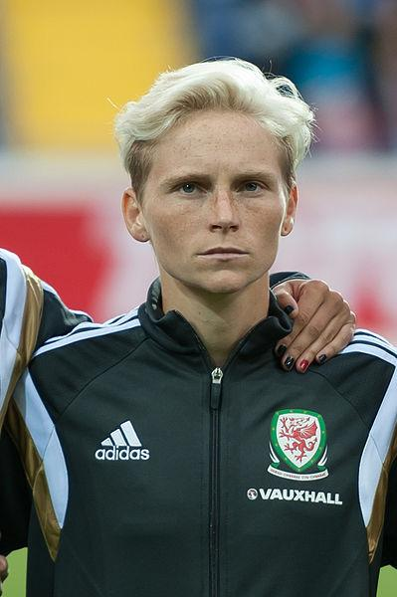
Jess Fishlock
Jess Fishlock is a Welsh midfielder who is openly gay. On 5 April 2017, Fishlock became the first Welsh football player to earn 100 caps for the national team. For four years running, Fishlock was named as the female Welsh Footballer of the Year.
“Ultimately everyone has an opinion about you, on what you do and how you do it. It’ll be positive and negative but the truth is you probably see 80 percent negative and 20 percent positive. It’s not easy, you just have to be able to deal with the good and the bad the same.” – Jess Fishlock

Slide 3
Oscar Wilde
Author Oscar Wilde was known for his flamboyant style and marvellous wit. He won accolades for his works including ‘The Importance of Being Earnest’ and ‘The Picture of Dorian Gray’. He was imprisoned because of his sexuality in 1895 for two years.
“You don’t love someone for their looks, or their clothes, or for their fancy car, but because they sing a song only you can hear.” – Oscar Wilde

Slide 4
Harry Hay
Henry ‘Harry’ Hay began his activist life in the 1930s in which he was fighting for workers’ rights during the labour movement. With this experience, he became part of the communist party and started America’s first successful homosexual liberation organisation.
“I knew that I was gay in every bone of my body. So I did the only thing I could do. I started the movement.” – Harry Hay

Slide 5
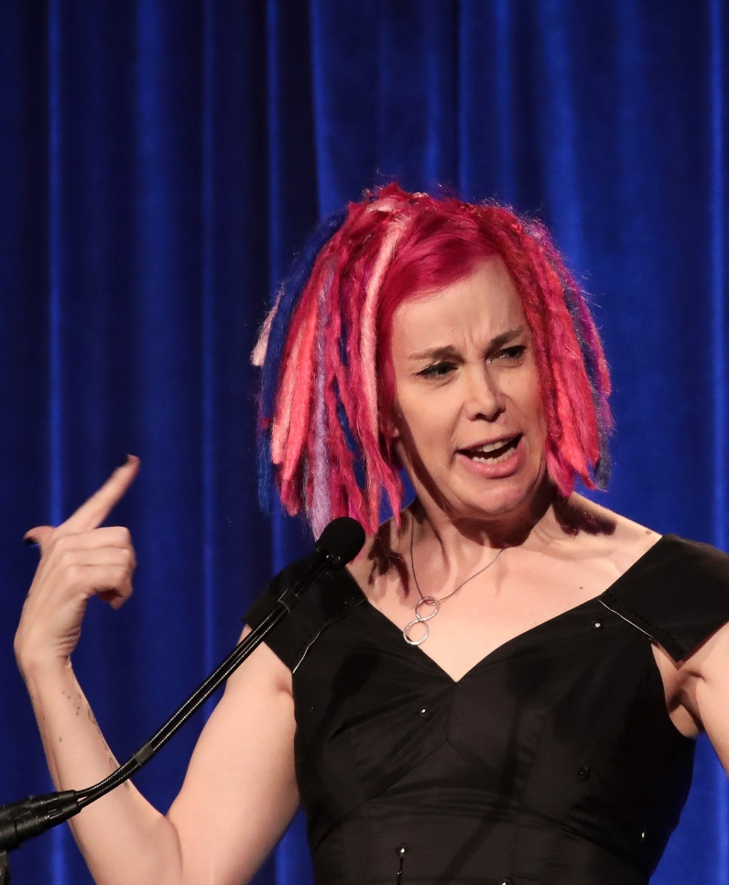
Lana Wachowski
Lana Wachowski is an American film director, screenwriter and producer. Wachowski is a transgender woman. She has had success with films ‘The Matrix’ and ‘Cloud Atlas’ which she produced with her sister Lilly. Lilly is also a transgender woman.
“Art is an invitation to abandon your perspective. Art always says: come with me and look at life in a different way.” – Lana Wachowski

Slide 6
Sally Ride
Sally Ride joined NASA in 1978 and was the first American woman in space in 1983. She was inducted into the National Women’s Hall of Fame and the Astronaut Hall of Fame in recognition of her work as an American physicist and astronaut. Ride wrote a number of science books for children.
“All adventures, especially into new territory, are scary.”
– Sally Ride

Slide 7
Nicola Adams
Nicola Adams is a British professional boxer. She was the first woman to win an Olympic boxing title. She is the 2012 and 2016 Olympic gold medallist in the woman’s flyweight division. Adams is openly bisexual and was named the most influential LGBTQ+ person in Britain in 2012.
“I always look back on the hard times. It’s what gives me the drive and ambition to keep moving forward.” – Nicola Adams

Slide 8
Miley Cyrus
Miley Cyrus is an American singer, songwriter and actor. She was a teen idol starring in the Disney television series Hannah Montana. Cyrus has achieved five number-one singles and eleven top-ten albums. She is a huge supporter of the LGBTQ+ community and set up a foundation ‘The Happy Hippie’ which focuses on youth, homelessness and the LGBTQ+ community.
“Don’t be anything you don’t want to be, always be yourself.” – Miley Cyrus

Slide 9
Caitlyn Jenner
Caitlyn Marie Jenner is an American television personality and retired Olympic gold medal winning decathlete. Jenner publicly revealed her identity as a transgender woman in a Vanity Fair cover story.
“We’re all different. That’s not a bad thing.” – Caitlyn Jenner

Slide 10
Tom Daley
Tom Daley is a British diver. His event is the 10m platform and he competes in the synchronised and team events. He was the world champion for diving in 2009 and 2017. He has created a YouTube channel that features vlogs and fitness videos. It was through this medium that, in 2013, he announced that he was in a relationship with a man. He won the title of Independent Influencer Award at the British LBGT awards in 2017.
“In an ideal world I wouldn’t be doing this video because it shouldn’t matter.” – Tom Daley

Slide 11
Elliot Page
Elliot is a Canadian actor who began his career on Canadian television. He starred in the 2005 drama ‘Hard Candy’ in which he won the best actor award for his role at the Austin Film Critics. In 2007, he played the lead character in the movie Juno and he was nominated for an Academy Award. In 2014, during a speech at the Human Rights Campaign’s ‘Time to Thrive’ conference, he revealed that he was gay. In 2020, Page announced that he is transgender.
“This world would be a whole lot better if we just made an effort to be less horrible to one another.” – Elliot Page

Slide 12
Gareth Thomas
Gareth ‘Alfie’ Thomas is a professional rugby player. He has represented Wales in both Rugby Union and Rugby League. He has played in over 100 test matches and is currently ranked 13th among international try scorers. Thomas announced that he was gay in 2009 and the following year he was voted the most influential gay person in the United Kingdom IoS Pink List and received the Stonewall’s Hero of the Year award.
“I don’t want to be known as a gay rugby player. I am a rugby player, first and foremost I am a man.” – Gareth Thomas

Slide 13
Laverne Cox
Laverne Cox is an actor and LGBTQ+ advocate. She has an identical twin brother and was raised in Alabama by her mother and grandmother. Cox was nominated for a Primetime Emmy Award in the acting category and was the first transgender woman to be nominated since 1990.
“You are worthy… simply because of who you are.” – Laverne Cox

Slide 14
Tim Cook
Tim Cook is an American business executive, industrial engineer and developer. He is currently the Chief Executive Officer of Apple Inc. Cook is known for keeping his private life private and he did not confirm that he was gay until 2014. He publicly supports LGBTQ+ rights. He was the first openly gay CEO on the Fortune 500 list.
“Let your joy be in your journey, not in some distant goal.”
– Tim Cook

Slide 15
Kate McKinnon
Kathryn ‘Kate’ McKinnon is an American comedian, actor and model. She is best known as a regular cast member on Saturday Night Live and The Big Gay Sketch Show. McKinnon is also known for doing impressions. She has received five nominations for Primetime Emmy awards and four for Outstanding Supporting Actress in a comedy series, winning in 2016 and 2017.
“Why punish yourself by trying to be extraordinary or even good or normal? Because the sight of a person who has decided to make their own music is breathtaking.”
– Kate McKinnon

Slide 16
RuPaul
RuPaul Andre Charles is an American drag queen and is thought to be the most successful drag queen of all time. He is an actor, model, singer, songwriter, television personality and author. He has produced and hosted the reality show RuPaul’s Drag Race on the LGBTQ+ network. Charles has played men in a number of roles and makes public appearances both in and out of drag.
"You can call me he. You can call me she. You can call me Regis and Kathie Lee; I don't care! Just as long as you call me." – RuPaul

Slide 17
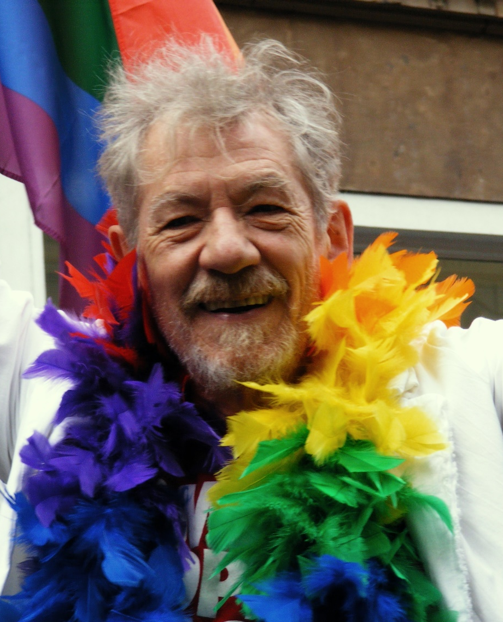
Sir Ian McKellen
Sir Ian McKellen is a British theatre actor who is best known for his portrayal of Gandalf in the Lord of the Rings and the Hobbit films, and Magneto in the X-Men franchise.
After coming out on a radio show in 1988, he has actively and publicly fought for LBGTQ+ rights. In 1989, he co-founded ‘Stonewall’, a UK LGBT rights lobby group. He is also patron of LGBT+ History Month, Pride London, Oxford Pride, GAY-GLOS, LGBT Foundation and FFLAG.
“Be honest with each other. Admit there are limitless possibilities in relationships, and love as many people as you can in whatever way you want…” – Sir Ian McKellen
Man Alive!, CC BY 2.0 <https://creativecommons.org/licenses/by/2.0>, via Wikimedia Commons

