Slide 1
Oswald Road Reception
Welcome Parents / Carers
OSWALD ROAD PRIMARY SCHOOL

Slide 2
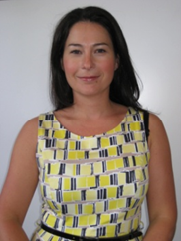
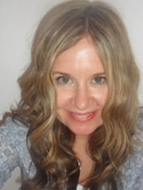
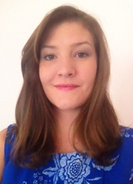
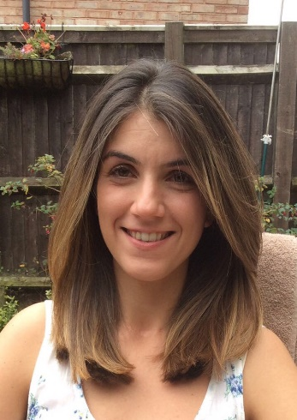
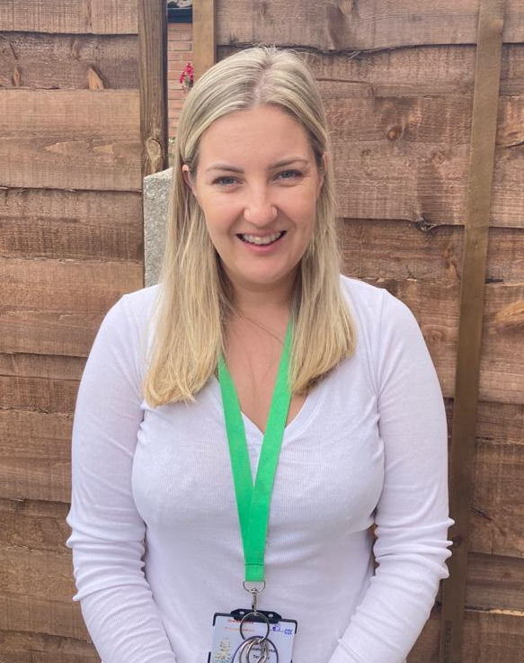
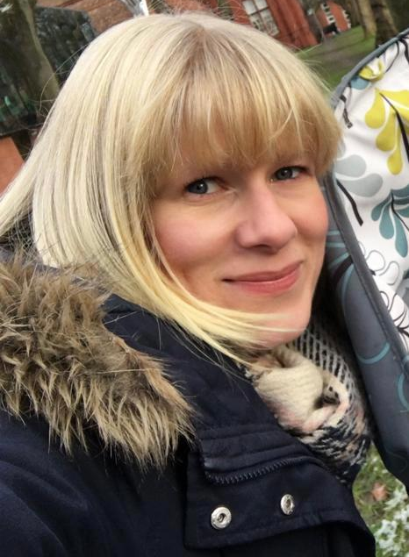
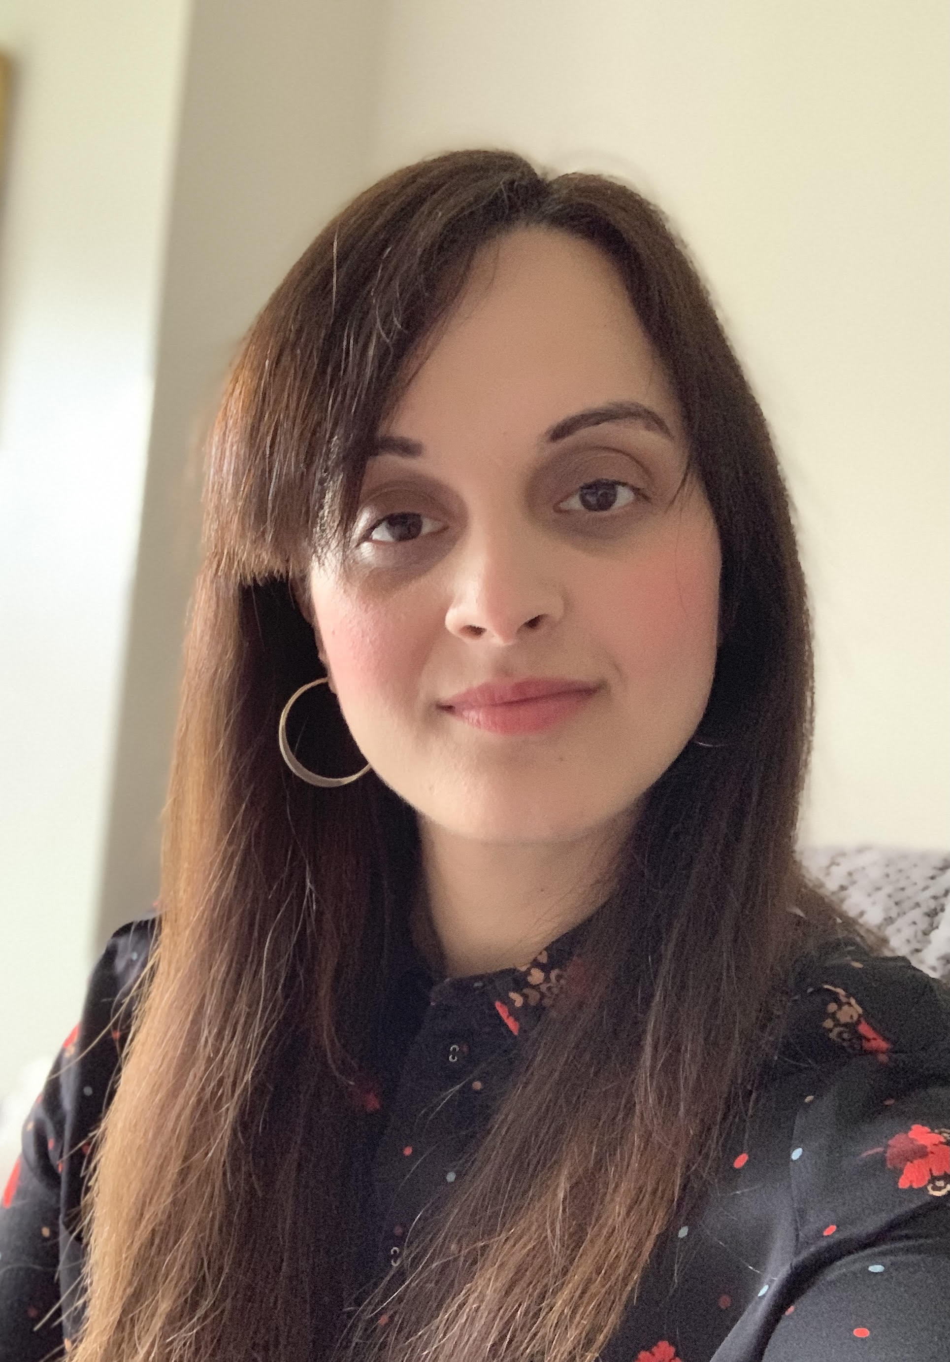
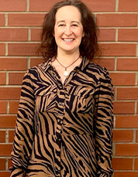
Meet the Team
Deborah Howard- Headteacher
Helen Woolf- Deputy Headteacher & SENCO
Donna Wealleans- Deputy Headteacher, Pastoral & Safeguarding Lead
Laura Tracanna- Assistant Headteacher, EYFS Phase Lead
Natalie Tuton
Reception Teacher
Natalie Hickman
Reception Teacher
Khadijah Iqbal
Reception Teacher
Sarah Greenway
Reception Teacher

Slide 3
Aims:
Here at Oswald Road Nursery we aim to provide the highest quality care and education for all our children thereby giving them a strong foundation for their future learning. We create a safe and happy environment with motivating and enjoyable learning experiences that enable children to become confident and independent. We value the individual child and work alongside parents, carers and others to meet their needs and help every child to reach their full potential.

Slide 4
As part of our practice we . . .
• Deliver an exciting and varied, play-centred curriculum, based on the Early Years Foundation Stage (EYFS), across the 17 areas of learning.
• Promote equality of opportunity and anti-discriminatory practice. We provide early intervention for those children who require additional support and aim to identify those needs as early as possible.
• Work in partnership with parents and develop links in the local community.
• Plan challenging and stimulating learning experiences, based on the individual child, informed by observation and assessment.
• Provide learning experiences developed from child-led ideas.
• Build strong relationships with the children in our care.
• Provide nurturing and inspiring indoor and outdoor learning environments.
• Inspire a love of learning and independence that will remain with them throughout school.

Slide 5
The EYFS Curriculum
The Early Years Foundation Stage (EYFS) is the stage of education for children from birth to the end of the Reception year.
It is based on the recognition that children learn best through play and active learning.

Slide 6
Developed around 4 themes …
1. A unique child: All children are different and we want them to be resilient, capable and confident throughout their learning journey.
2. Positive relationships: Children learn to be strong and independent through this.
3. Enabling Environments: children learn and develop well if this is provided right from the start.
4. Learning and development: All children develop at different rates.

Slide 7
Early Years Curriculum
In September we will be adopting the new statutory curriculum which includes the following areas;
Personal social and emotional development -
Self – Regulation, Managing Self & Building Relationships
Communication and language -
Listening, Attention & Understanding and Speaking
Moving and handling -
Gross Motor Skills and Fine Motor Skills
Literacy –
Reading and Comprehension and Writing
Mathematics -
Number/Numerical Patterns including Shape, Space & Measure
Understanding the world -
Past and Present, People, Culture and Communities & The Natural World
Expressive arts and design -
Creating with Materials & Being Imaginative and Expressive
The characteristics of learning haven’t changed and will continue to form the basis of our practice.

Slide 8
Early Years Curriculum
Throughout the year we will be conducting a variety of parent workshops to give you an overview of how we teach the different areas of learning in Reception.
The workshops will be based around our literacy, mathematics and phonics.
You will receive a letter usually around 2/3 before the workshop will take place inviting you to attend.
Parents have always given us positive feedback around the workshops and feel they really help when supporting their child at home.

Slide 9
Reception Baseline
The reception baseline assessment will provide the basis for a new way of measuring the progress primary schools make with their pupils.
Following a successful national voluntary pilot, the reception baseline assessment will be statutory in schools from September 2021.
The assessment framework provides details about the assessment, including information about the content of the assessment and its design.
https://www.gov.uk/government/publications/reception-baseline-assessment-framework
This will be conducted within the first two – three weeks of the children being in school.

Slide 10
General Information which could change depending on Covid regulations at the time.
School day 8:55am-3:25pm (doors open at 8.45am)
We have currently adopted a staggered drop off and pick up routine due to Covid regulations. This is in line with the schools Covid policy. If this continues in the new academic year, then we will be in touch to confirm your child’s start and pick up time.
Drop off times are between 8.45 and 8.55 and pick up times are between 3.15 and 3.25.
Children are usually dropped off and picked up from their classroom.
Due to Covid children are currently being dropped off and picked up from the red gate on Nicolas Road. We will confirm this before the new academic year.
Children arriving after 9.00am must sign in at the school office.

Slide 11
General Information
Lunch time 11:30am – 12.30pm.
Daily fruit and milk will be provided but milk needs to be ordered from the school office.
If someone else if picking up your child, please make sure the class teacher is aware of this and provide your pickup password.
All medicines (besides inhalers) must be kept in the school office and cannot be administered without consent (medical form)
School jumpers: although there is no uniform, each child is required to have a school branded jumper for when we go on trips.

Slide 12
What your child will need
A book bag. Reading books will be changed once a week and children must have their books in on the correct day.
Comfortable, durable clothes suitable for indoor and outdoor play in all weather including sensible shoes.
A spare set of clothes, labelled, to be kept on your child’s peg.
If your child is on packed lunch, please ensure it has their name on it.
Feel free to bring in books to be shared with the class but please don’t bring toys into school.

Slide 13
Transition to Reception- How can you help?
Use our school website as a talking point with your child.
Go for a walk past our school grounds to familiarise your child with their new setting.
Fill in your ‘All About Me’ sheet with your child.
Highlight any similarities between their current setting and their new Reception class.
Encourage children to practise using the toilet independently and to put on coats and jumpers without support.
Encourage children to write their first name.
Talk about any friends who you know may be joining at the same time.

Slide 14
A Typical Day in Reception…
Children learn through a range of whole class, small group and individual sessions.
Over the week we cover all 17 areas of the curriculum both indoors and outdoors. These activities are usually based on our ‘book of the week’.
Children complete 3 independent activities every day called ‘challenges’ and one adult led focus across the week.
Children have access to continuous provision indoors and outdoors which consolidates and extends whole class learning.
Phonics is taught as a full class for 20 minutes each day.

Slide 15
Your child’s first week…
School will reopen on Friday 3rd September at 8.45am.
Children will complete full time days from the beginning of the year.
Each child will have their own coat peg.
We will be doing lots of PSHE, ‘getting to know you’ activities, learning new routines, making new friends.
The children will have lunch in the dining hall – we will be on hand to support them with this for the first week

Slide 16
Tapestry Online Journal
Each Reception child will have their own Tapestry online learning journey, chronicling their achievements over the year.
You will receive information about registering your email for your child’s account and for children already in our Nursery, the children’s current journals will just continue into Reception.
Parental engagement is a huge part of EYFS and here at Oswald Road it is vitally important to us to celebrate the children’s achievements .
We will have drop-in workshops for any difficulties with set up and uploading observations.

