Slide 1
Oswald Road Nursery
Welcome Parents / Carers
OSWALD ROAD PRIMARY SCHOOL

Slide 2
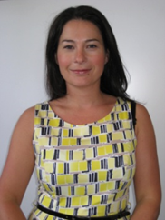
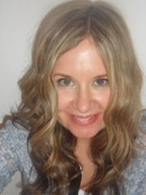
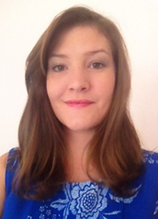
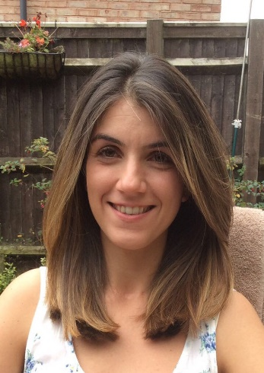
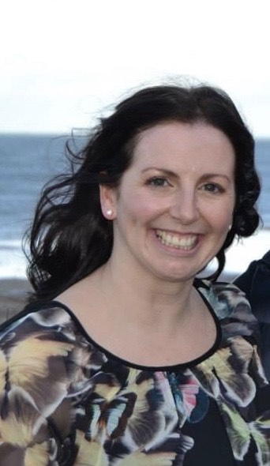
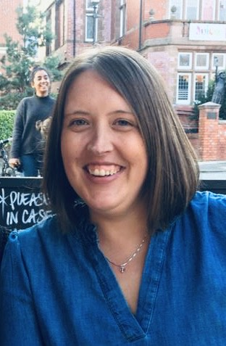
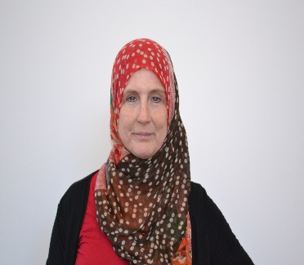
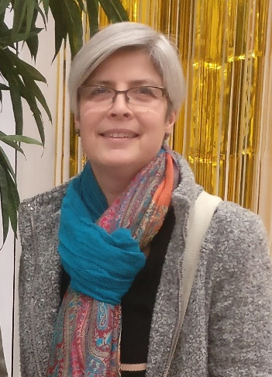
Meet the Team
Deborah Howard- Headteacher
Helen Woolf- Deputy Headteacher & SENCO
Donna Wealleans- Deputy Headteacher, Pastoral & Safeguarding Lead
Laura Tracanna- Assistant Headteacher, EYFS Phase Lead
Kathryn Ben Halima
Nursery Teacher
Jen Dyson
Nursery Teacher
Rose Hassan-
Nursery TA
Karen Whittick-
Nursery TA

Slide 3
Aims:
Here at Oswald Road Nursery we aim to provide the highest quality care and education for all our children thereby giving them a strong foundation for their future learning. We create a safe and happy environment with motivating and enjoyable learning experiences that enable children to become confident and independent. We value the individual child and work alongside parents, carers and others to meet their needs and help every child to reach their full potential.

Slide 4
As part of our practice we . . .
• Deliver an exciting and varied, play-centred curriculum, based on the Early Years Foundation Stage (EYFS), across the 17 areas of learning.
• Promote equality of opportunity and anti-discriminatory practice. We provide early intervention for those children who require additional support and aim to identify those needs as early as possible.
• Work in partnership with parents and develop links in the local community.
• Plan challenging and stimulating learning experiences, based on the individual child, informed by observation and assessment.
• Provide learning experiences developed from child-led ideas.
• Build strong relationships with the children in our care.
• Provide nurturing and inspiring indoor and outdoor learning environments.
• Inspire a love of learning and independence that will remain with them throughout school.

Slide 5
The EYFS Curriculum
The Early Years Foundation Stage (EYFS) is the stage of education for children from birth to the end of the Reception year.
It is based on the recognition that children learn best through play and active learning.

Slide 6
Developed around 4 themes …
1. A unique child: All children are different and we want them to be resilient, capable and confident throughout their learning journey.
2. Positive relationships: Children learn to be strong and independent through this.
3. Enabling Environments: children learn and develop well if this is provided right from the start.
4. Learning and development: All children develop at different rates.

Slide 7
Early Years Curriculum
In September we will be adopting the new statutory curriculum which includes the following areas;
Personal social and emotional development -
Self – Regulation, Managing Self & Building Relationships
Communication and language -
Listening, Attention & Understanding and Speaking
Moving and handling -
Gross Motor Skills and Fine Motor Skills
Literacy –
Reading and Comprehension and Writing
Mathematics -
Number/Numerical Patterns including Shape, Space & Measure
Understanding the world -
Past and Present, People, Culture and Communities & The Natural World
Expressive arts and design -
Creating with Materials & Being Imaginative and Expressive
The characteristics of learning haven’t changed and will continue to form the basis of our practice.

Slide 8
General Information which could change depending on Covid regulations at the time.
School day 8:55am-3:15pm (doors open at 8.45am)
We have currently adopted a staggered drop off and pick up routine due to Covid regulations. This is in line with the schools Covid policy. If this continues in the new academic year, then we will be in touch to confirm your child’s start and pick up time.
Drop off times are between 8.45 and 8.55 and pick up times are between 3.15 and 3.25.
Children are usually dropped off and picked up from their classroom.
Due to Covid children are currently being dropped off and picked up from the staff car park. We will confirm this before the new academic year.
Children arriving after 9.00am must sign in at the school office.

Slide 9
A typical day in Oswald Road Nursery . . .
Welcome to parents and children/ start of day task
Teaching groups for registration and teaching session
Continuous Provision – inside and outside
Snack Times- milk and fruit provided
Phonics
Preparation for lunch
Story
Lunch time is at 11.30am – 12.30pm
Teaching session
Continuous Provision – inside and outside
Singing / Nursery rhymes
End of day
The areas in nursery allow for opportunities to; mark-make, take part in physical activity, construction, be creative, investigate numbers and shapes, explore properties of water and sand, role play, listen and talk, share books, appreciate music and make friends.

Slide 10
How can you begin preparing your child?
Use the ‘Starting School’ page on our school website and look through our webpage with your child.
Ensure good routines are established over summer Eg. early bedtimes, less afternoon naps, beginning to collect their own coats for outdoor play.
Toileting- ensure children are being encouraged to toilet independently or at least tell an adult when they need to go.
Talk about the importance of trying different foods and look at meals that we provide in school if you are going to opt for school dinners.

Slide 11
Things To Remember
Please ensure children have a bag of spare clothes on their peg with their name clearly labelled.
We ask that all children have a red school jumper to wear on school trips and any school outings around the local area (available from school office).
Book bags are also available from the school office. We give out lots of letters and this is also a good place for children to place their pictures that they want to take home etc.
Punctuality is really important: Please ensure your child is dropped off on time and is collected promptly. Our attendance officer monitors attendance and punctuality.
Please ensure your child is sent in with a warm coat with a hood if possible. We do play outside in all weathers.
Pick up passwords: we will not dismiss children without this being issued (form can be found in your welcome pack).

Slide 12
Tapestry Online Journal
All of your child's achievements will be recorded in their own personal online journal.
You will be sent an activation email once the children begin in September and you will have 48 hours to activate.
You will receive direct notifications when an observation for your child has been added to their journal.
You will also be able to add observations of your child from home.

