Slide 1
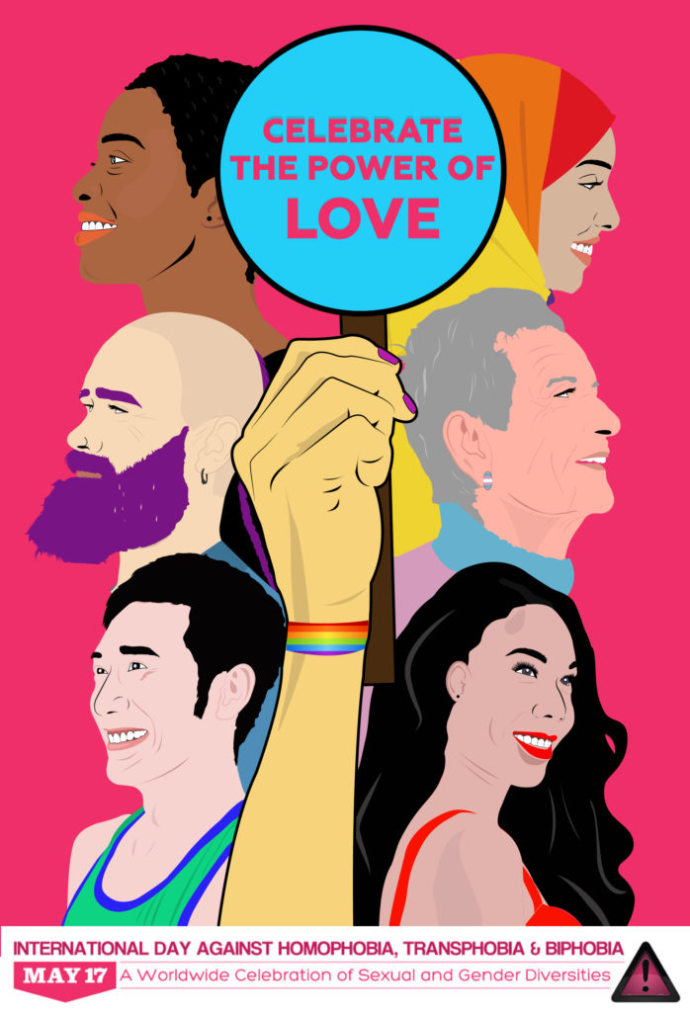
RSE Day 2021 – ‘Faces’
The theme of this year’s RSE Day is ‘Faces’ and we’d like to take this opportunity to look at some of the faces in our community that are often less visible.
This session is a celebration of sexual and gender diversity.
To help celebrate, let’s look at LGBT+ representation.

Slide 2
LGBT+
What do these letters mean?
L = Lesbian – Women who are attracted to women.
G = Gay – People who are attracted to other people of the same gender as themselves.
B = Bisexual – People who are attracted to people of their own gender and other genders.
T = Trans – People whose gender is different to the one they were assigned at birth. This includes men, women, and non-binary people.
+ – We use a plus sign to include anyone not included under LGBT, for example pansexual people, asexual people, intersex people, or those questioning their gender or sexual identity.
Notes:
Non-binary - People whose gender is outside the binary of “man” and “woman”.
Pansexual – People who are attracted to people of all genders; or people who are attracted to people regardless of their gender.
Asexual – People who do not have sexual attraction.
Intersex – People who do not fit neatly into the biological sex categories of “male” and “female”

Slide 3
How many famous LGBT+ people can you name?
L
G
B
T
+

Slide 4
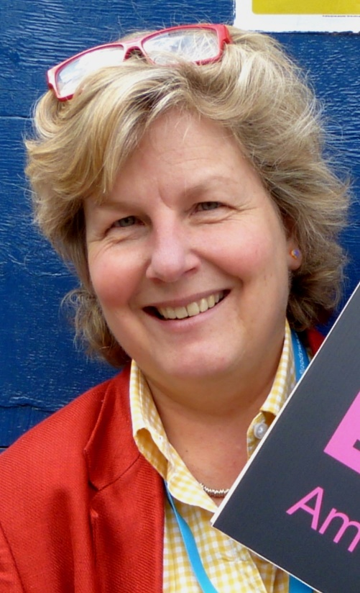
Who am I?
Sandi Toksvig
I’m a lesbian.
I was born in Denmark but I live in Britain.
I’m a comedian and TV presenter.
I’m a political activist and founded the ‘Women’s Equality Party’.
I used to host the Great British Bake-Off, and I took over from Steven Fry as the presenter of QI.

Slide 5
Who am I?
I’m trans.
I’m an actress.
I’m the first openly transgender person to appear on the cover of a Cosmopolitan magazine.
I campaign for LGBT+ equality.
I am most famous for playing a trans character in ‘Orange is the New Black’.
Laverne Cox

Slide 6
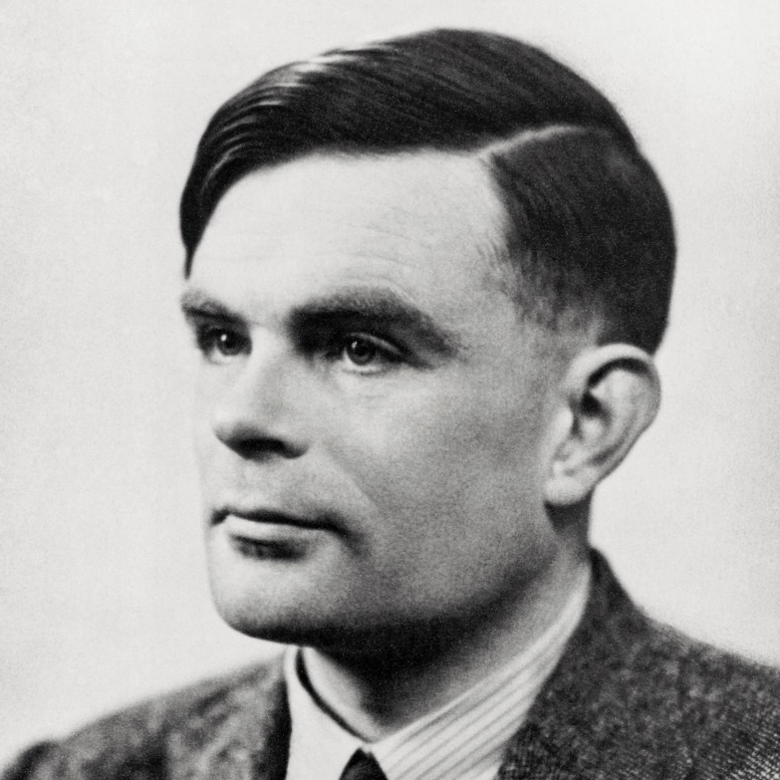
Who am I?
I’m gay.
I was born in 1912 and died in 1954.
My face appears on the back of the latest £50 note.
I’m a mathematician, computer scientist, and philosopher.
I cracked the German ‘Enigma code’ which helped win the second world war.
Alan Turing

Slide 7
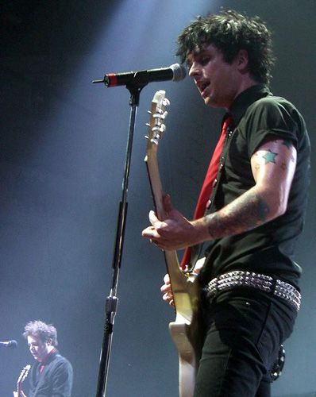
Who am I?
Billie Joe Armstrong
I’m bisexual.
I’m a singer and guitarist.
I’m from California.
My music has been adapted into a musical called ‘American Idiot’.
I’m in a punk band called Green Day.

Slide 8
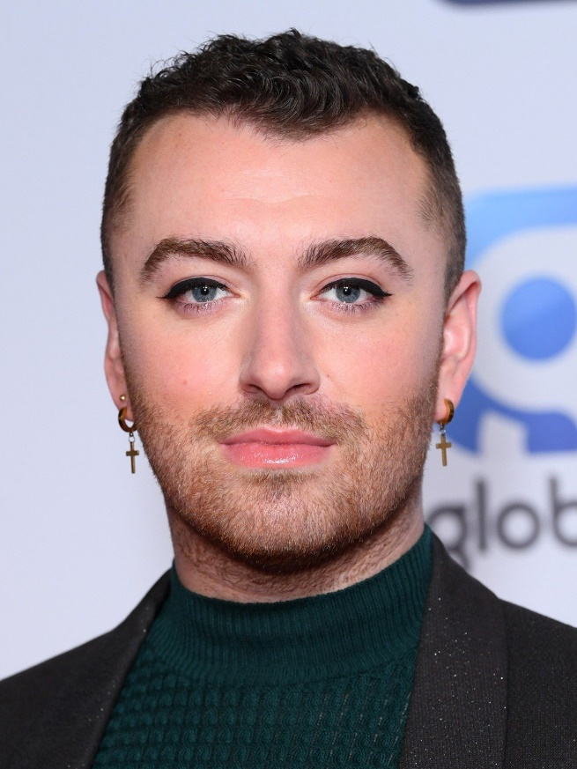
Who am I?
Sam Smith
I’m non-binary.
I’m from England.
I’m a singer-songwriter.
I have won 4 Grammy Awards, 3 Brit Awards, and a Golden Globe.
One of my most famous songs is called ‘Stay with Me’.

Slide 9
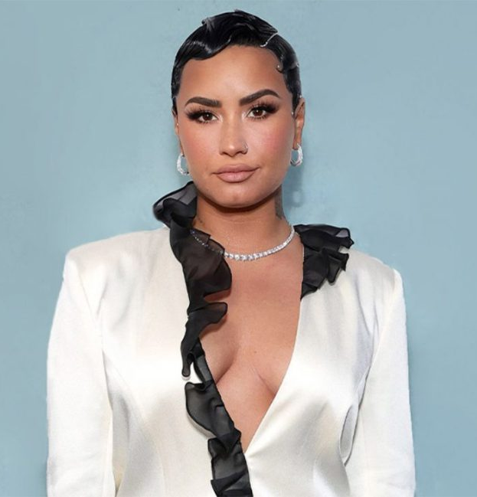
Who am I?
Demi Lovato
I’m pansexual and non-binary.
I’m a singer and songwriter.
I also act.
I am the youngest judge ever to appear on X Factor.
My latest album is called ‘Dancing with the Devil ... the Art of Starting Over’.

Slide 10
Representation
LGBT+ representation means:
Seeing more LGBT+ people positively represented in the media.
Seeing more LGBT+ people across society.
Seeing more positive stories about LGBT+ people’s lives.

Slide 11
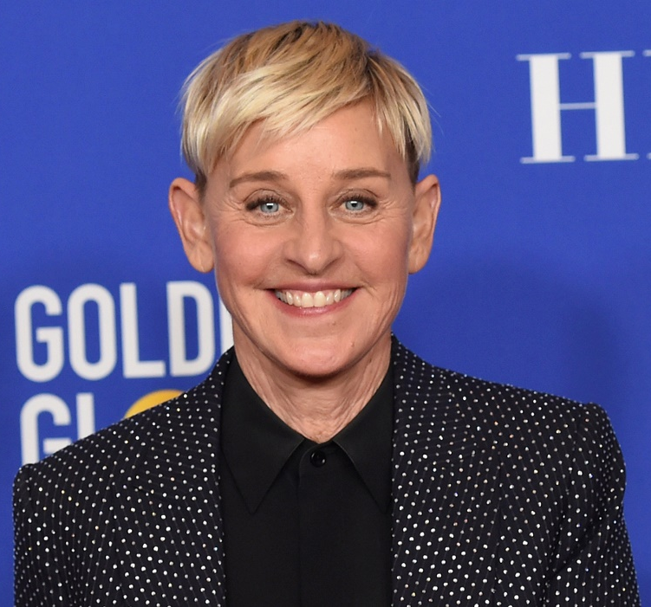
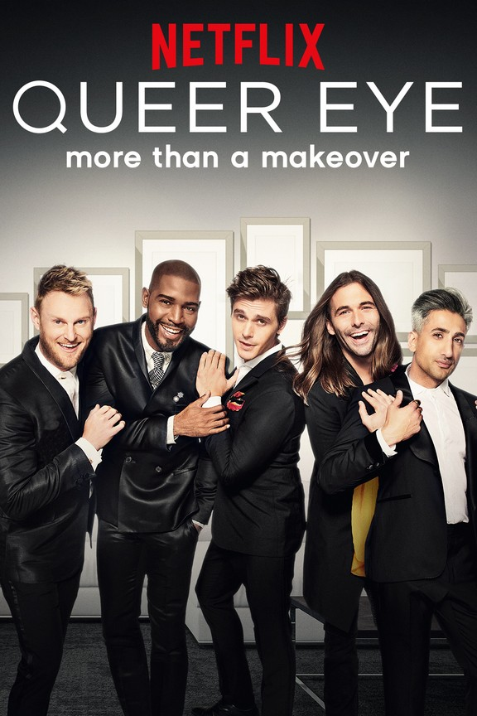
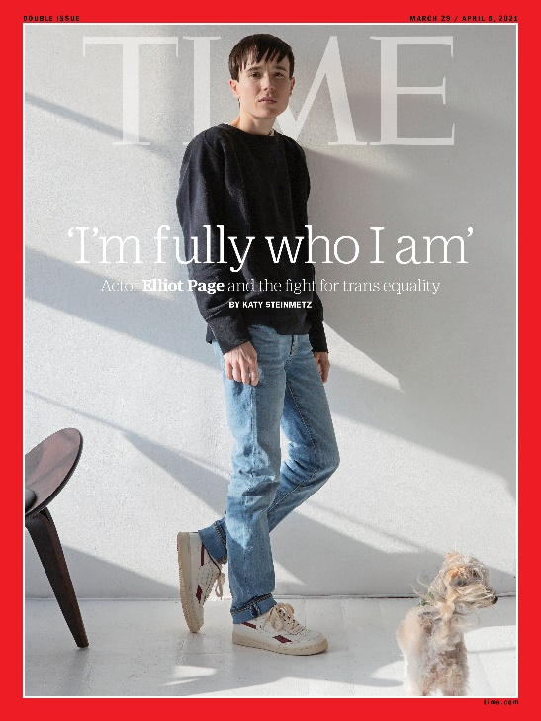
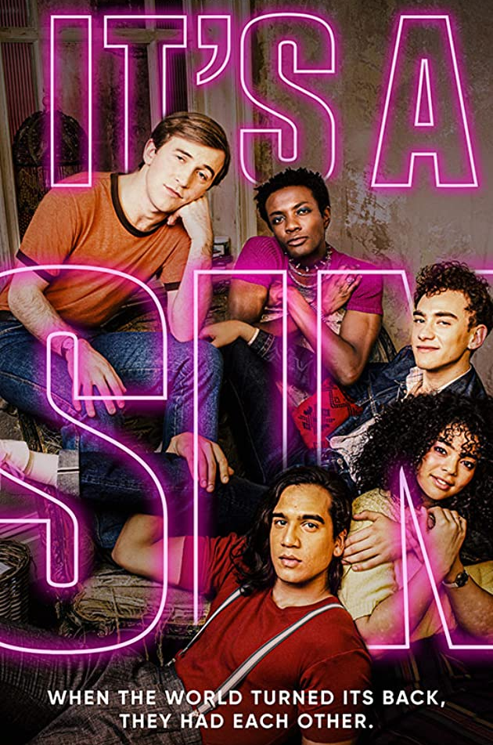
Representation
Representation of LGBT+ people has increased in recent years!

Slide 12
In Film...
Actor Elliot Page recently featured on the cover of Time magazine after coming out as trans.

Slide 13
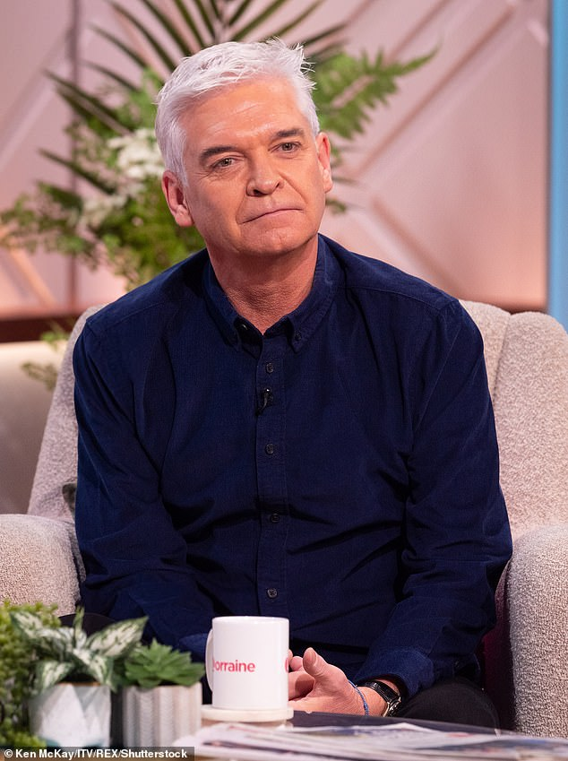
In TV...
Recent TV show ‘It’s a Sin’ decided to only cast gay actors to play gay characters.
Last year, presenter Philip Schofield came out as gay live on TV.

Slide 14
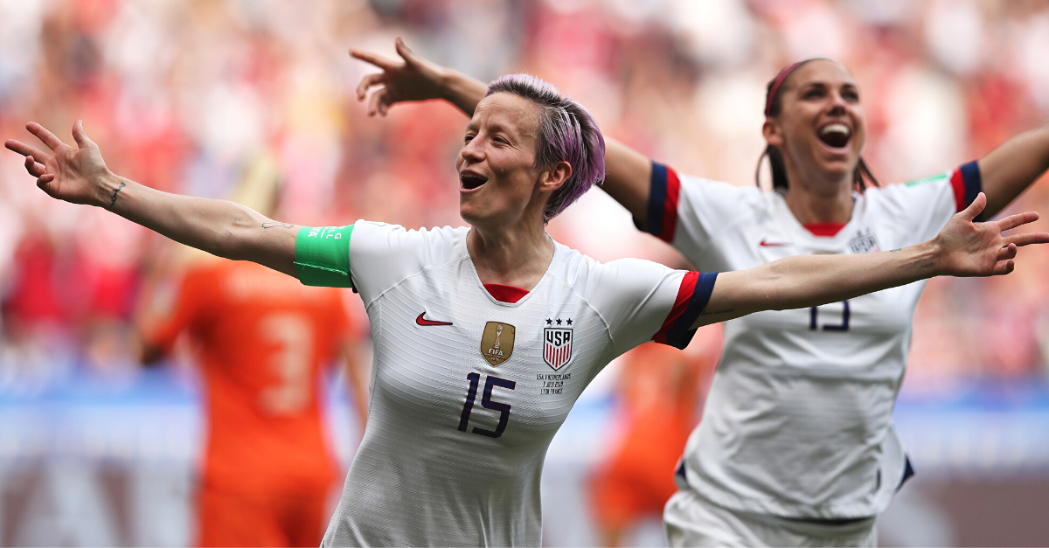
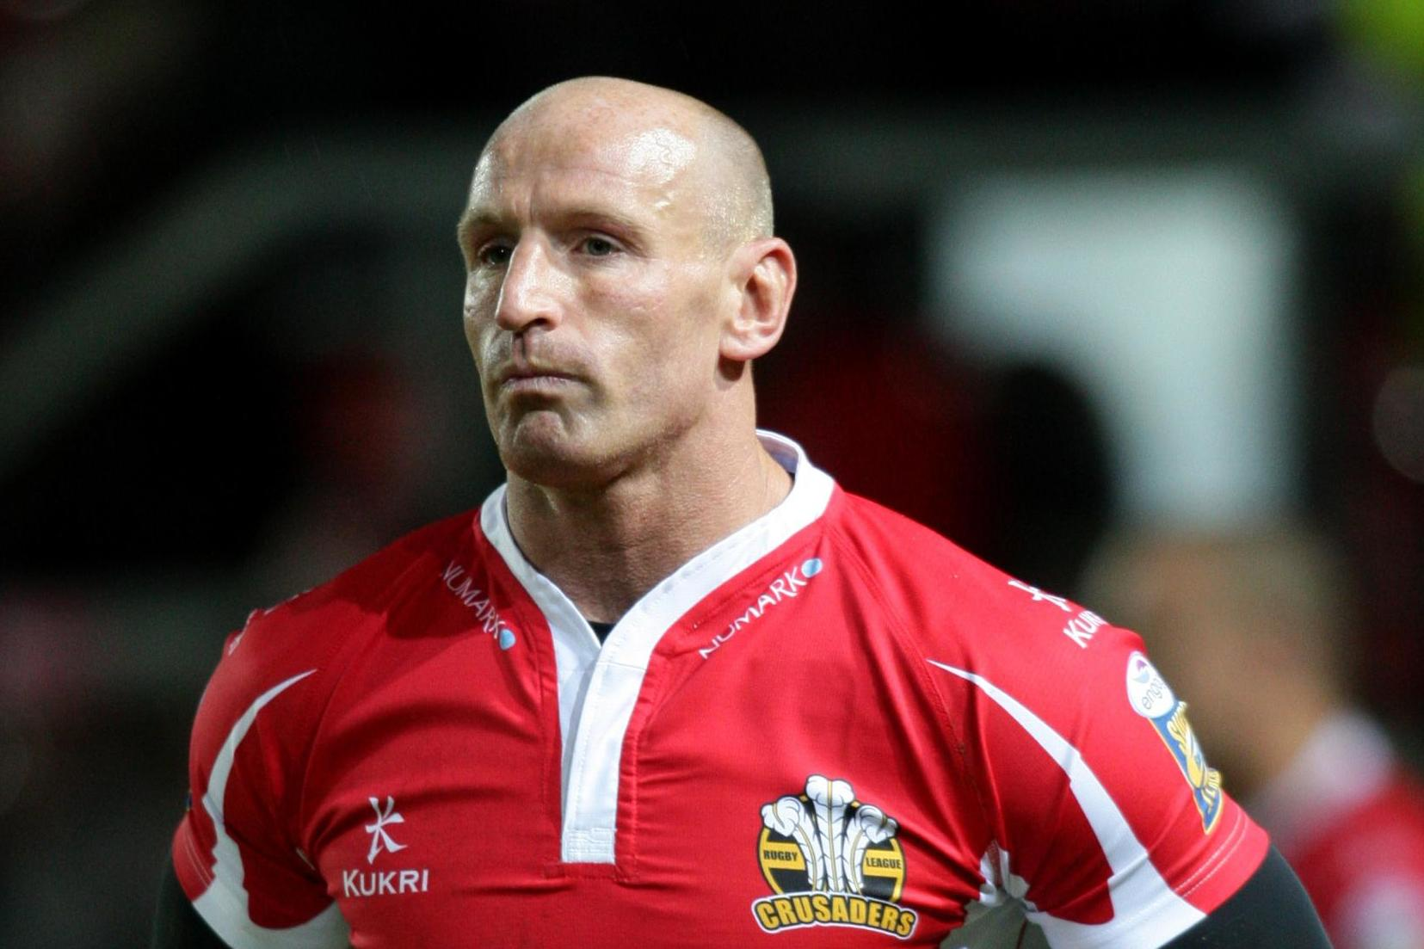
In Sport...
Megan Rapinoe, a footballer, and a lesbian, made Time magazine’s 2020 list of 100 most influential people for her LGBT+ activism.
Rugby player, Gareth Thomas, came out as gay in 2009. In 2020 he was given a CBE for his services to sport and health.

Slide 15
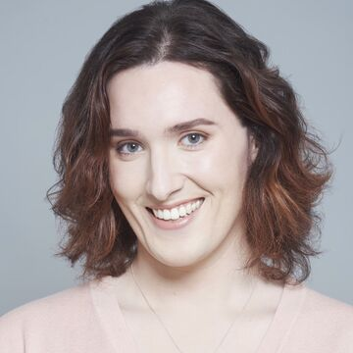
In Online Entertainment...
This year, popular British YouTuber Abigail Thorn came out as trans.

Slide 16
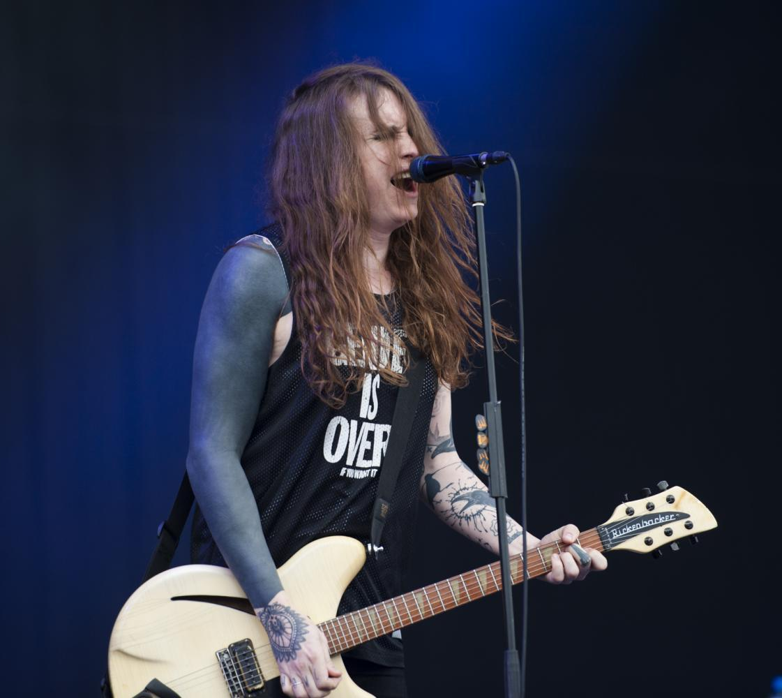
In Music...
Sam Smith is a singer who came out publicly as non-binary in 2019.
Laura Jane Grace is a singer and guitarist in a punk band called ‘Against Me’. She has also written a book about her experiences as a trans woman.

Slide 17
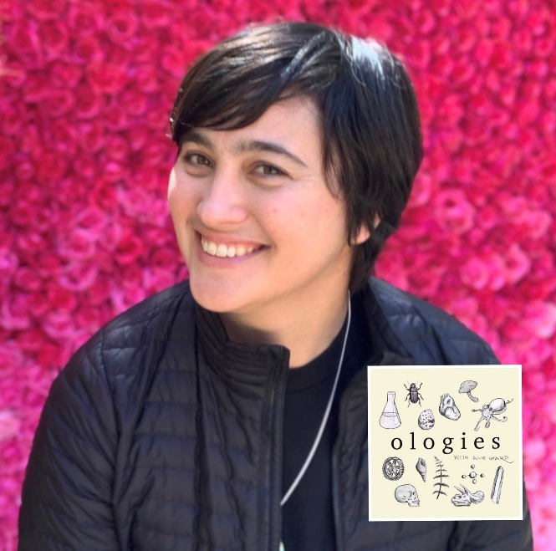
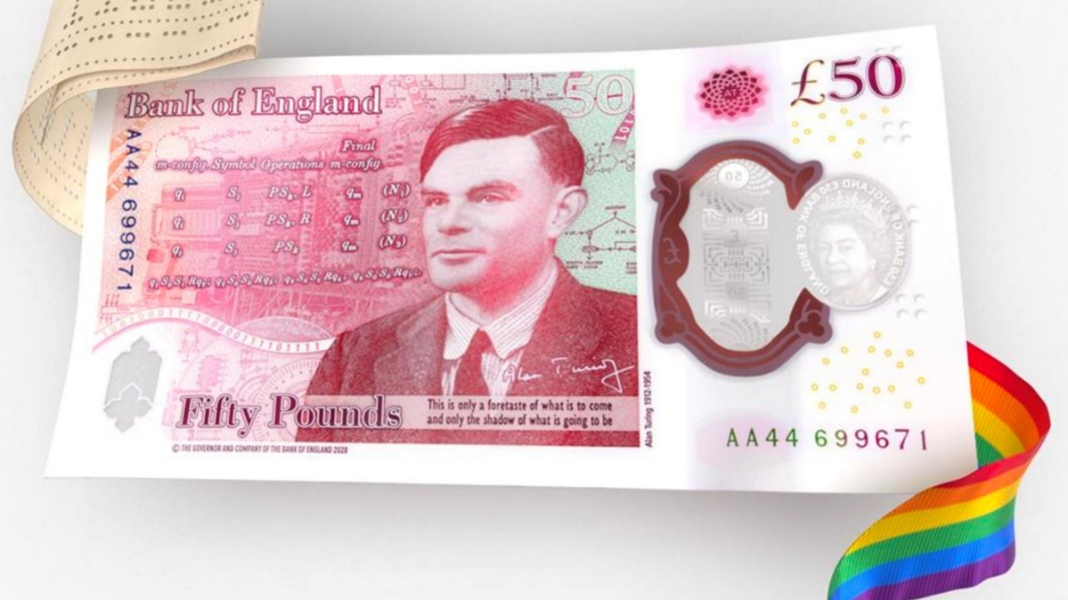
In Science...
Computer Scientist Alan Turing is being recognised by putting his face on the new £50 note.
Lauren Esposito is a scientist at the California Academy of Sciences. She is the co-founder of the network ‘500 Queer Scientists’.

Slide 18
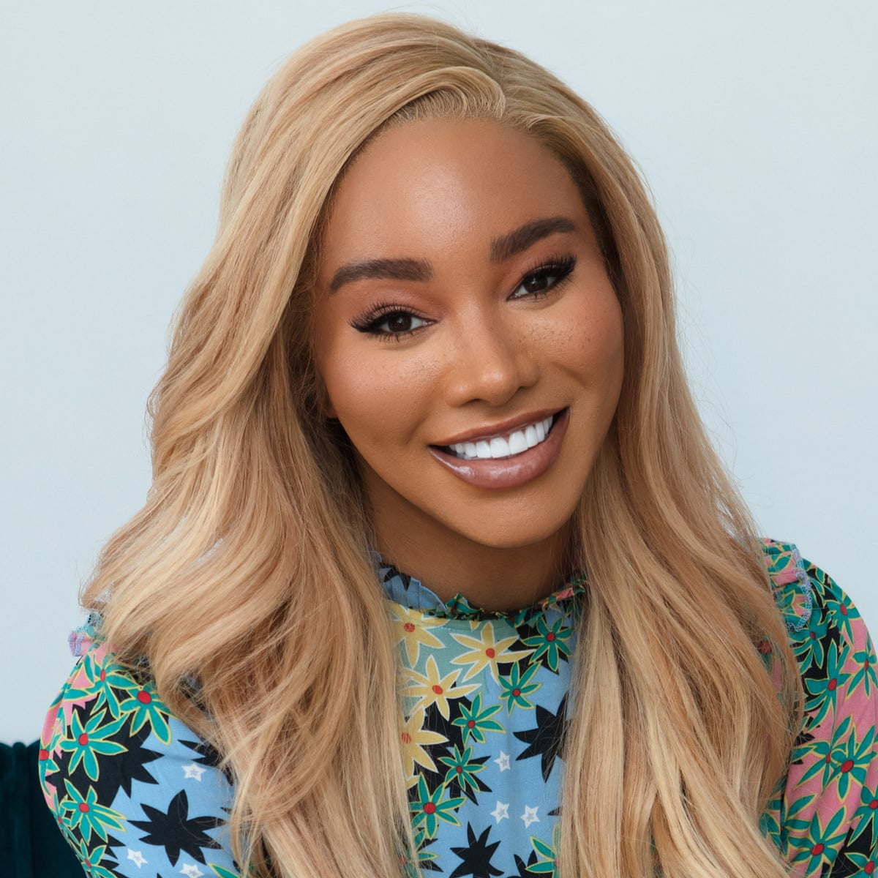
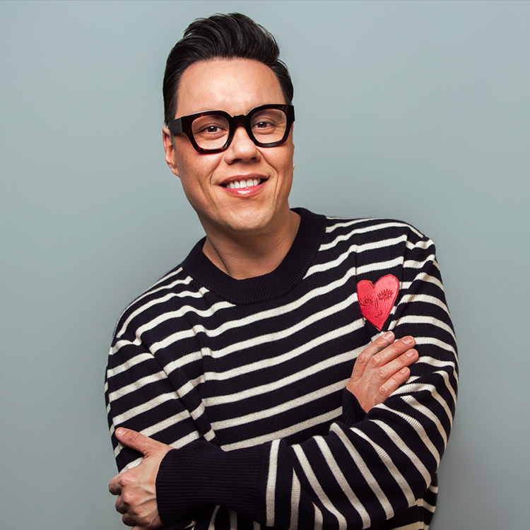
In Fashion...
Gok Wan is fashion consultant and TV presenter. In 2014, he was named in the top 10 on the World Pride Power list.
Munroe Bergdorf is a trans model and activist. She won ‘Changemaker of the Year’ at the 2018 Cosmopolitan Awards.

Slide 19
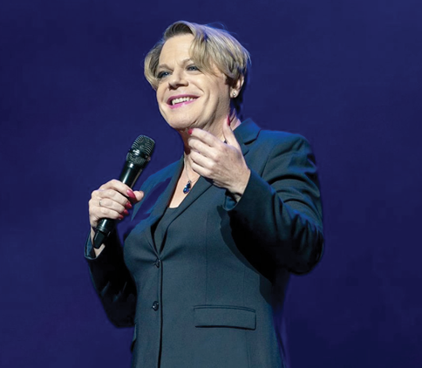
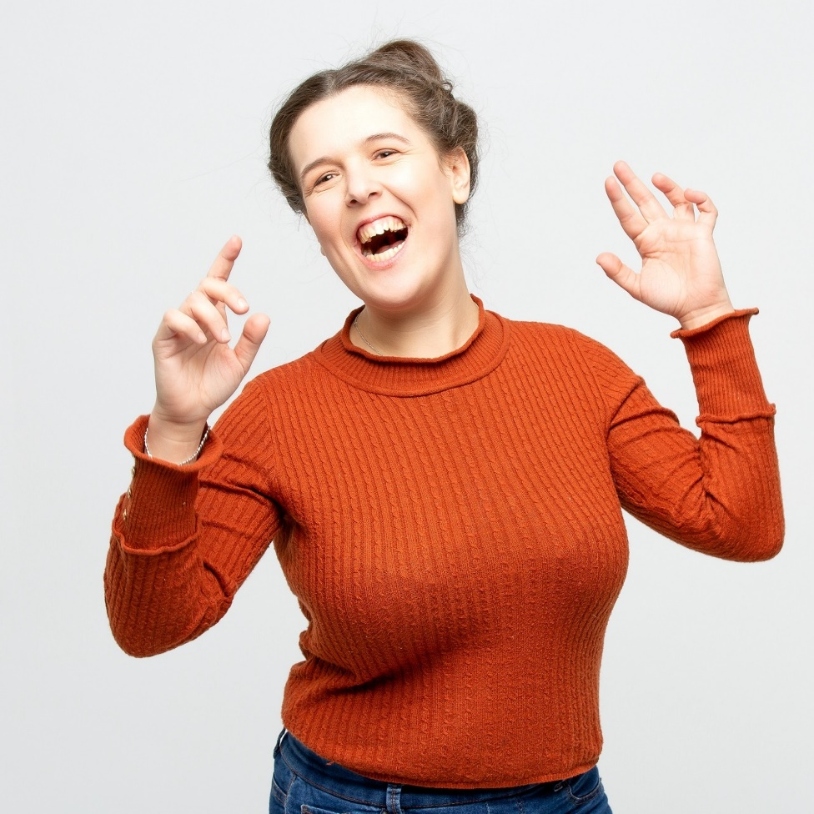
In Comedy...
Rosie Jones is a comedian. She has talked openly in the media about her cerebral palsy and about being a lesbian.
Eddie Izzard is a comedian, actor, writer, and activist. In 2009, she completed 43 marathons in 51 days for Sport Relief.

Slide 20
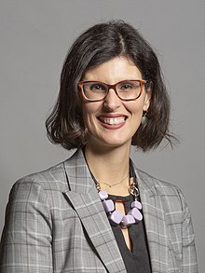
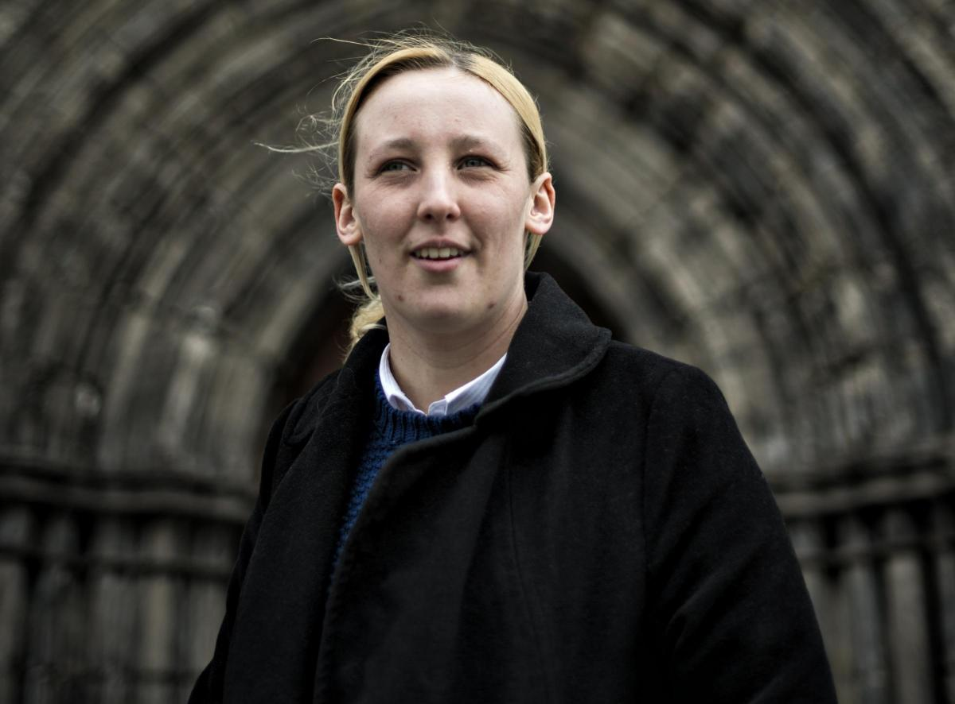
In Politics...
Mhairi Black, a lesbian, became the youngest ever MP when she was elected in 2015.
In 2020, MP, Layla Moran came out as pansexual.

Slide 21
Representation
It wasn’t always like this...

Slide 22
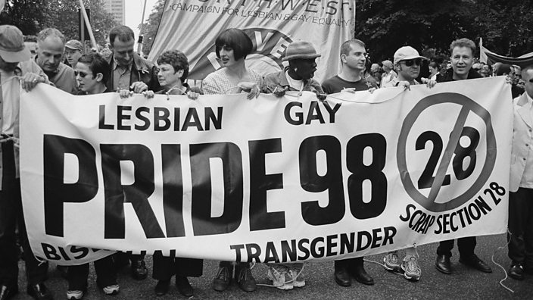
Representation
It used to be much less common to see successful LGBT+ people in the media.
Until 2003, there was an LGBTphobic law that prevented schools from talking about these identities.

Slide 23
We still have a long way to go!
There is still underrepresentation of LGBT+ People of Colour and LGBT+ people of faith.
LGBT+ people are still underrepresented in the TV and Film industry, especially in the top positions.
There has never been an openly trans MP.
There are currently no openly gay men’s footballers in the Premier League.
Less than 60% of LGBT+ people in STEM are out.
LGBT+ people, and especially LGBT+ women, are still underrepresented in business.
There are often less trans, non-binary, bisexual people and lesbians represented in the media than gay men.

Slide 24
Why do you think representation is important?

Slide 25
Why is it important?
So LGBT+ people have role models to inspire them
“If you can see it you can be it”
Break down stereotypes
More accurate depiction of real life
Make everyone feel more included in society
Give confidence to young LGBT+ people

Slide 26
What can be done to improve representation in your school?
Over to you…

Slide 27
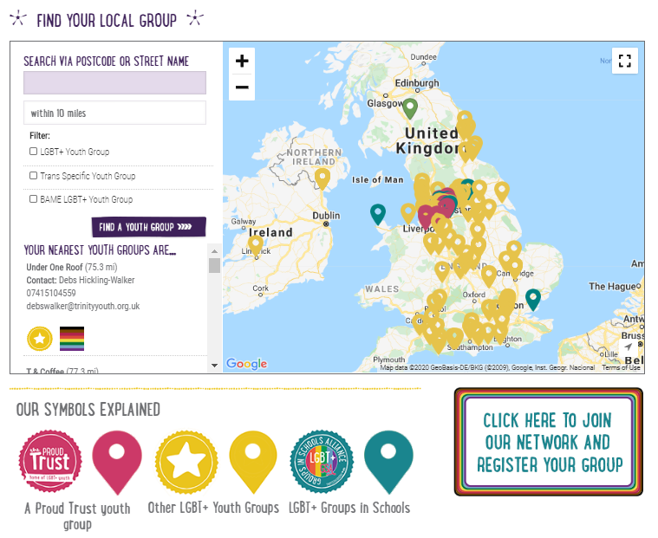
Find your local group for lesbian, gay, bisexual and trans (LGBT+) young people via The Proud Trust website:
www.theproudtrust.org

