Slide 1
Maya’s rock survey
By Maya Ellis

Slide 2
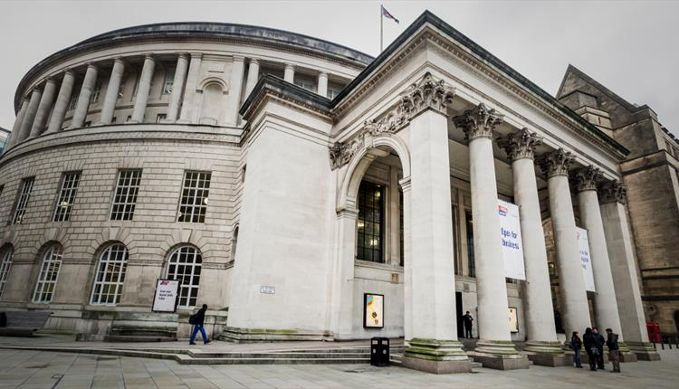
Central library
This is Central library in Manchester
I like to go to Central library because I like the books that are there
Central library is made out of a kind of rock called Portland rock
I hope I go again very soon!

Slide 3
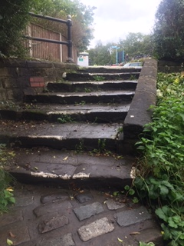
An eroded set of steps
This is an old set of steps
As you can see these steps have been eroded by people’s feet
As time goes by and as people walk on these steps, it creates a curve. This is called erosion

Slide 4
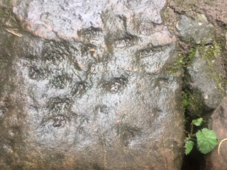
Interesting eroded walls to look at
This wall has also eroded
This wall has been eroded not by feet by weather

Slide 5
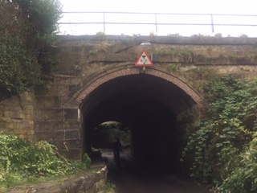
Use of different types of rocks
This is a bridge
As you can see this bridge has bricks and BIG stones
Brick is not a naturally formed rock it is man made

Slide 6
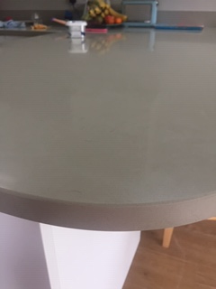
Rock in the house!
This is our breakfast bar
It is made out of quartz so it makes it very strong

Slide 7
The End!

