Slide 1
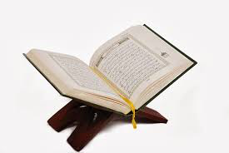
The Qur’an
Lucy Marchant

Slide 2
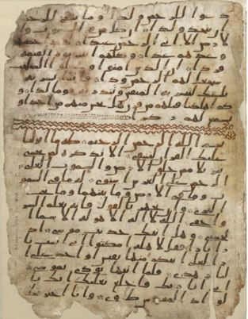
القرآن
The Qur’an
According to tradition, several of Muhammad’s companions wrote down the revelations. Shortly after his death, the Qur’an was put together by his companions, who had written down or memorized parts of it.
This is a page of the Hijazi Qur’an now in Birmingham, from roughly 600CE, one of the oldest in the world!

Slide 3
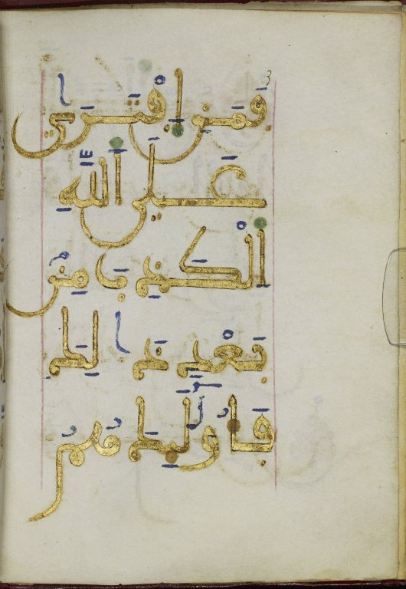
This is a page from a Qur’an written in real gold on parchment (animal skin from a cow, sheep or goat). It was made in North Africa or Spain (we know this because of the handwriting). It was written in around 1,000 CE. It is now at the John Rylands Library.

Slide 4
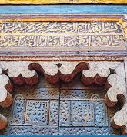
This is a part of the Qur’an written on the Sultan Hassan Mosque in Cairo, Egypt. It was built in 1356-1363 CE

Slide 5
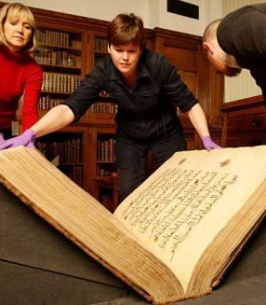
Carol, Elaine and Jamie are getting a giant Qur’an ready for photographing.

Slide 6
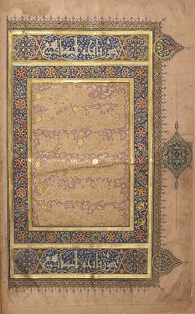
This is one of the pages of it. The book measures 876mm x 592mm (5280cm²), has 470 thick pages and weighs 52kg. It is from the late 14th century. It was made in Egypt.

