Slide 1
World Down Syndrome day!
By Florence

Slide 2
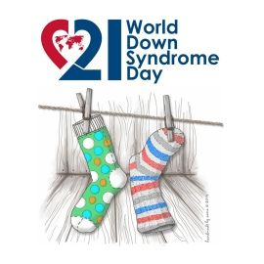
World Down Syndrome day is a day to represent people with Down Syndrome. People like to wear odd socks to celebrate this day.

Slide 3
This is my brother Benjamin. He has down syndrome.

Slide 4
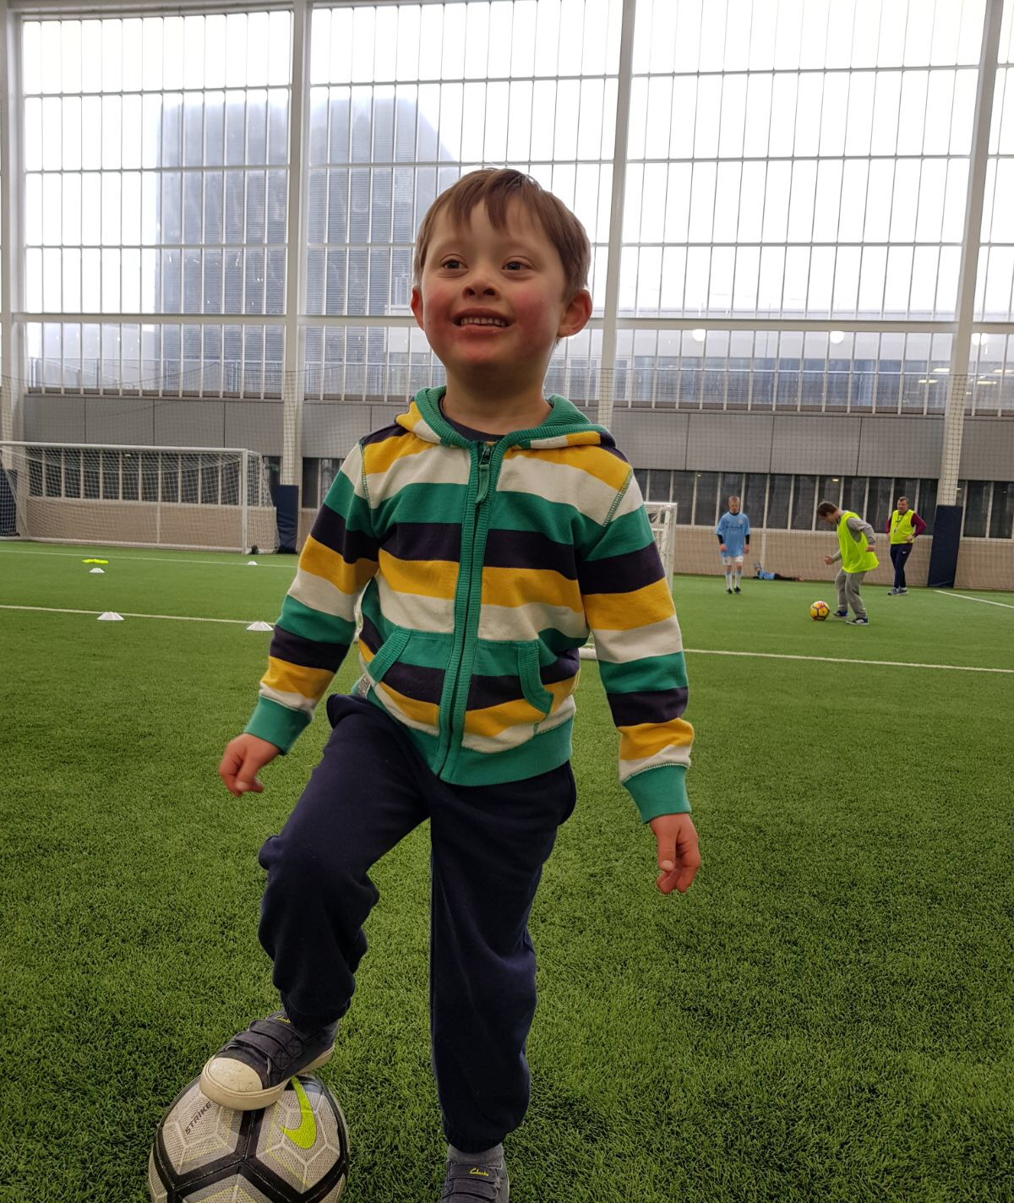
Benjamin is playing football. This shows that just because he has a disability doesn't mean he can’t do anything other people can.
He is playing at Man City!

Slide 5
What is Down Syndrome?
The human body is made up of cells which include chromosomes. Down Syndrome is caused by an extra chromosome in a baby’s cells.
Around 1 in every 1000 babies born have Down Syndrome
Down Syndrome is not a disease and people with Down Syndrome are not ill.

Slide 6
This is the World Down Syndrome day logo:
World down syndrome day is on the 21st March every year. That is why there is a 21 in the logo.

Slide 7
Down Syndrome affects people of all races, male and female and in all countries in the world. It can happen to anyone. People with Down Syndrome have some learning disability. That means that they may need more help to learn things and take a bit longer to learn. People with Down Syndrome often have difficulties talking so you need to give them more time and listen carefully. People with Down Syndrome are good at lots of different activities, have friendships and get jobs when they are older. It is very important for people with Down Syndrome to be included and treated the same as everyone else. You should never stare at someone with a disability because its makes them feel uncomfortable.

Slide 8
If you’re nervous about standing up for someone with a disability, then just think, If this was me would I like to be made fun of? Does anyone have anything they want to share or ask?

Slide 9
Thank you for listening to me talk about Down Syndrome. I hope now you know a bit more about it.

