Slide 1
WITHOUT LEVELS
ASSESSMENT
2015
Updated 2017

Slide 2
SEPTEMBER 2014
New National Curriculum introduced
September 2015
The National Curriculum levels have been removed now we’re in ‘Life without Levels’

Slide 3
ASSESSMENT WITHOUT LEVELS
From September 2015, schools cannot continue to use levels to track children’s progress and attainment.

Slide 4
WHY WERE LEVELS REMOVED?
They were too broad and not detailed enough
They were not informative enough – they gave a generic statement about a child rather than give information about the learning
They relied on “best fit” which did not necessarily mean that a child had a full grasp of that level
They conveyed the wrong idea of ability

Slide 5
THE LEVELS WERE ALSO
REMOVED BECAUSE:
They encouraged teaching and learning to race through the levels going higher and higher.
Was a level 6 really a true level 6?
The levels did not encourage or reward
depth of learning.

Slide 6
The new National Curriculum delivers “fewer things in greater depth”.
Nick Gibb, Education

Slide 7
Mastery & Greater Depth
What is Mastery? Before moving on, children should be able to apply their learning in different and new contexts – deepening their learning.
Greater Depth– a child’s ability to apply their learning across a range of different subjects.
How much I can apply my learning
How much I’ve learned

Slide 8








What Does Mastery Look Like?
Pupil is entirely
independent – can use the concept independently.
Pupil is entirely fluent in their application of the concept.
Pupil is able to apply their learning in a range of contexts and across subjects.
Pupil is consistent over time in relation to the concept.

Slide 9









What Does Mastery Look Like?
Pupil shows confidence after a break and requires no
pre-teaching or reminders.
Pupil can explain connections with other learning.
Pupil can synthesize their learning, i.e. can use it in connection with other learning and new areas.
Pupil shows resilience in relation to their learning and application.
Pupil can explain their thinking and also search for alternative ways.

Slide 10
Characteristics of Mastery and Depth
Independence | Can apply the skill or knowledge without recall to the teacher.
Fluency | Can apply the skill and knowledge with a high level of confidence.
Application | Can apply the skill and knowledge to a range of different contexts, including other areas of the curriculum.
Consistency | Will be consistent in their use of the skills and understanding
Synthesise | Can organise ideas, information, or experiences into new, more complex interpretations and relationships and make decisions as to when to use different skills
Re-visit | Can come back to this aspect of learning after a break and still feel confident that they can work on the skill and knowledge without difficulty.
Explain it | Can explain their understanding to others or teach the concept to others.

Slide 11
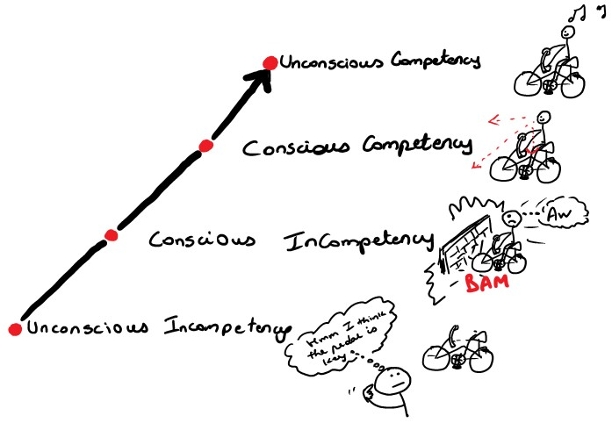

Slide 12
SEPTEMBER 2015
“Schools will be free to design their approaches to assessment to support pupil attainment and progression”
New tests for Y2 and Y6
Y1 Phonics Check will continue

Slide 13

What do we not mean by Mastery?
Whilst on first take mastery can be tricky to define and understand, we can be clear what mastery is not.
Mastery is not working on content from the next year group.
Mastery in mathematics is not practising the same concept with bigger numbers.
Mastery in reading is not necessarily reading a more challenging text.

Slide 14
Stages of learning
Shallow learning
Surface, temporary, often lost
(This is when children raced through levels)
Deep
learning
It sticks, can be recalled and used
Can be transferred and applied in different contexts
Mastery

Slide 15
Embedding Mastery into the curriculum
On-going: Development of reasoning skills. Think harder not harder numbers.
Opportunities should be found to provide a deep learning task
within each aspect of mathematics.
Maths
On-going: Through better quality questioning about broader aspects of the books being read.
Provide opportunities for putting ‘literature’ at the heart of the
English curriculum.
Reading
Through providing opportunities for learners to apply their writing in different subject areas.
Opportunities should be found for learners to apply different written genres’ in different contexts and subjects.
Writing

Slide 16
What Have We Already Done?
We have the new curriculum embedded
We are moderating with other schools
We have developed our tracking system that monitors in year progress of our children to integrate our new assessment system
We are regularly cross moderating in school using our new informative assessment system to ensure consistency.
We have regular internal phase and whole school moderation meetings.

Slide 17
THERE IS A KEY FOCUS ON EXPECTATIONS
Expected
Working Towards
Higher Standard
Year 1 Expectations: Number
Count reliably to 100 | Mathematics (Number) Meeting Expectations for Year 1
Count on and back in 1s, 2s, 5s, and 10s from any given number to 100
Write all numbers in words to 20
Say the number that is one more or one less than a number to 100
Recall all pairs of addition and subtraction number bonds to 20
Add and subtract 1-digit and 2-digit numbers to 20, including zero
Know the signs (+); (-) and (=)
Solve a missing number problem, such as: 5 = 8 - x
Solve a one-step problem involving an addition and subtraction, using concrete objects, pictorial representations and arrays
Solve a one-step problem involving a multiplication and division, using concrete objects, pictorial representations and arrays
If these are not
If these are met then consider ‘exceeding’ statements
met then they are
‘emerging’

Slide 18

OUR NEW ASSESSMENT SYSTEM
School Assessment System | Working Towards the expected standard | Working at the expected standard | Working at greater depth
National Expectations | Working towards the expected standard | Working at the expected standard | Working at the higher level
Percentage of targets achieved | 0%-79% | 80%-100% | 40% of the greater depth targets
The majority of pupils will start the year as ‘working towards’ the expected standard within their own year group.
Good progress would be for these children to achieve 20% of the year group objectives by the end of the autumn term, 50% by the end of the spring term and 80% by the end of the summer term.
Outstanding progress would be where a child achieves 80% of the expected targets and a further 40% of the greater depth targets.
Any child working within this band will have secured their year’s objectives and would confidently be applying them to different contexts and subjects

Slide 19
What About Our SEND
Children?
Children identified as SEND (Special Educational Needs) may work outside their own year group targets if their need is a cognition and learning need.
These children will be monitored within this year group and planning and assessments will be differentiated accordingly.

Slide 20
What will be reported to parents?
Parents evenings and the end of year reports will include a statements linked to our new assessment system stating how your child is performing i.e:
Your child is working at the 'Expected’ standard and is at the National benchmark for Year 4.
Children in Year 2 and Year 6 will be given a scaled score following their SATs tests.

Slide 21
2017 NATIONAL CURRICULUM TESTS AND ASSESSMENTS
KS1
New tests include:
a grammar, punctuation and spelling
test (optional for schools)
an arithmetic paper (+ - x ÷)
No set days for the administration
To be administered during May 2018

Slide 22
English reading 2 papers:
KS1 tests:
1 with text and questions combined
1 more challenging text with the questions in a
separate booklet
All pupils should be given the opportunity to sit both papers
Teacher assessment for reading is also submitted and forms part of the overall judgement
Grammar, punctuation and spelling (optional for schools)
Emphasis on technical aspects of grammar
Separate spelling test
No English writing test (Teacher assessed)
Mathematics 2 papers:
New arithmetic test introduced
Reasoning paper
Teacher assessment for maths is also submitted and forms part of the overall judgement

Slide 23
2017 NATIONAL CURRICULUM TESTS AND ASSESSMENTS
KS2
New Test include:
Mental maths replaced by Arithmetic
test
No Level 6 tests
  all pupils will take just 1 set of tests
  tests will include a small number of questions that will stretch the most able pupils

Slide 24
KS2 tests:
Mathematics
Arithmetic test introduced to assess basic mathematical
calculations (+ - x and ÷)
No contextualised questions
36 questions, 40 marks available, 30 minutes duration Questions will cover:
straightforward addition and subtraction
more complex calculations with fractions
long divisions and long multiplications
KS2 English reading
Retained a similar structure to the previous KS2 reading test
Greater emphasis on the comprehension elements of the new
curriculum
Each test will have 3-4 unrelated texts of increasing difficulty
There will be a mixture of text types
Teacher assessment for reading is also submitted to the Local Authority.

Slide 25
KS2 English Grammar, Punctuation And Spelling
No contextual items - design of the test unchanged:
–1 short answer paper with questions, 50 marks available
–1 spelling test with questions, 20 marks available
spelling tested by asking pupils to complete sentences with a word missing
Teacher assessment for writing is also submitted to the Local Authority.
KS2 Mathematics
3 papers:
–1 arithmetic paper
–2 mathematical reasoning papers
gridded paper provided in answer spaces for questions on the arithmetic paper and some questions on paper 2
Teacher assessment for maths is also submitted to the Local Authority.

Slide 26
No Sats Levels But
Scaled Scores!
What are Scaled scores?
Used to report National curriculum outcomes
Helps test results to be reported consistently -2 pupils achieving the same scaled score in different years will have demonstrated the same attainment
National standard will be ‘100’
The ‘raw score’ that equates to 100 might be
different each year

Slide 27
Reporting scaled scores
Raw scores translated to scaled scores using
a conversion table
KS1 conversion tables published by
May/June 2018
KS2 test results published in July 2018
Pupils to receive a raw score, scaled score and confirmation of attainment of the National Standard
KS2 conversion tables published on return of results day

Slide 28
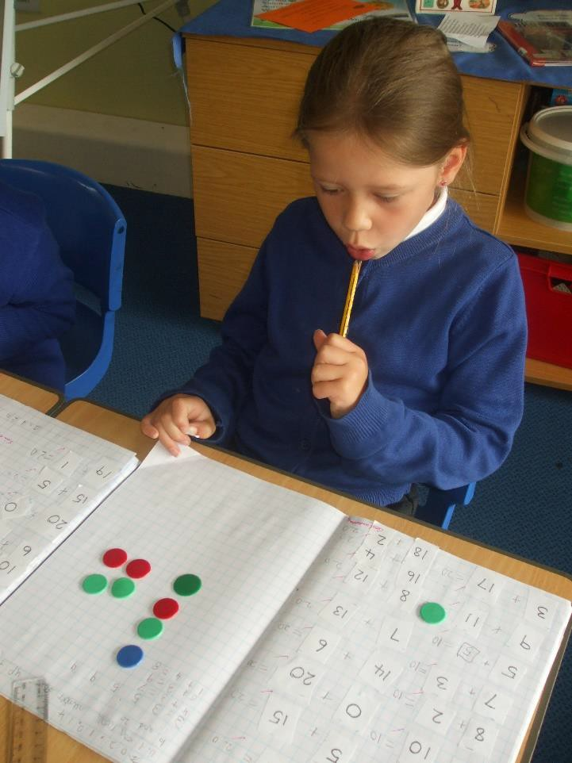
NEW PRIMARY CURRICULUM
FOR MATHEMATICS
Aims:
Fluency in the
fundamentals
Reason mathematically
Solve problems

Slide 29
NEW PRIMARY CURRICULUM FOR MATHEMATICS
What’s out?
Informal written methods
of calculation
Calculators
Separate strand for using and applying
What’s there less of?
Emphasis on estimation
Less work on place value
Less work on data handling (statistics)
What’s in?
Roman numerals (Why?)
Times tables up to 12 x 12
Equivalence between metric and imperial
Long division and algebra
(Y6)
What’s there more of?
More challenging objectives, especially in number
Formal written methods introduced earlier
More work on fractions

Slide 30
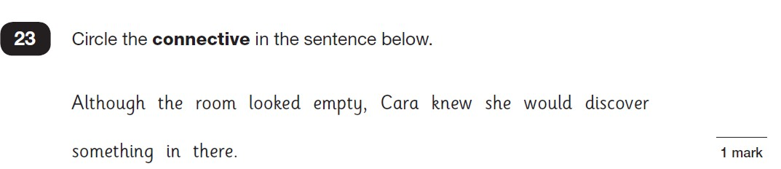
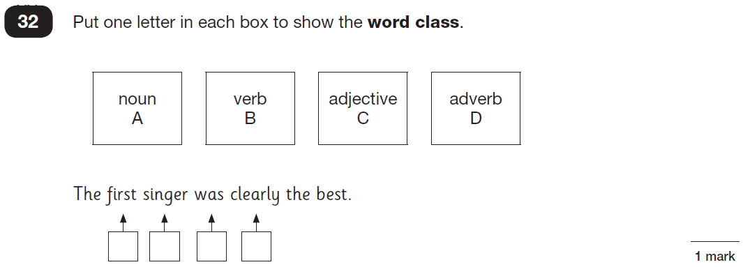
Example Of A SpaG
Challenge...

Slide 31


ENGLISH IN KS1 (FASTER, FULLER, DEEPER!)
Writing:
Increased challenge, including developing “stamina” for writing
Longer compositions and proof-reading of own writing;
Deeper focus on learning grammar and punctuation;
Joined writing expected in Year 2.
Reading:
Emphasis on reading wildly for pleasure, re-reading books and reading aloud;
Increased focus on engaging with and interpreting texts;
Learning of poetry (including reciting poetry) introduced.
Spelling:
Specific spellings, e.g. days of the week, prefixes & suffixes;
Pupils expected to write sentences dictated by the teacher.

Slide 32


ENGLISH IN KS2 (FASTER, FULLER, DEEPER!)
Writing:
Greatly increased expectations in grammar and punctuation;
Children have to identify and label complex grammatical concepts, punctuation and spelling rules;
Expectation that children expertly use and apply the grammar and punctuation concepts in independent writing to create specific effects;
Reading:
Read for pleasure;
Word reading: pupils applying their knowledge to understand the
meaning of new words;
Learning of classic & modern poetry (including reciting poetry) introduced.
Spelling:
Statutory lists of words to be learnt in Years 3 - 6;
Specific spelling rules to be taught.

Slide 33
Final thoughts
Much of what is learnt is never fully
assessed but used every bit as much.
We believe assessment is not solely meant to be used as a measure of your child’s ability at school but as a means to improve their
ability to learn; their knowledge, their understanding and their skills.

