Slide 1
When I Grow Up...
Super Learning Mathematics Week
16.10.17 – 20.10.17

Slide 2
What Do You want to be when you grow up?

Slide 3
The future is yours!
In this room we could have the future Prime Minister, the next top Premiership footballer, or pop sensation, a heart surgeon or top lawyer. Some of you will become entrepreneurs and open your own businesses, some of you may work abroad.
Some of you may go on to teach the next generation in schools and universities and some of you may design or build new structures that will change the landscape around us.

Slide 4
Some of you will work in jobs that don’t exist yet!
Technology is changing so much and advancing so rapidly that many of the top jobs of 2017 did not even exist 5 years ago.
Studies show that as many as 65% of children today will go on to employment in jobs that don’t as yet exist.

Slide 5
The possibilities are endless!

Slide 6
how do we prepare you for your future?
We know that whatever job you all go on to do, there will be certain skills you need such as good communication skills and the ability to work collaboratively. You will need resilience and perseverance and the ability to think creatively, but also logically and systematically.
So how does all of this link with maths?

Slide 7
For whatever job you do and for future life skills – we all need maths!

Slide 8
Don’t forget the past
This Super Learning Maths Week is all about showing you how maths will be a part of your life when you grow up. But although we are looking towards the future, we need to look at some of the people who have been important in the study of maths through the ages.
In fact, it could be said that these people were ahead of their time with what they discovered and we still use their ideas today. They may have lived in the past but these mathematicians were definitely looking towards the future.

Slide 9
Inspire and Aspire
At Oswald Road, we want to inspire you to learn and succeed. During this week you will look at some famous mathematicians and we hope their stories will inspire you.
You will also hear from some of our parents and carers who have volunteered to come in and talk to you about how they use maths in their daily life and job.
We hope you hear something that will inspire you. Maybe you will even aspire to be like them when you grow up.

Slide 10
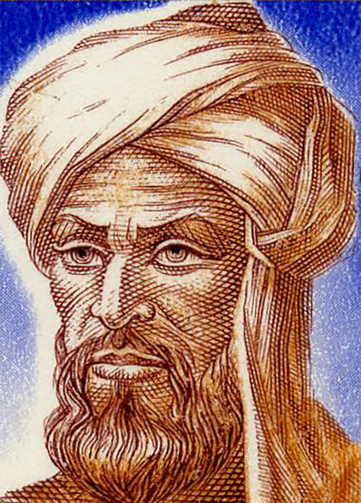
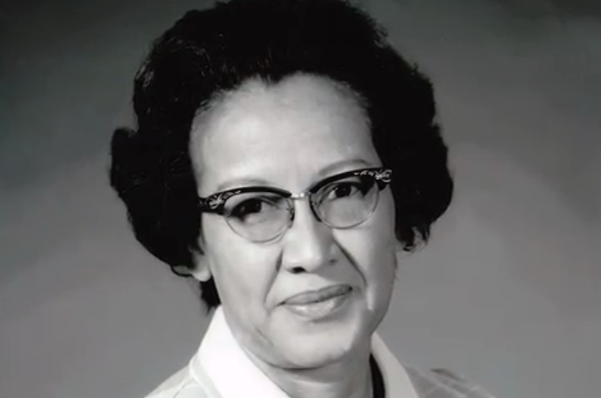
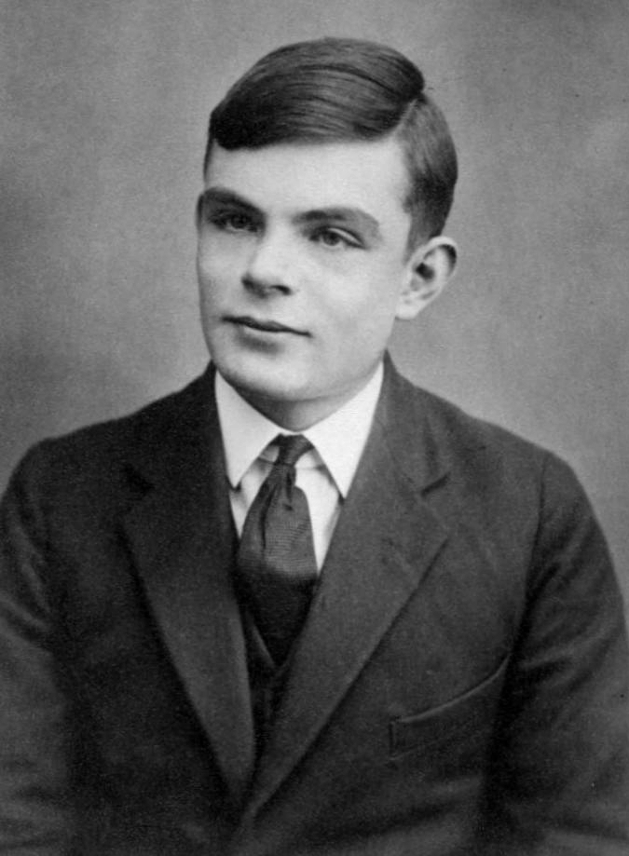
Famous mathematicians

Slide 11
Are you the next ‘great’?
Will a room full of schoolchildren one day be learning about you as one of the great mathematicians?

Slide 12
Real-Life maths
Some of us love maths, some of us struggle. But everybody, sooner or later, has to use money. And managing money effectively is a valuable life skill we all need.
During this week, we will look at developing some of the money and budgeting skills you will need in the future.

Slide 13
Be THE TEACHER
The final challenge during the When I Grow Up maths week is to see whether you can teach a maths lesson to the year group below you. To really understand something, you have to be able to explain it! So you get to ‘be the teacher’!

Slide 14
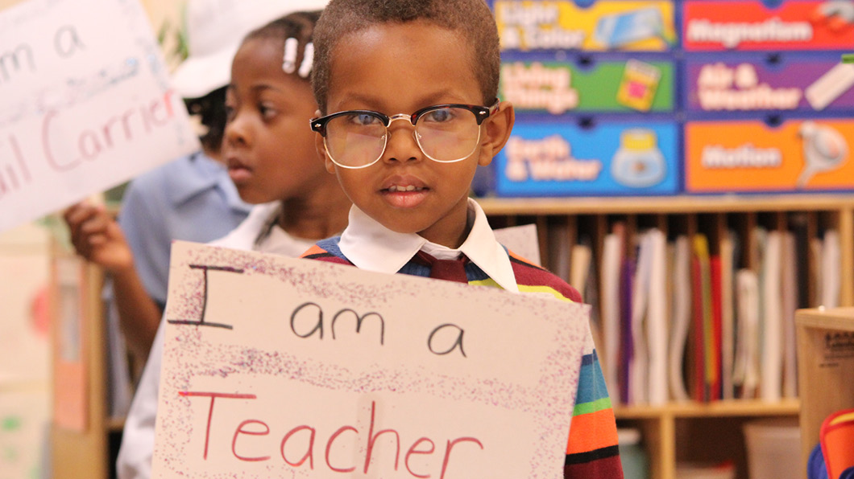
So we will have more of this...
And you get to dress like a teacher to deliver your lesson...
... as long as it’s flattering and you make us look good!

Slide 15
... And we get to do this!

Slide 16
... And we get to do this!

Slide 17
... And we get to do this!

