Slide 1
E Safety
Oswald Road Primary School

Slide 2
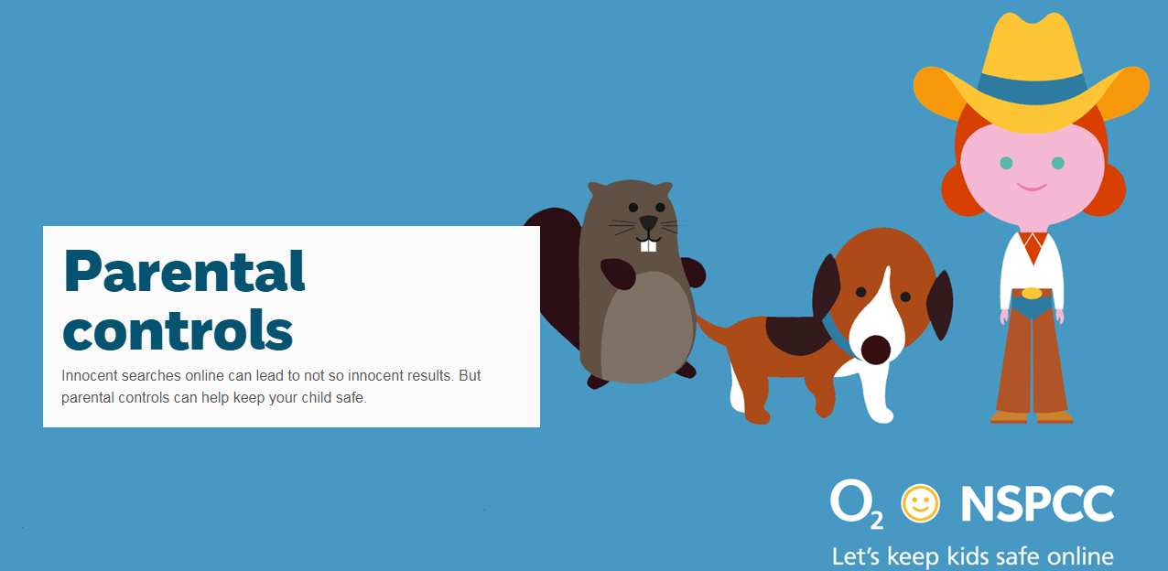
Parental Controls
Notes:
Parental controls can be used to block upsetting or harmful content, control in-app purchases or manage how long your child spends online. And the good news is parental controls are really easy to set up.
Parental controls are software and tools which you can install on phones or tablets, games consoles or laptops – and even your home broadband.
You can also use them to help you block or filter the content your child sees when searching online. And family-friendly public WiFi can help when you’re out and about.
Parental controls are also available to help you to:
plan what time of day your child can go online and how long for
stop them from downloading apps they're too young for
manage the content different members of the family can see.
So whatever your child is doing online, there’s a way that you can help keep them safe.

Slide 3
Mobile Devices

Slide 4
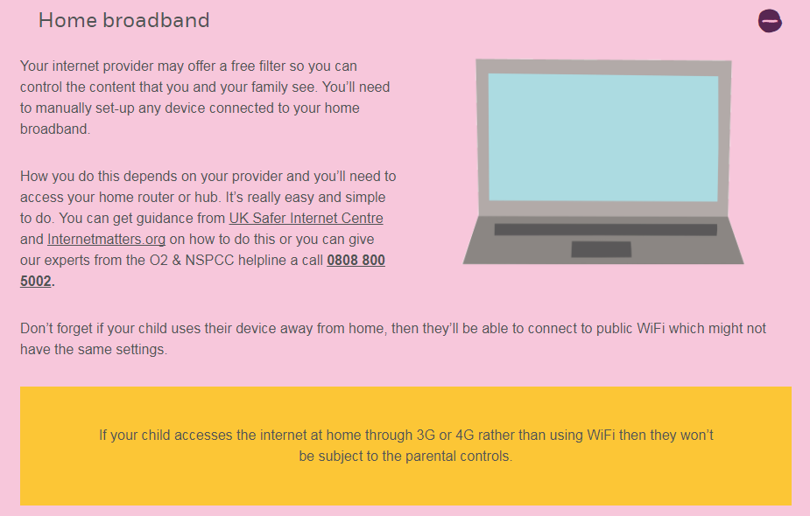
Home Broadband

Slide 5
WIFI

Slide 6
Search Engines

Slide 7
Popular Sites
Notes:
Children must be over the age of 13 to access these sites

Slide 8
Notes:
Children must be over the age of 13 to access these sites except mind craft, which is over 7 years.

Slide 9
Talk
Explore sites and apps together
Ask about things they might see online which make them feel uncomfortable
Talk about how they can stay safe on social networks
Reassure them that you won't overreact – you're just looking out for them
Notes:
Talk about what might be OK for children of different ages. Ask your child what sites or apps they like. Write a list, and look at them together.
Be positive about what you see, but also be open about concerns you have: "I think this site's really good" or "I'm a little worried about things I've seen here".
Talk to your child about what you think is appropriate – but also involve them in the conversation. Ask what they think is OK for children of different ages – they'll feel involved in the decision-making.
Be aware that your child might talk about friends who use apps or visit sites that you've decided aren't suitable. Be ready to discuss your reasons, but recognise that they may not agree with you. Listen carefully for the reasons why.
Go through a final list of sites you both agree are OK, and work out when you'll next discuss it.

Slide 10
Further Information
https://nspcc.o2.co.uk/

Slide 11
https://www.nspcc.org.uk/preventing-abuse/keeping-children-safe/share-aware/
https://www.nspcc.org.uk/preventing-abuse/keeping-children-safe/online-safety/parental-controls/

Slide 12
Reminder…
Notes:
The internet is amazing. Children can play, learn, create and connect - opening up a whole world of exciting possibilities. But with the digital world changing all the time, how can you make sure your child’s staying safe?
Talk – about staying safe
Explore – their world together
Agree – rules about what is ok and what is not ok
Manage – family settings and control

Slide 13
Notes:
The internet is amazing. Children can play, learn, create and connect - opening up a whole world of exciting possibilities. But with the digital world changing all the time, how can you make sure your child’s staying safe?
Talk – about staying safe
Explore – their world together
Agree – rules about what is ok and what is not ok
Manage – family settings and control
Further information – NSPCC or O2 helpline 0808 800 5002

