Slide 1
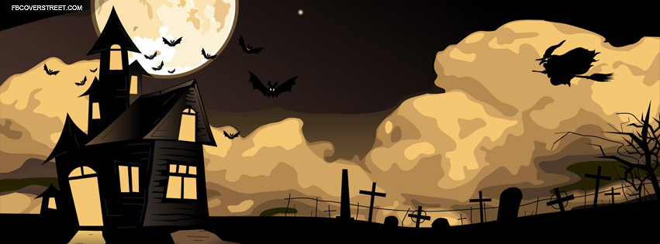
The Wonderful World Of Witches ,
Witchcraft And Wizardry

Slide 2
A diary entry by someone who was accused
Introduction
Do you think of witches as mean horrible green skinned creatures ? If so read on to find out why there not monsters. You will also find out lots of silly things that they blamed on innocent people like you and me.
What we think of witches
The ways of torcher

Slide 3
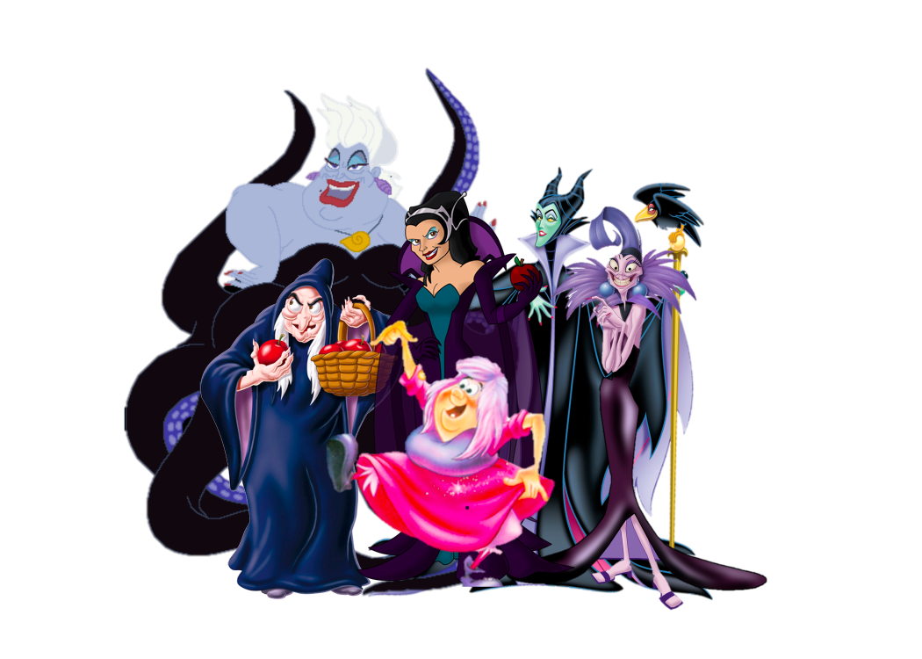
What we think of witches
Most people think of witches as green , gruesome , potion making people but actually this is just your imagination . Did you know that people were accused of being witches for small things such as being a cunning person or being slightly different to everyone else? Even people who we know as doctors were also accused because they helped people become better.

Slide 4
Diary Entry
Dear Diary ,
I never thought it would come to this but I admit my life has ended . This is probably going to be the last time I touch a pen ( psscht, I know this is actually typed on a computer ). I don’t even want to think about the torture and punishment that awaits me . I can’t believe that just by giving a herbal tea to someone to make them feel better you get accused of being bewitched by these horrible people. Something told me when I did this action that I shouldn’t have done it but I just seemed to ignored it but now I really regret it .
HELP ME!!!!!!!!!
From
Anna

Slide 5
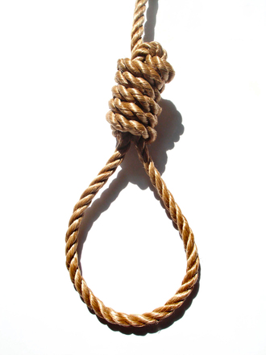
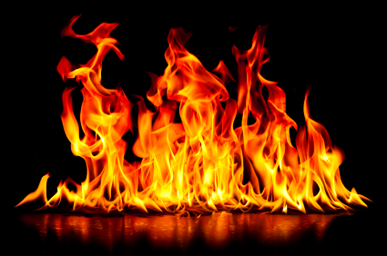
The ways of torture
Being accused is bad enough itself but what everyone is actually scared of is the torture, each country had there own way of torturing these innocent people. In England they did things like tying them down on the floor and squishing them with stones , but that was not it they also was the old slow death of drowning . Something also very gruesome is getting burnt ...

Slide 6
THE END HOPE YOU ENJOYED!!!!!!!!!
From Zoe

